Slide 1
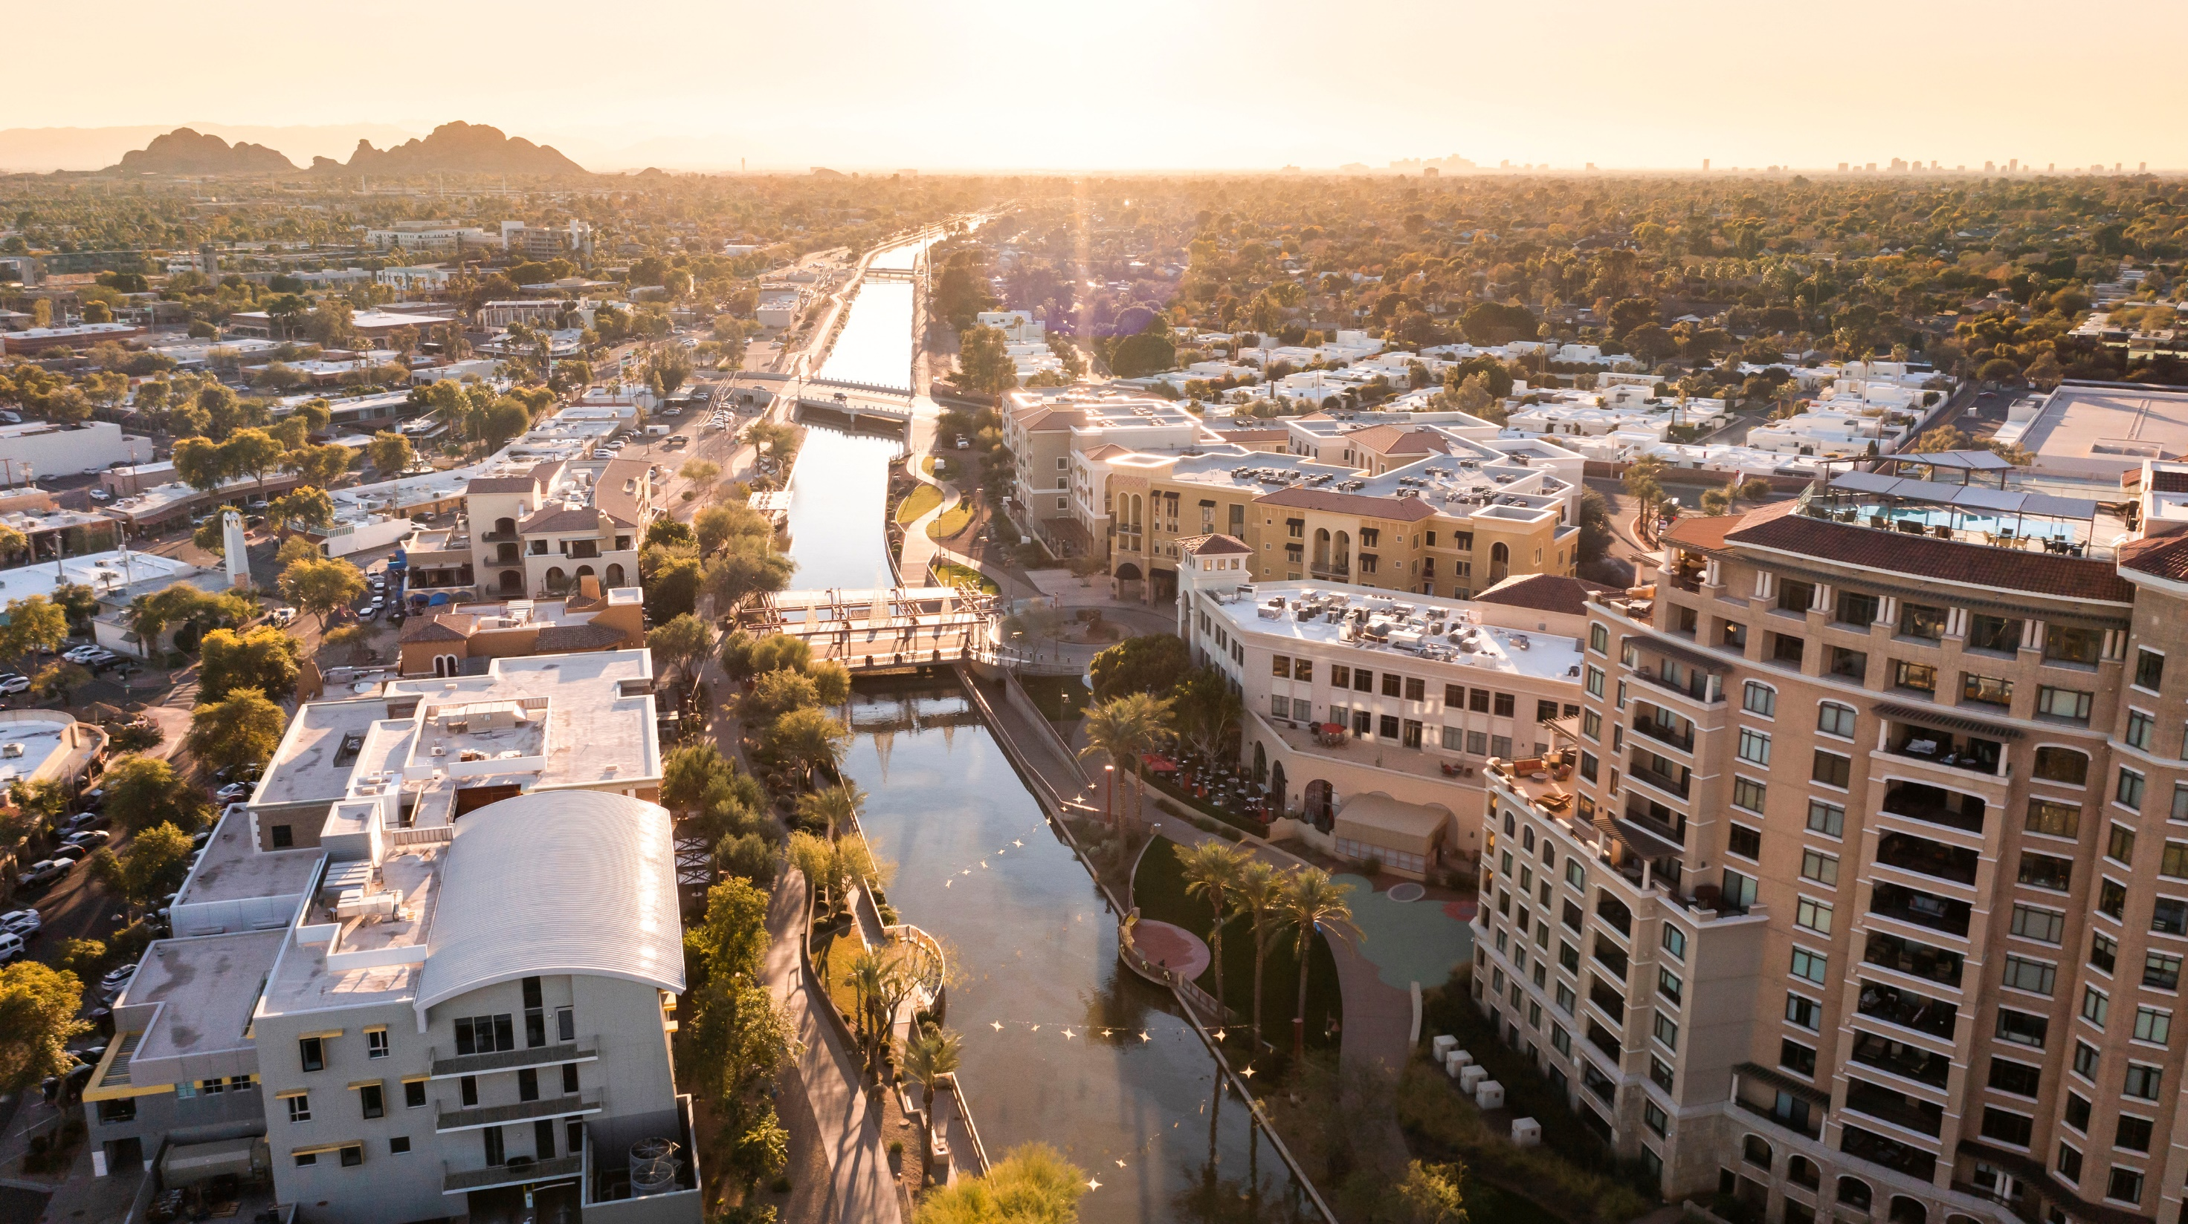

League of Arizona Cities and Towns
LegislativeUpdate
2024 GFOAz Winter Conference
Flagstaff, AZ

Slide 2

Session at
a Glance
Stats
  Day 33
  Introduced
    Bills - 1,629
    Memorials and Resolutions - 128
  Deadlines
State of the State
  Shortfall
  Sober Living Homes
  ESAs
Executive Budget
  Bad News – We’re Broke
  Good News – We’re not robbing from locals…more than usual

Slide 3
Session Topics at
a Glance
Budget Woes - On a scale from Nicholas Cage to Wesley Snipes, how bad is it?
Election Issues
Election “Issues”
Water
Election Year
Topics to make things awkward at Thanksgiving
What we haven’t seen

Slide 4
Major
Legislative Issues
Revenue
HB 2132: municipal land sales; public notice (Griffin)
HB 2175: marijuana monies; university police (Payne)
HB 2275: settlement agreements; report; approval (Marshall)
HB 2309: GPLET; agreement posting; abatement period (Grantham)
HB 2382: TPT; sourcing; validation (Carter)
HB 2594: TPT; prime contracting; exemption; alterations (Carbone)
HB 2866: electric vehicles; registration fee (Cook)
SB 1213: income tax; credit; labor costs (Rogers)
SB 1556: TPT; administration; remote sellers (Bennett)
SB 1652: municipal improvement districts; petitions; authorization (Bennett)
SCR 1006: property tax; refund; nuisance enforcement (Petersen)

Slide 5
Major
Legislative Issues
Administrative
HB 2030: cities; towns; water service; audit (Griffin)
HB 2088: bond; override; contributions; contracts; prohibition (Hendrix)
HB 2120: law enforcement; defunding; prohibition (Marshall)
HB 2196: commercial property assessed financing (Hendrix)
HB 2380: TPT; municipalities; audits; guidelines (Carter)
HB 2719: bond elections; date; voter turnout (Carbone)
SB 1005: public monies; ideology training; prohibition (Hoffman)
SB 1010/SCR 1002: vehicle mileage; tracking; tax; prohibitions (Hoffman)
SB 1056: municipalities; counties; fee increases; vote (Petersen)
SB 1370: youth businesses; licenses; tax; exemption (Bolick)
SCR 1015: public monies; prohibited expenditures. (Kern)

Slide 6

Thank You!
602-258-5786
League of Arizona Cities and Towns
1820 W. Washington St.
Phoenix, AZ 85007

Slide 7
Legislative
Issues
Sober Living Homes
Housing
Short-Term Rentals
Budget/Finance
Good Bills

Slide 8
Major
Legislative Issues
Sober Living Homes
HB 21111: licensed facilities; transfer; sale; prohibition (Willoughby)
HB 2650: sober living; behavioral health; licensure (Schweibert)
Governor’s Omnibus
SB 1361: sober living homes (Carroll)
  Better definitions
  Cap the number of residents
  Improving state role and enforcement
  Improving inspections
  Information sharing

Slide 9
Major
Legislative Issues
Housing
HB 2096: tiny homes; construction; requirements; exemptions (B Parker)
HB 2258: low-income housing tax credits; comment (Ortiz)
HB 2260: appropriation; housing trust fund (Ortiz)
HB 2261: minimum parking requirements; prohibition (Ortiz)
HB 2267: rental housing; income source discrimination. (Ortiz)
HB 2297: adaptive reuse; commercial buildings; zoning (Biasiucci)
HB 2518: municipalities; housing needs assessment; zoning (Gress)
HB 2570: planning; home design; restrictions; prohibition (Biaisucci)
SB 1112: planning; home design; restrictions; prohibition. (Borelli)

Slide 10
Major
Legislative Issues
Short-Term Rentals
HB 2156: short-term rentals; online lodging marketplace (Bliss)
HB 2488: vacation rentals; short-term rentals; restrictions (Bliss)
HB 2489: short-term rentals; ordinance; limits. (Bliss)
SB 1205: short-term rentals; ordinance; limits (Kavanagh)
  Cap licenses
  Set spacing requirements
  Limit density

Slide 11
Major
Legislative Issues
GOOD Bills?
HB 2196: commercial property assessed financing (Hendrix)
SB 1054: state construction project delivery methods (Carroll)
SB 1030: correctional facilities; body scanners (Shope)
SB 1285: local candidates; petitions; electronic signatures (Hoffman)
Municipal Improvement Districts
Redevelopment Tool

Slide 12
Type Your Subtitle
Legislative Engagement
-Elected official engagement is critical
-Relationships are critical
How can cities and towns stay informed on Legislative actions?
Passive Engagement
-Monday Calls
-Bulletin
Active Engagement
-Intergov Meetings

