Slide 1
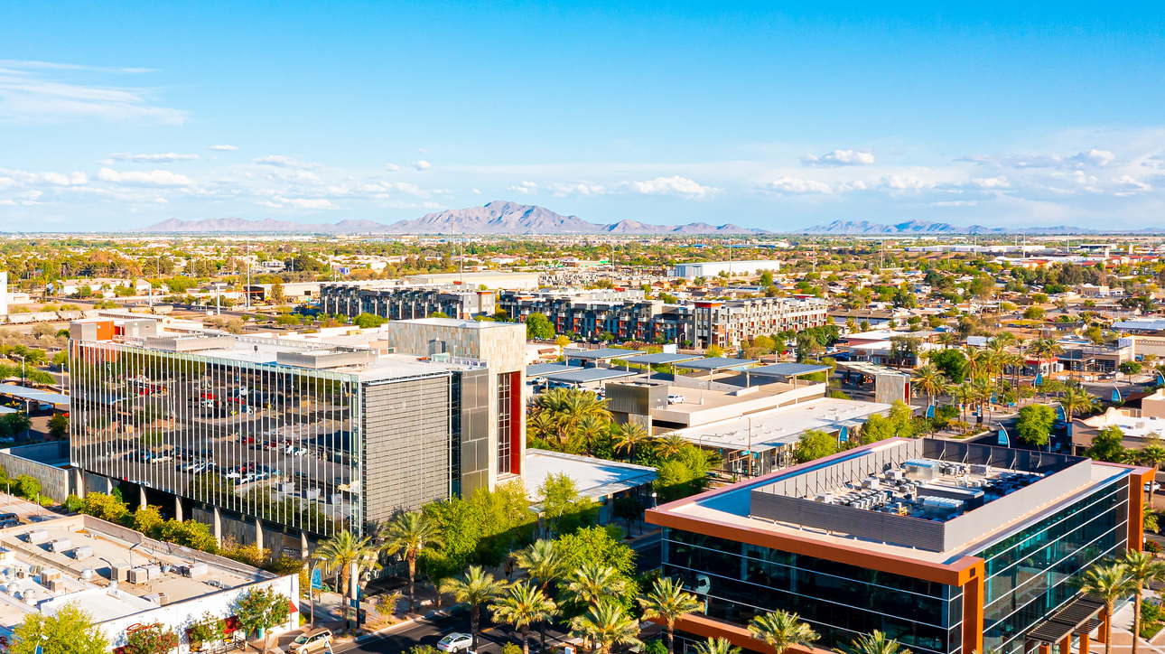

Telling your Budget and Financial Story
GFOAz Budget Forum
10/13/2022

Slide 2







Telling the Story
The same basic questions related to story telling apply to Budgets and Entity-wide Financials:
Who
What
When
Where
Why
How
“Narrative imagining –story- is the fundamental instrument of thought. Rational capacities depend upon it. It is our chief means of looking into the future, of predicting, of planning, and of explaining” Mark Turner Professor of Cognitive Science at Case Western Univ.

Slide 3
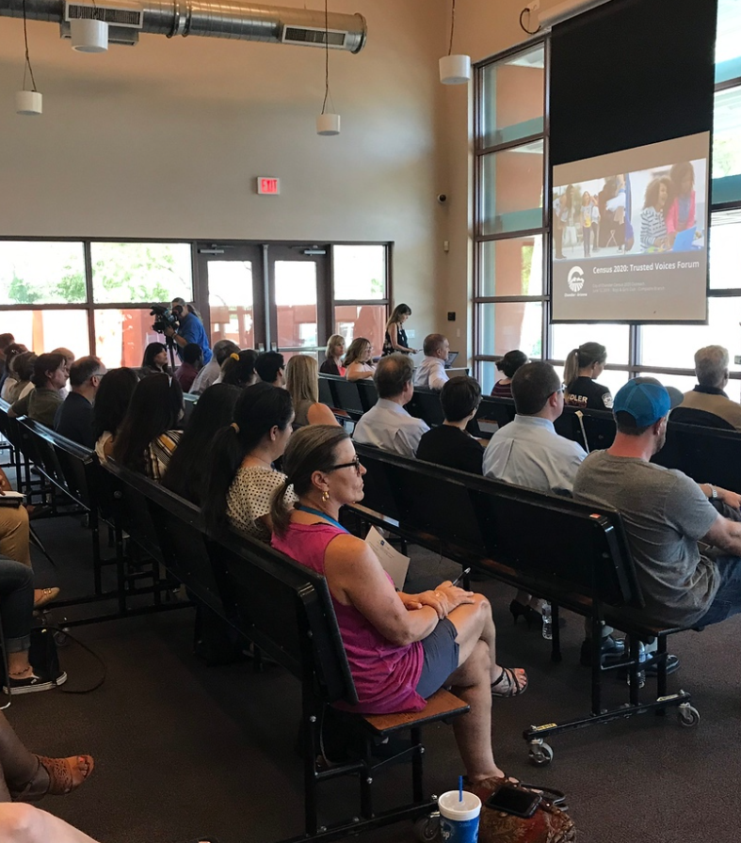
Telling the Story
Who
Residents/Community members
Board or Council
Small group
Large group
Bond rating agencies
Auditors

Slide 4
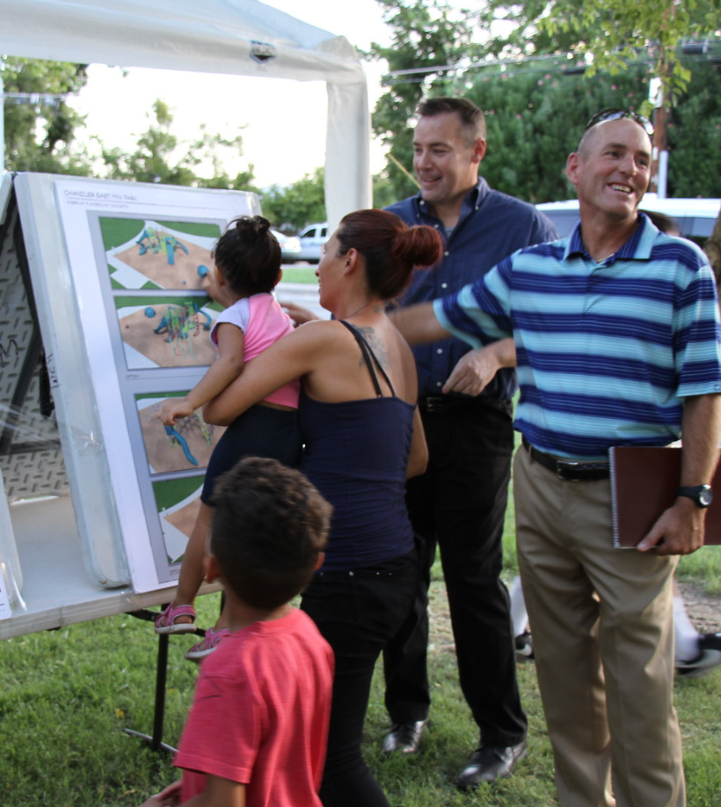

Telling the Story
What
What is the financial information saying about our City, Agency, School etc.
What action items should be taken based on the data
What can we do about certain issues that may need policy director or planning

Slide 5

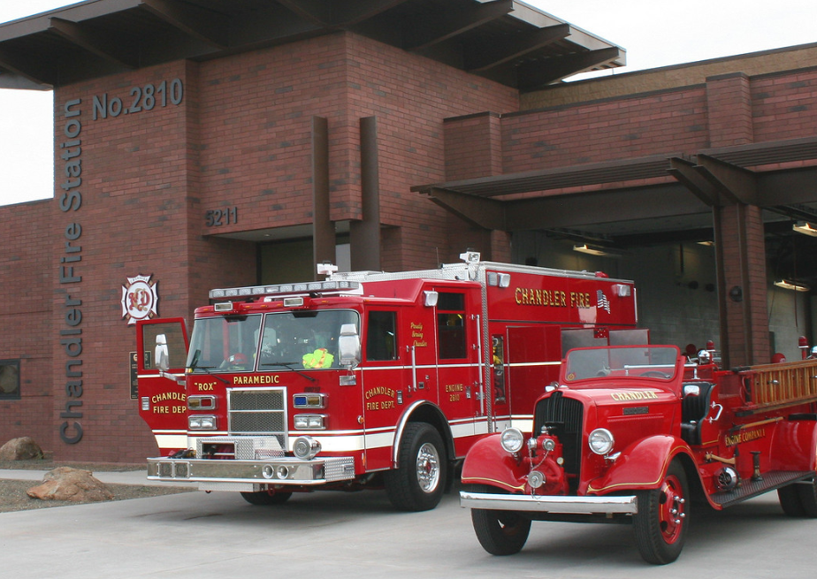
Telling the Story
When
When do the different groups need to hear the information
Should different groups hear about the information more than once, if so when does it make sense to update
Ask yourself does timing matter for different elements of what I will be sharing

Slide 6

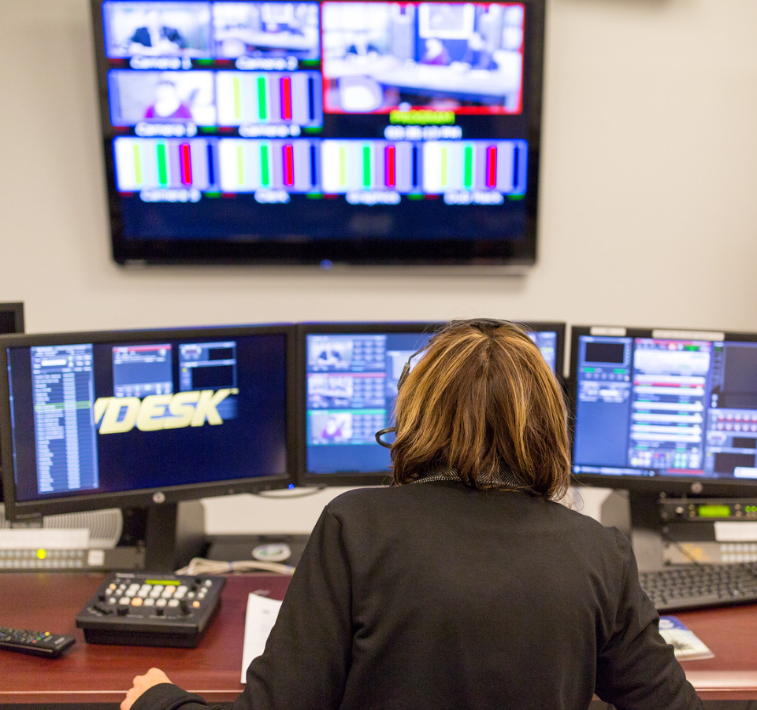
Telling the Story
Where
Are all interested in the story available when we plan to share it?
Would a different location or time allow for better access to the information, or be shared with a different group?
What methods of communication are available to be able to share the information?
    Physical space
    Social media
    Website
    Mailers
    etc.

Slide 7
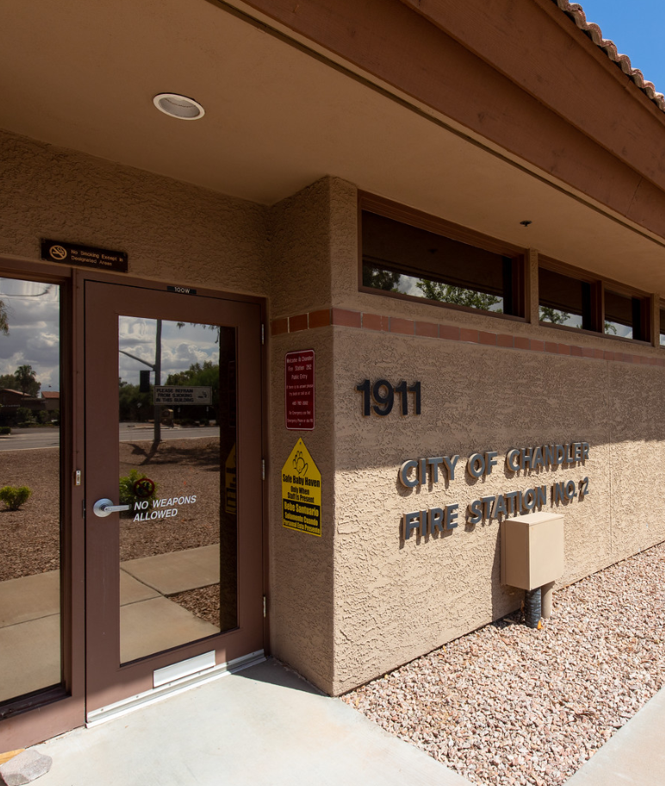

Telling the Story
Why
What is it we hope the audience will hear?
Is there action we need taken on the information?
Are we planting seeds or sharing the harvest?

Slide 8


Telling the Story
How
Reminiscent of the where discussion, we need to know our options of how the information is going to be presented
Narrative:
    Books
    Briefs
    Newsletters
Charts and graphs
Pictures
Videos
Consider having a consistent style no matter the method of delivery

Slide 9
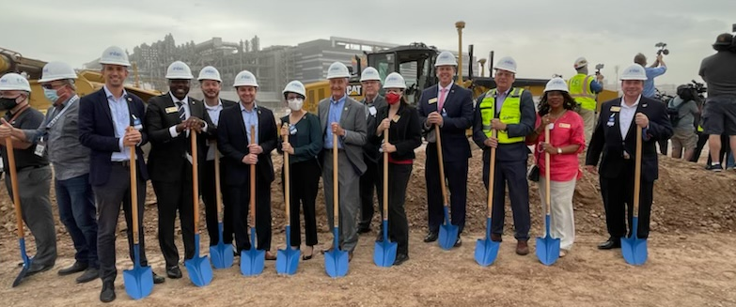
Telling the Story
Diving into examples of the “How”

Slide 10

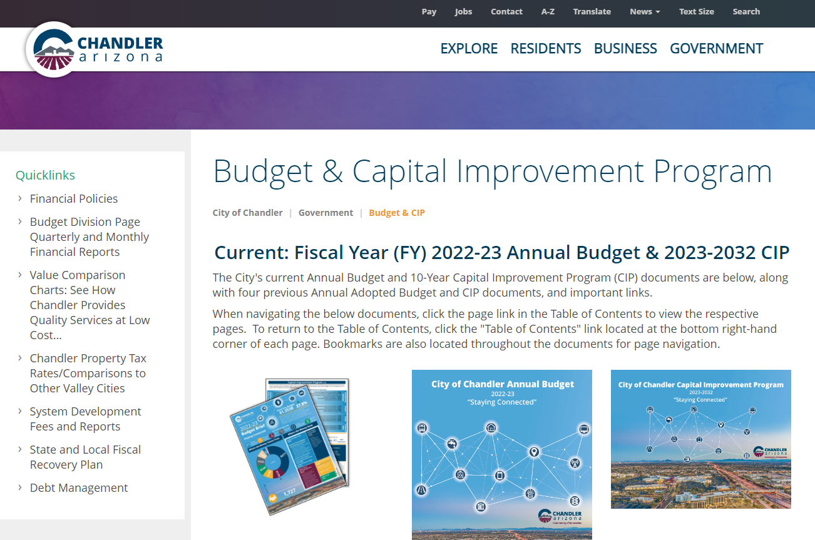
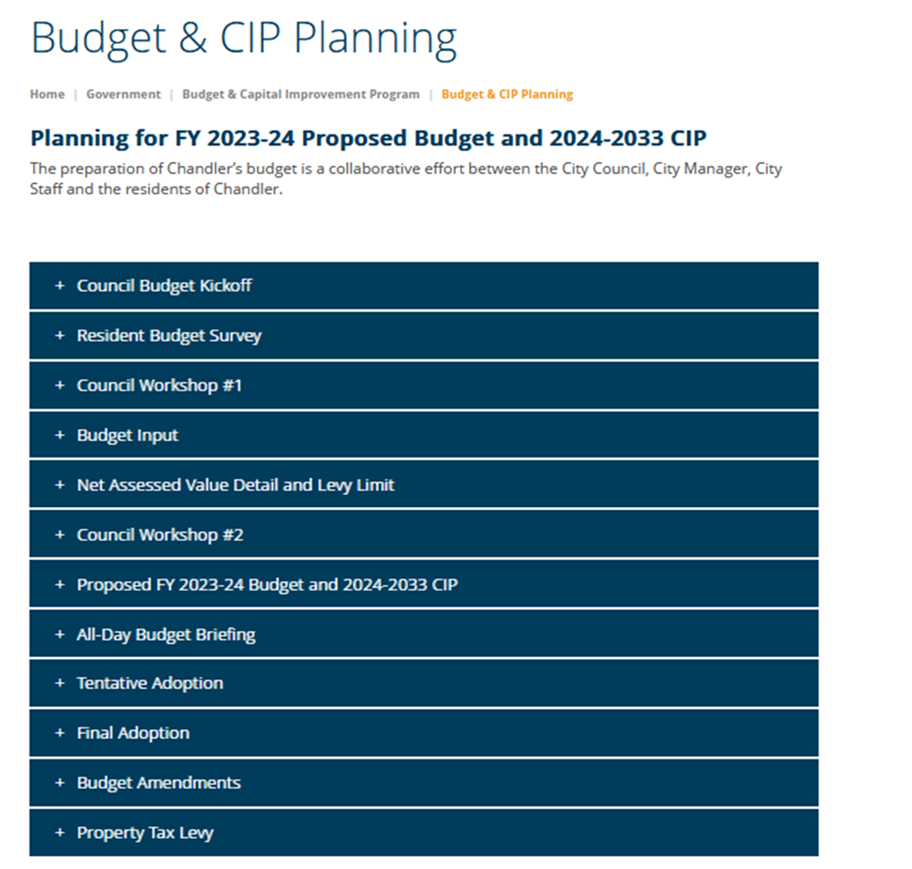
Website
Current Budget Details: Budget documents and State Auditor General forms
Next Years Budget Details: Minutes and presentations from Kick-off and Workshops, Survey Results, Schedule of future meetings, Proposed Budget
We try to have every notice encourage a visit to the website
Have someone outside your department try to find key data and report how easy it was

Slide 11
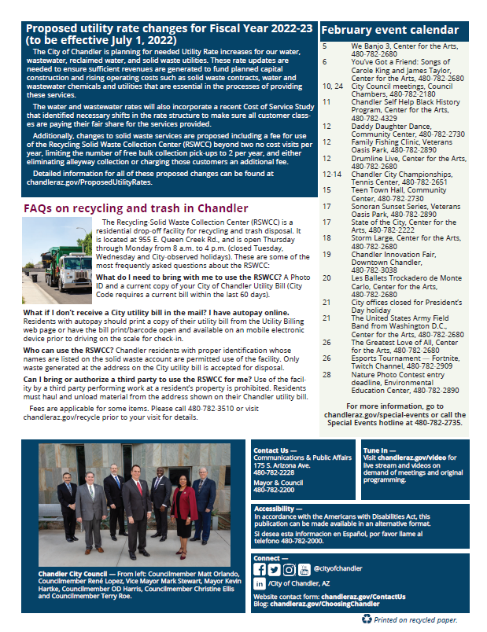
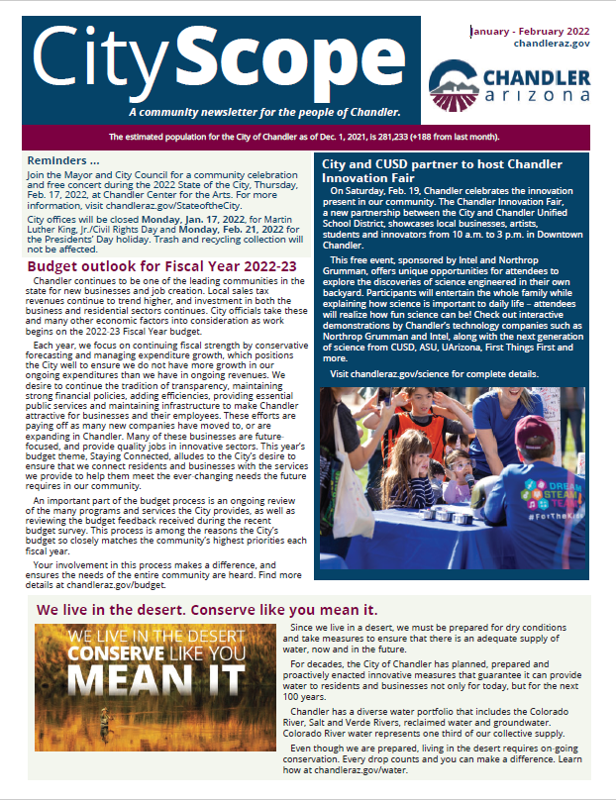
City Newsletter - CityScope
July – Message about budget approval
October – Message about upcoming budget survey
November – CIVIC invitation
January – Budget Outlook
March – Current and prior year budget summary

Slide 12
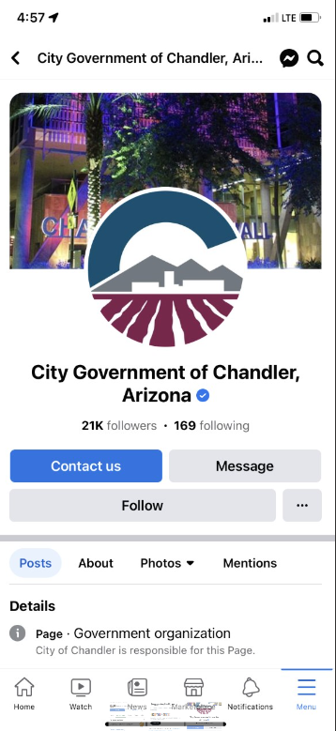
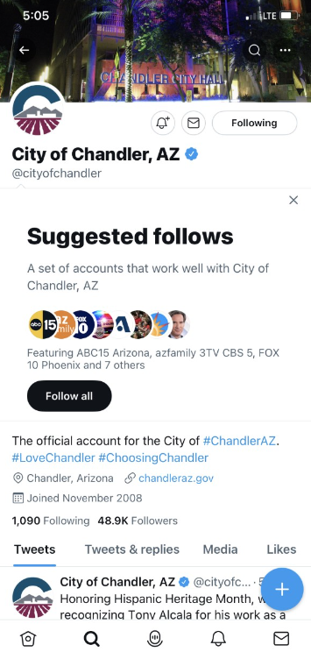
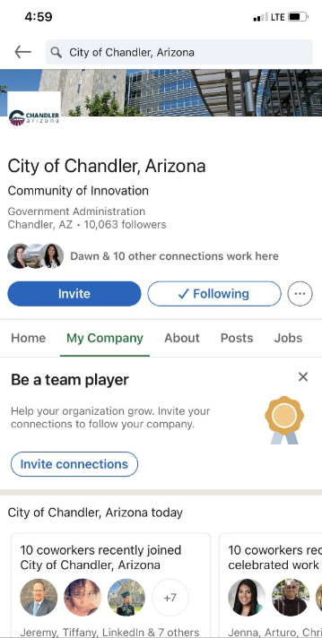
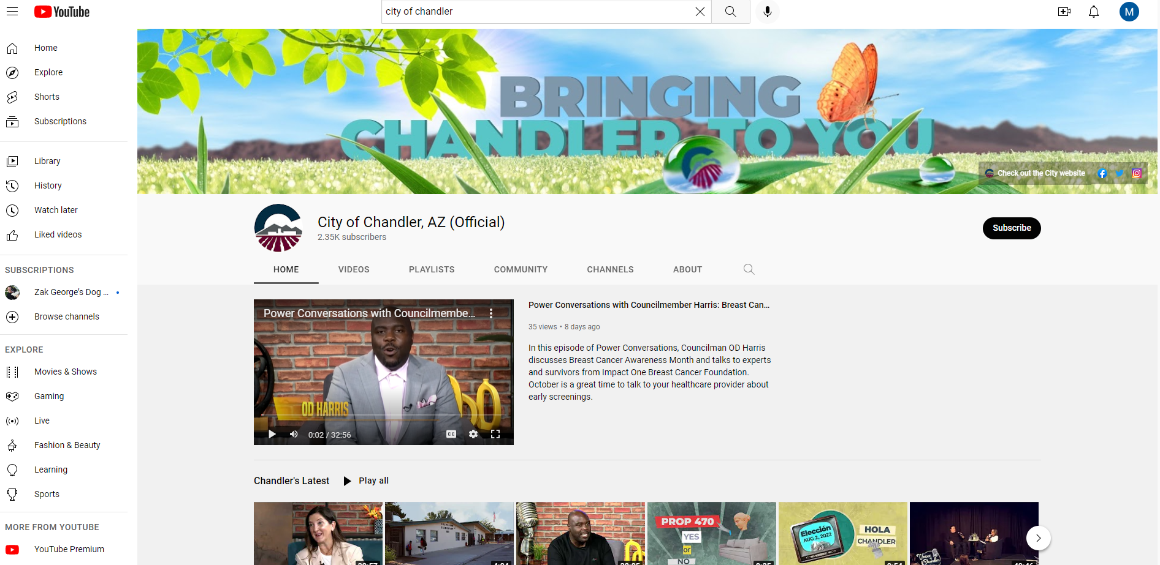
Social Media Posts

Slide 13

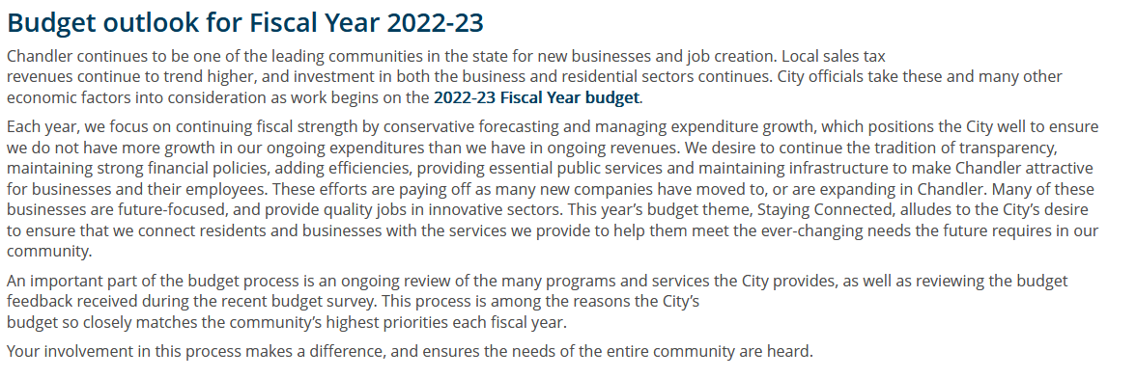
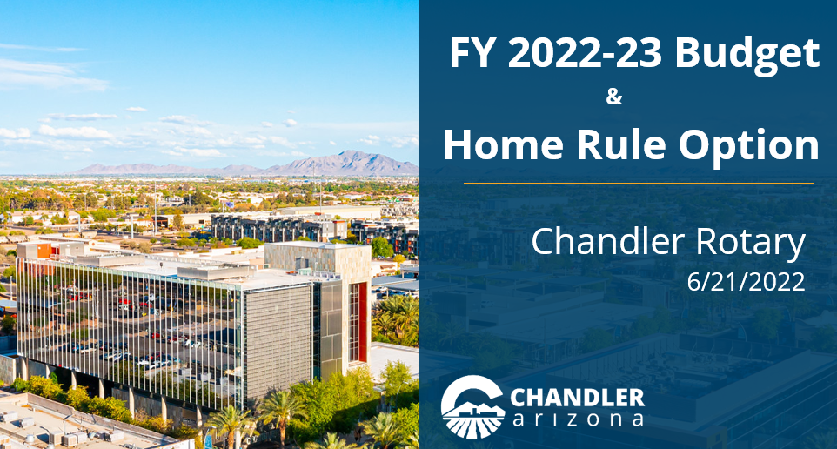
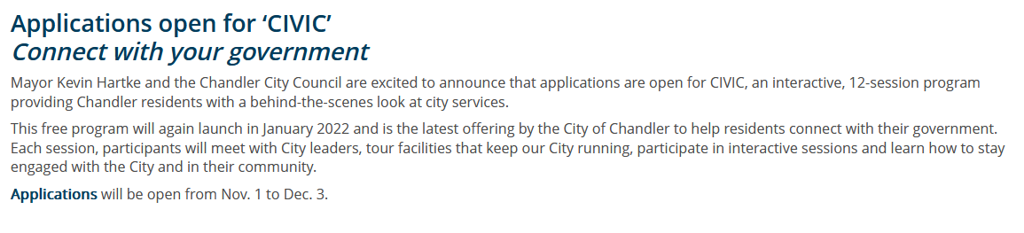
Press Releases &
In-person discussions

Slide 14
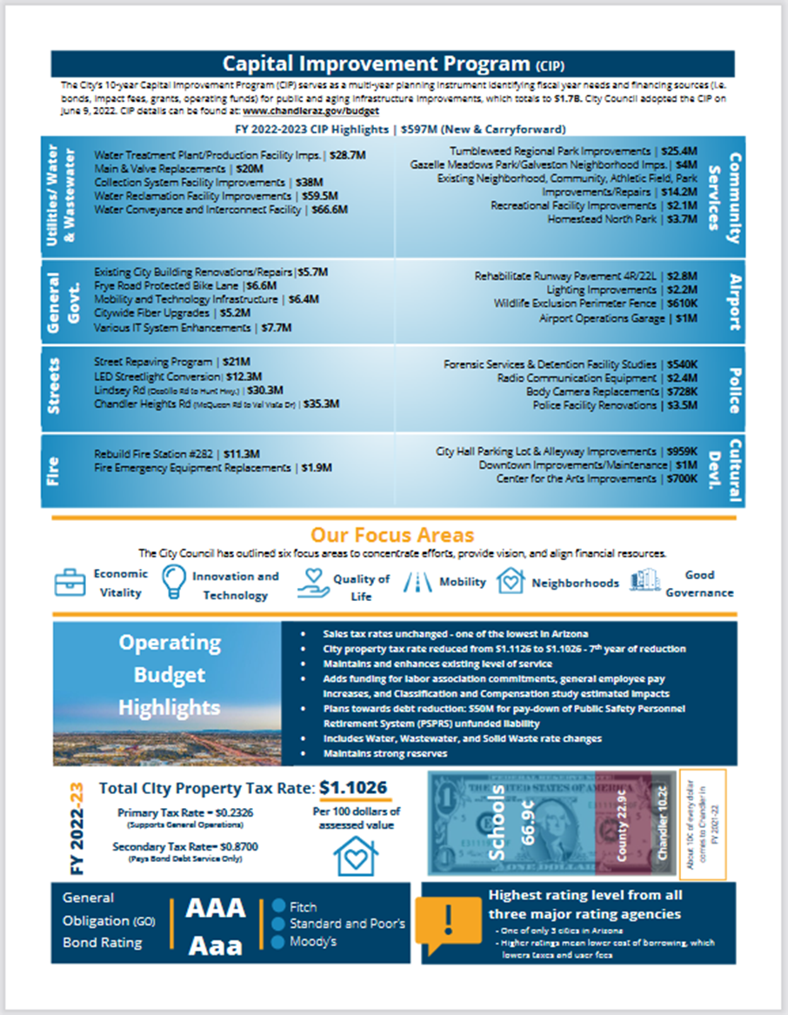
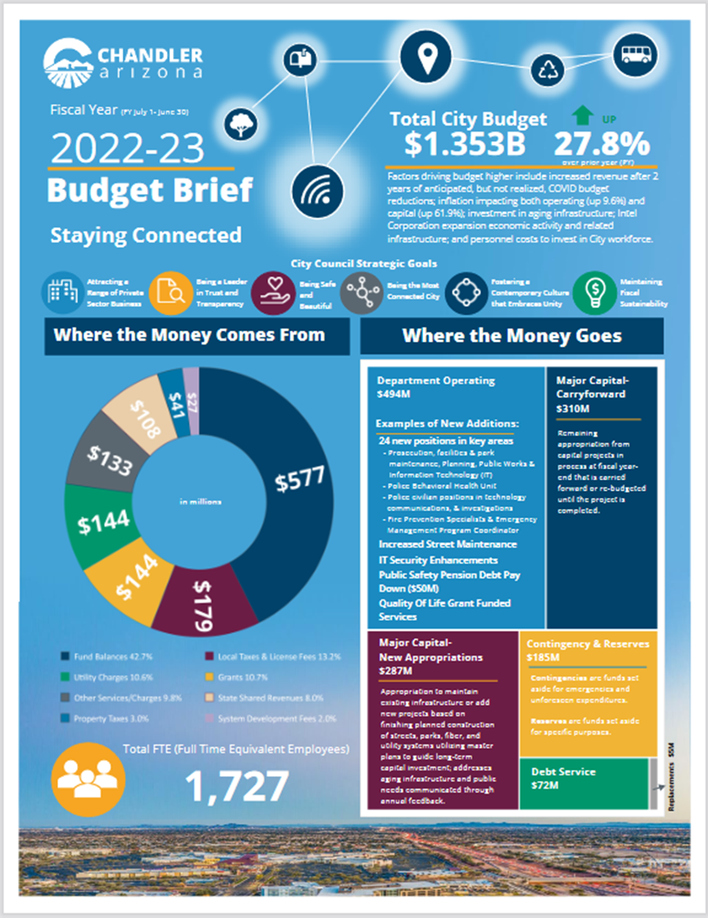
Budget Brief - Chandler
Condensed key information
Easy to digest
Must be selective in the story shared
Available on website and easily printed for distribution as needed

Slide 15
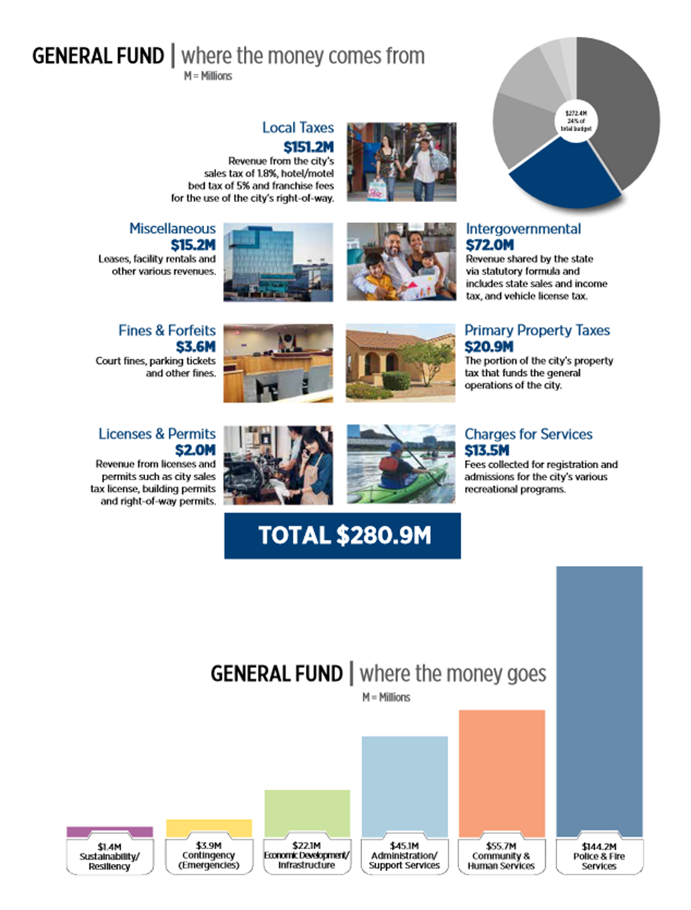
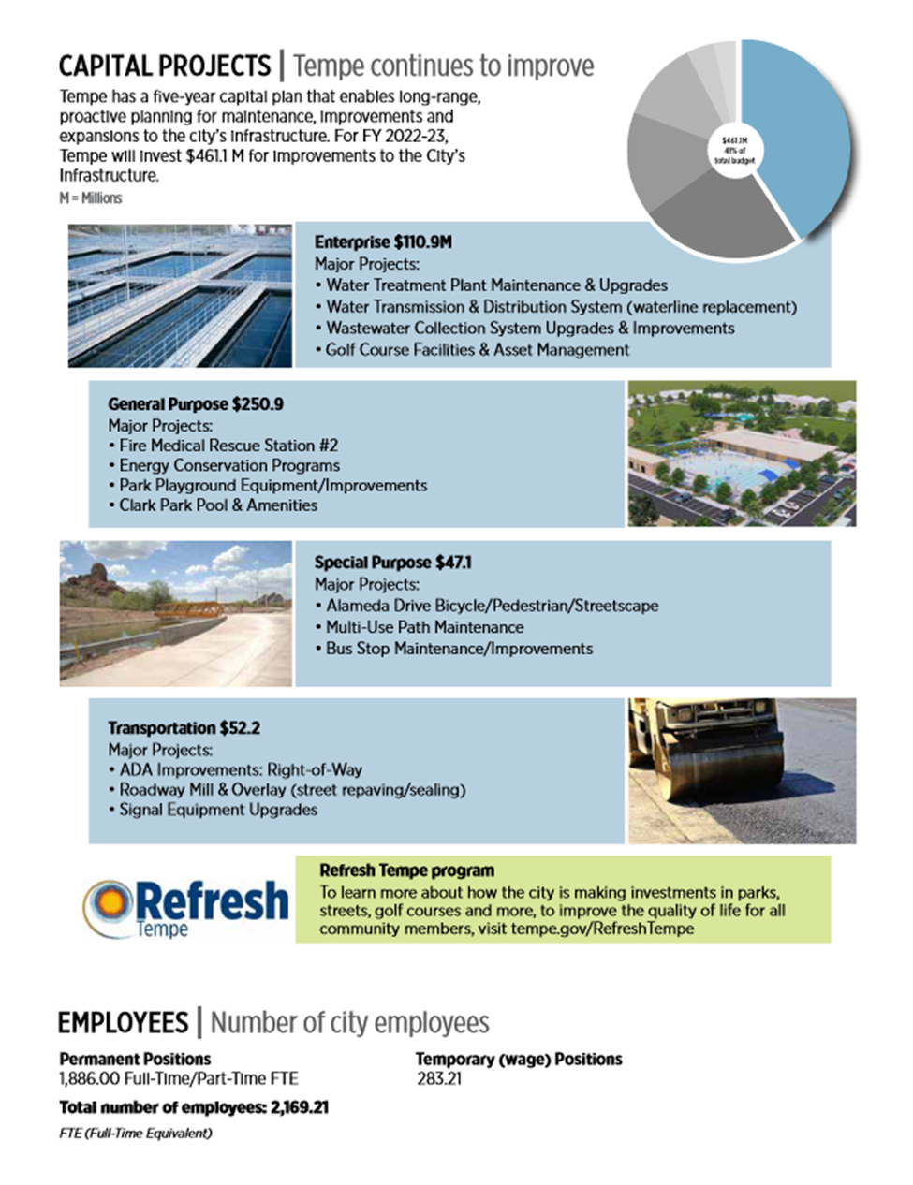
Budget Brief - Tempe

Slide 16

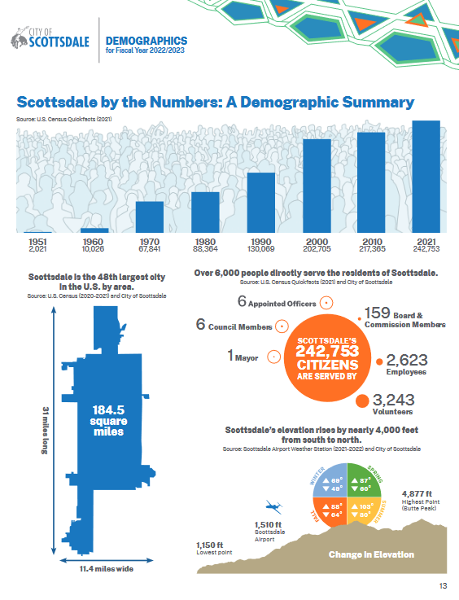
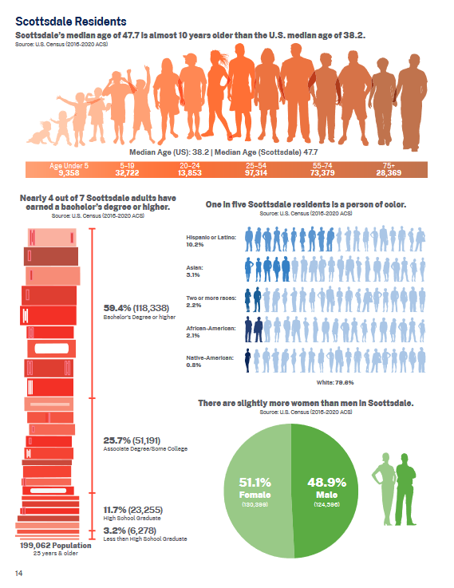
Scottsdale’s Annual
“Report To Our Community”
Notes:
26 pages

Slide 17
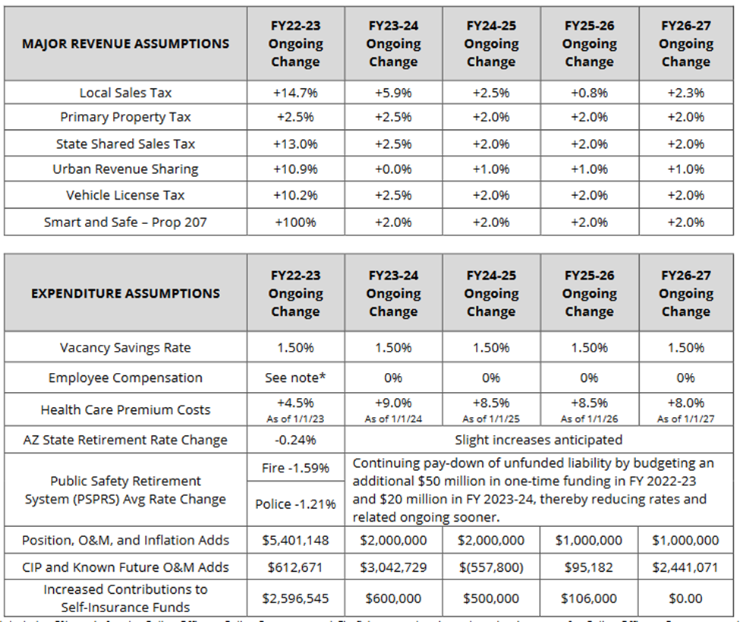
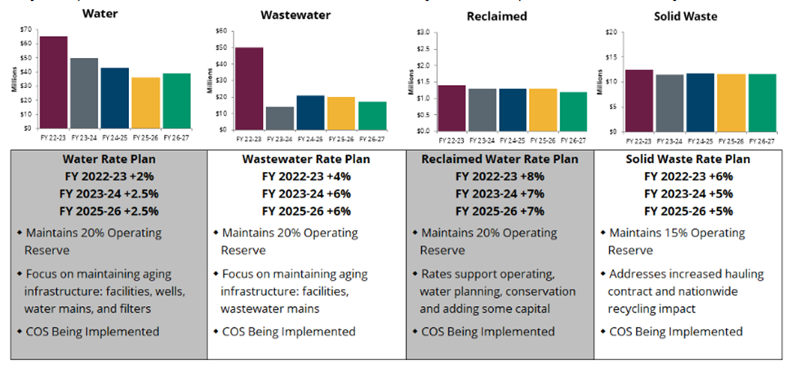
Charts, Graphs, Graphics

Slide 18
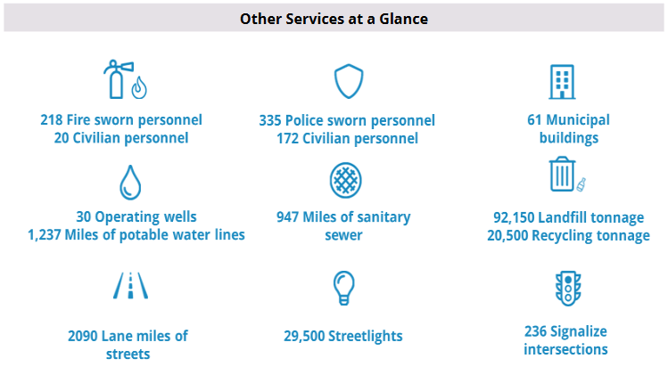
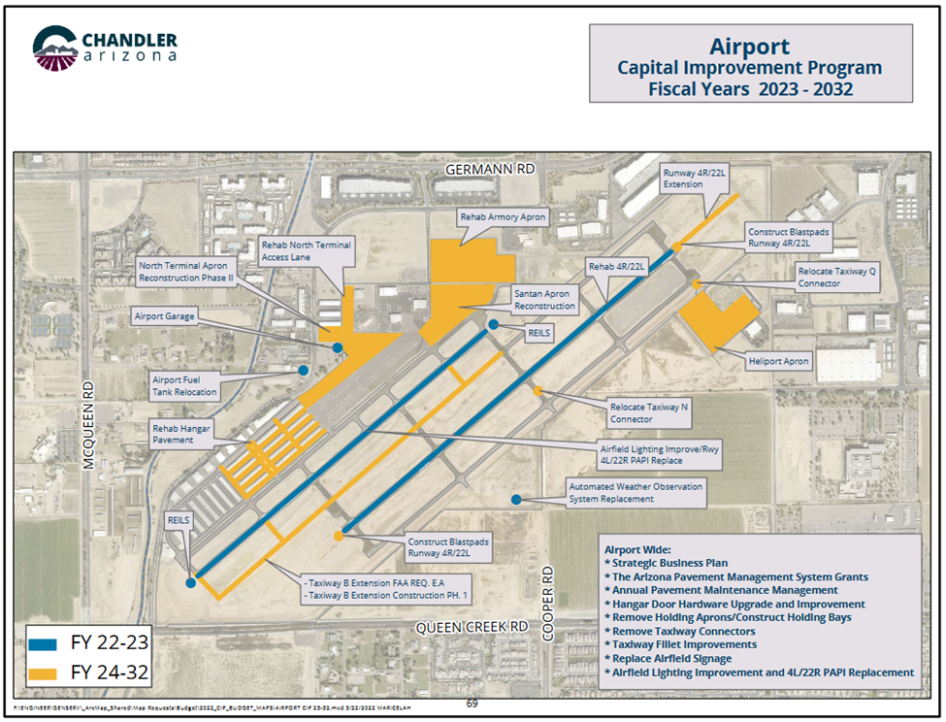
Charts, Graphs, Graphics

Slide 19
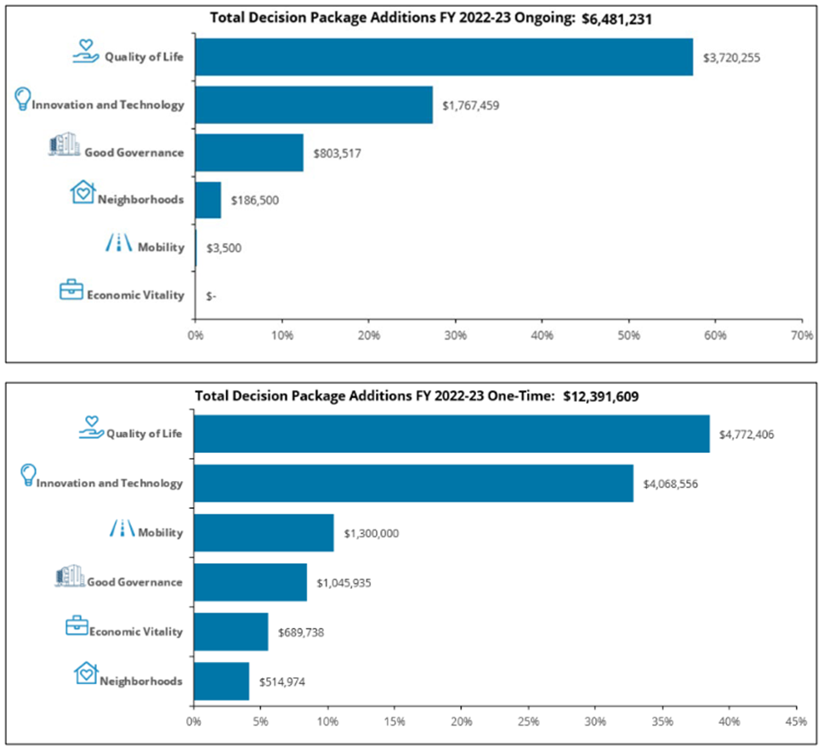
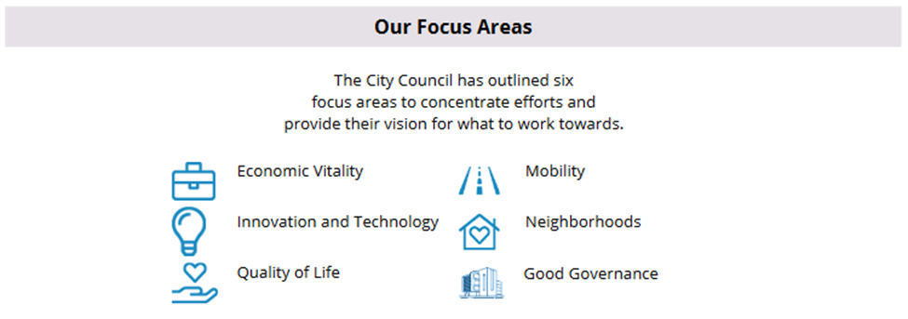
Charts, Graphs, Graphics

Slide 20
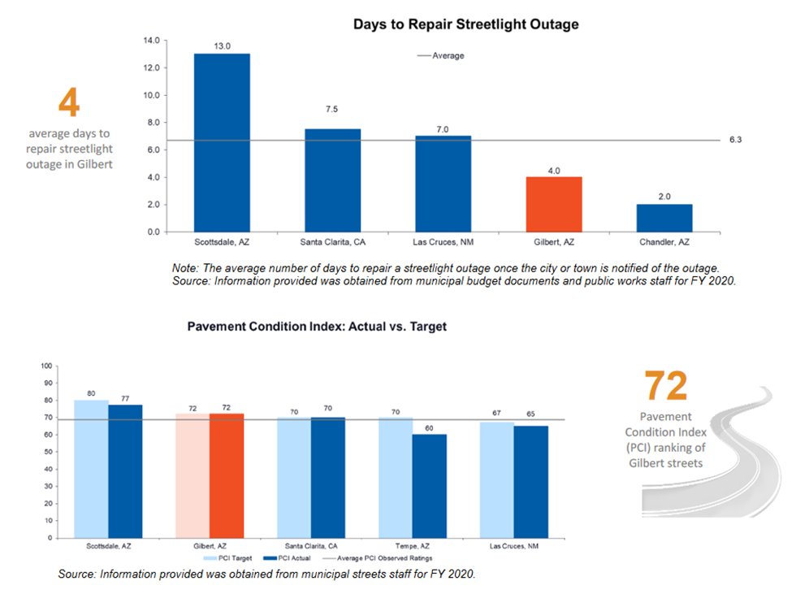
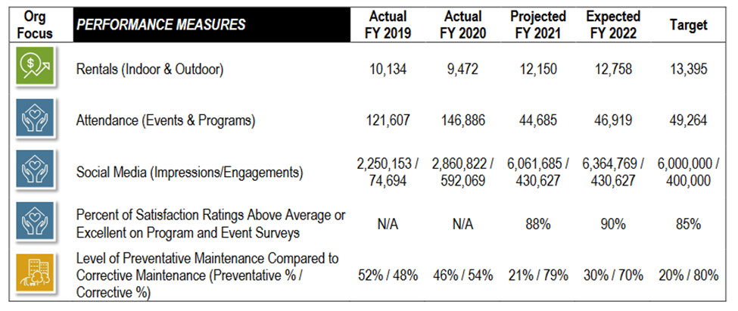
Charts, Graphs, Graphics - Gilbert

Slide 21
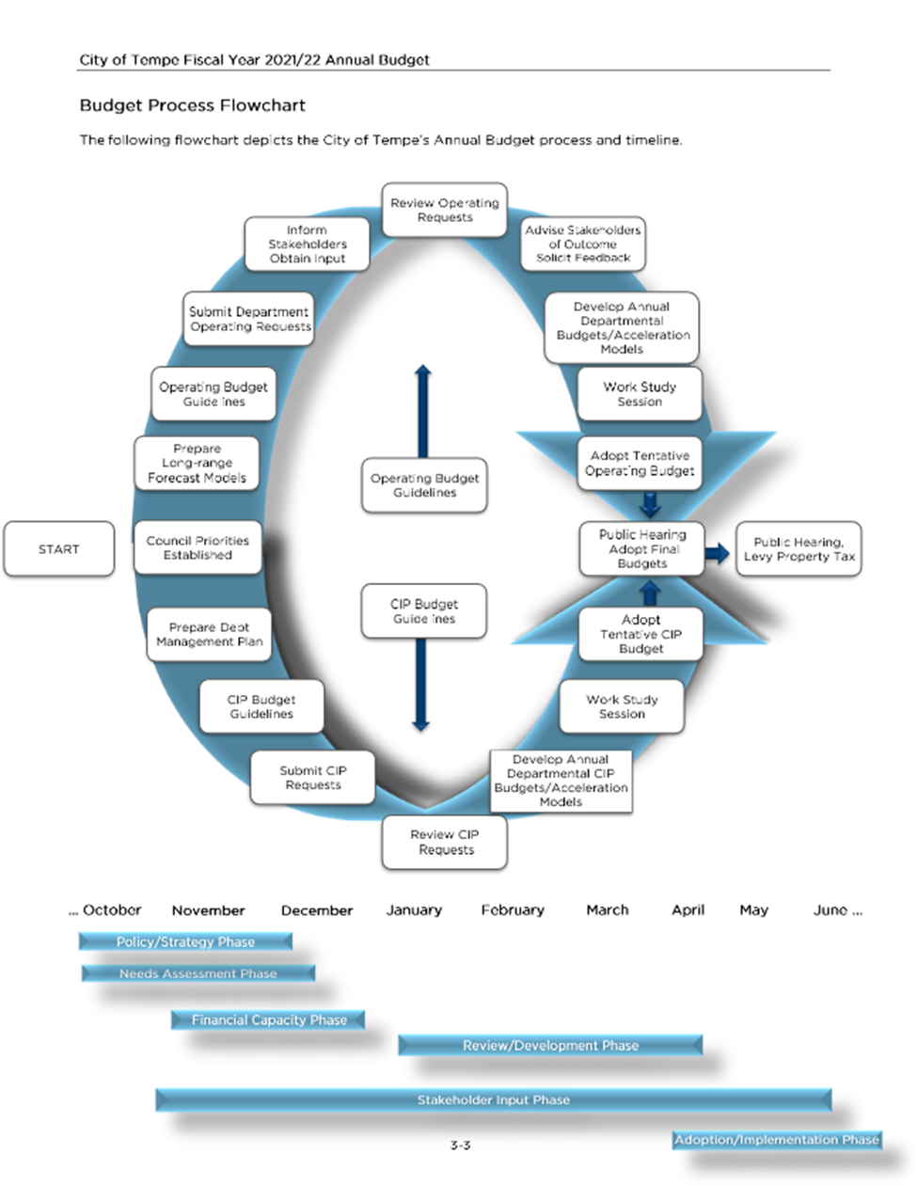
Charts, Graphs, Graphics - Tempe

Slide 22
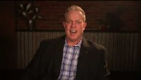
Budget Related Videos

Slide 23
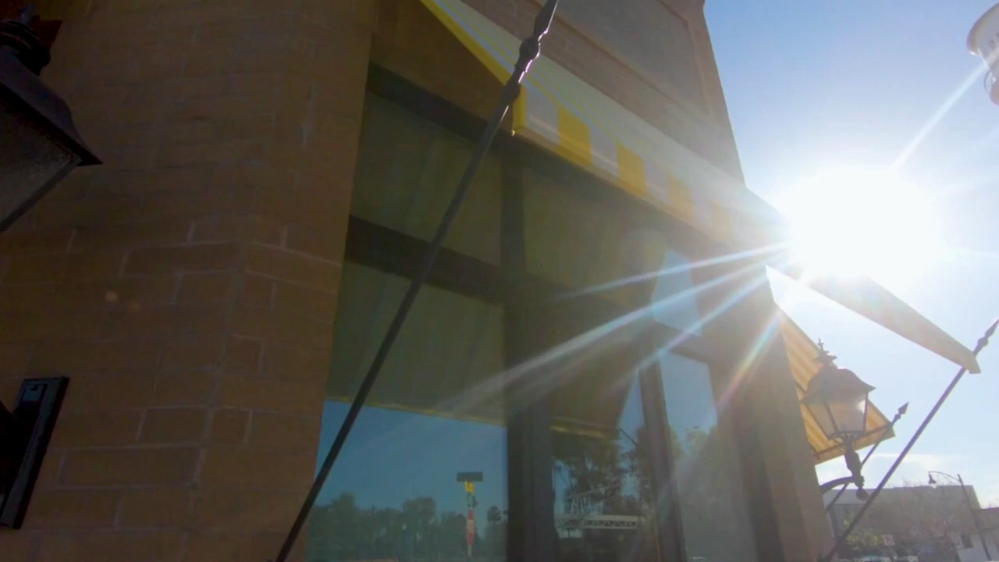
Budget Related Videos

Slide 24
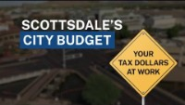
Budget Related Videos

Slide 25
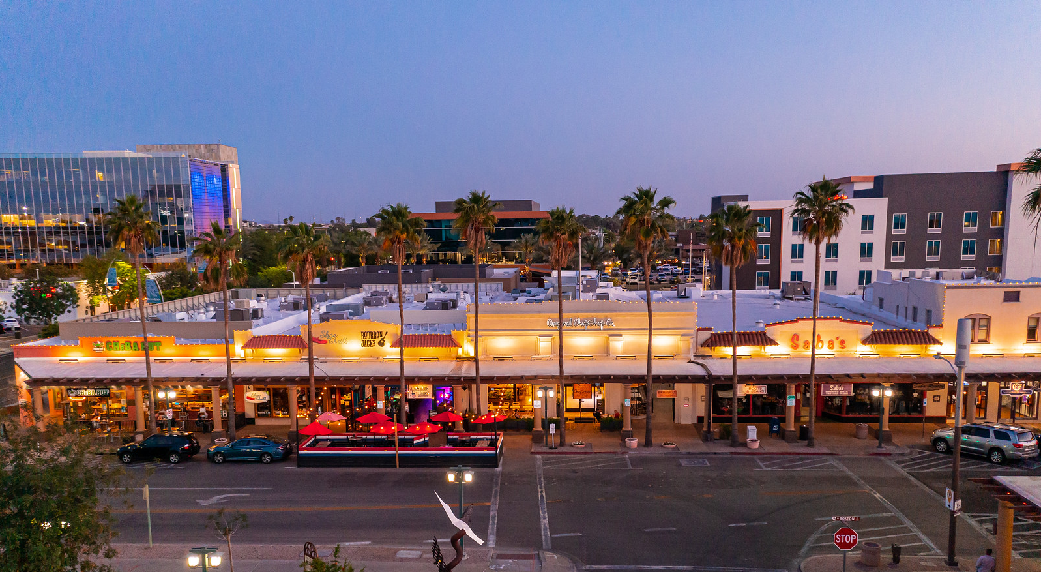
Conclusion
Take a moment and think about the information we are sharing, and answer the basic questions:
Who…are we trying to reach with our information?
What…are we trying to share, do we need action taken?
When…is the best time to share the information?
Where…is the ideal location, time or medium to share?
Why…are we sharing this, what is our goal in sharing?
How…can we share it in an easy to digest way to be the most effective?

Slide 26

Questions?
Matt Dunbar
Budget & Policy Officer
480-782-2256 matthew.dunbar@chandleraz.gov chandleraz.gov/budget

