Slide 1
Completing the State Required Auditor General Budget Forms and the Inconsistencies in Cities and Towns
October 21, 2021

Slide 2
Outline
Forms and instructions:
Arizona Revised Statutes (A.R.S.) §§42-17101 and 42-17102
Examples
Filing requirements:
A.R.S. §42-17103 - website posting requirements

Slide 3
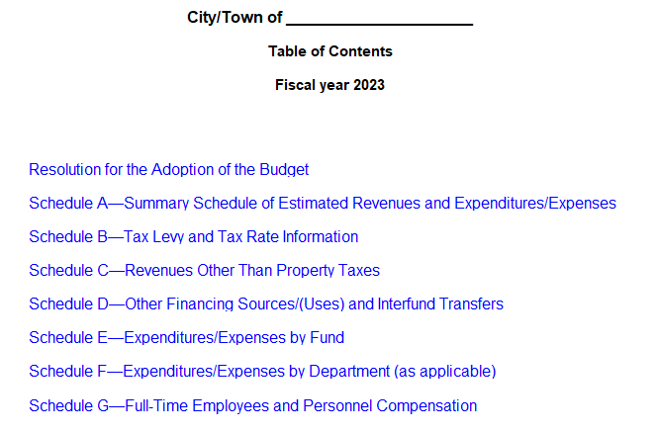
City-Town Official Budget Forms

Slide 4
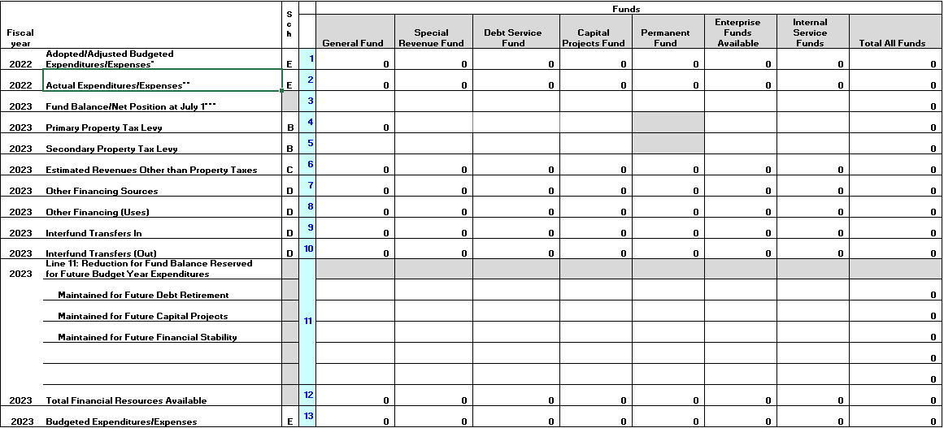
Schedule A

Slide 5
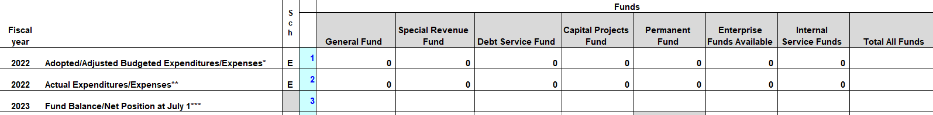
Schedule A

Slide 6
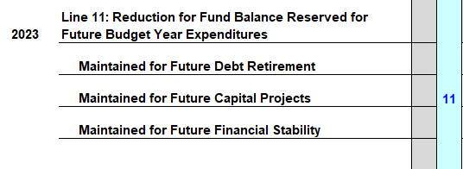
Schedule A

Slide 7
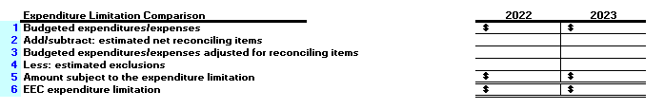
Schedule A – expenditure limitation comparison

Slide 8
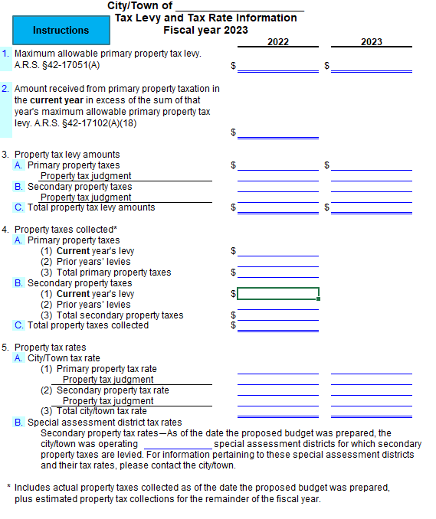
Schedule B

Slide 9
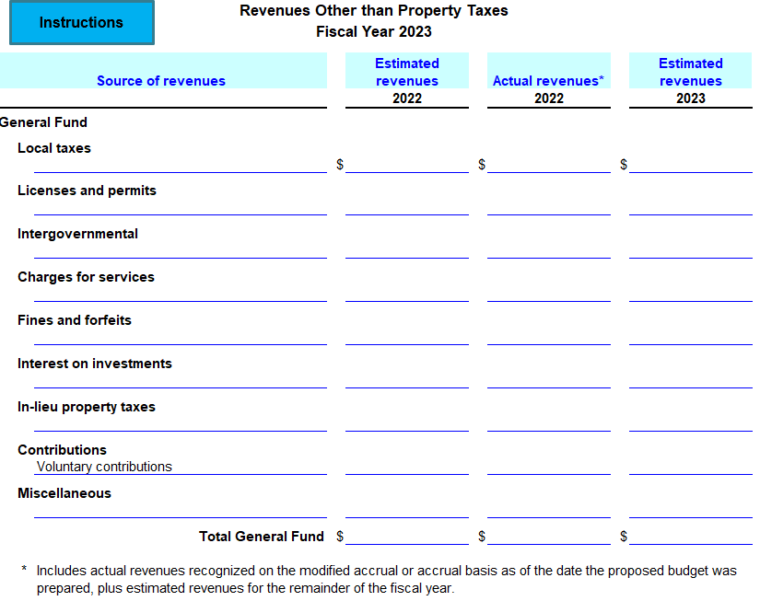
Schedule C – Revenue Other than Property Taxes

Slide 10
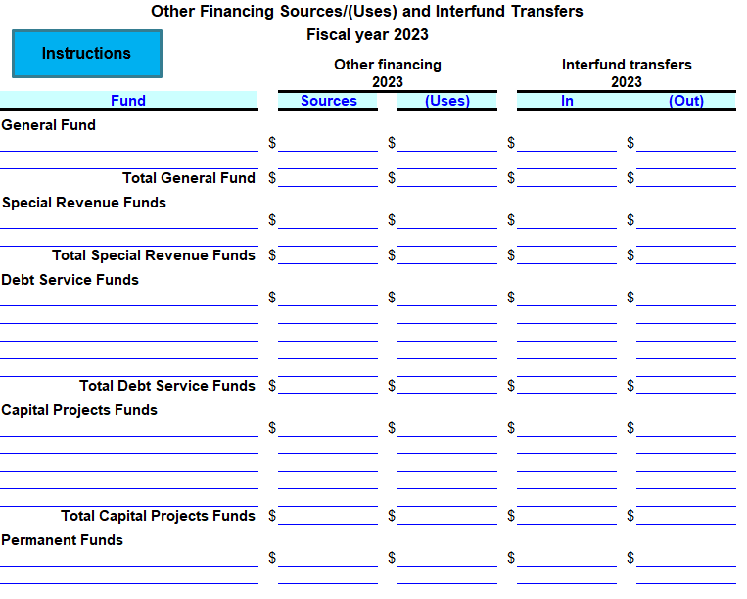
Schedule D - Other Financing Sources/(Uses) and Interfund Transfers

Slide 11
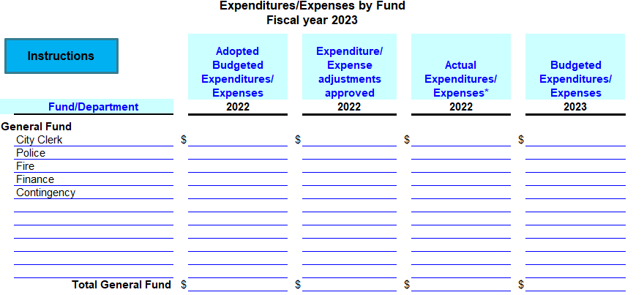
Schedule E – Expenditures/Expenses by Fund

Slide 12
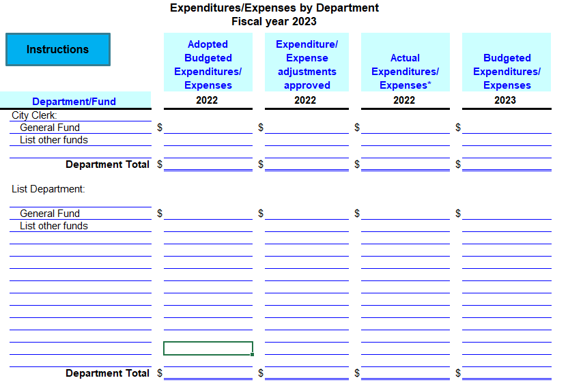
Schedule F – Expenditures/Expenses by Department

Slide 13
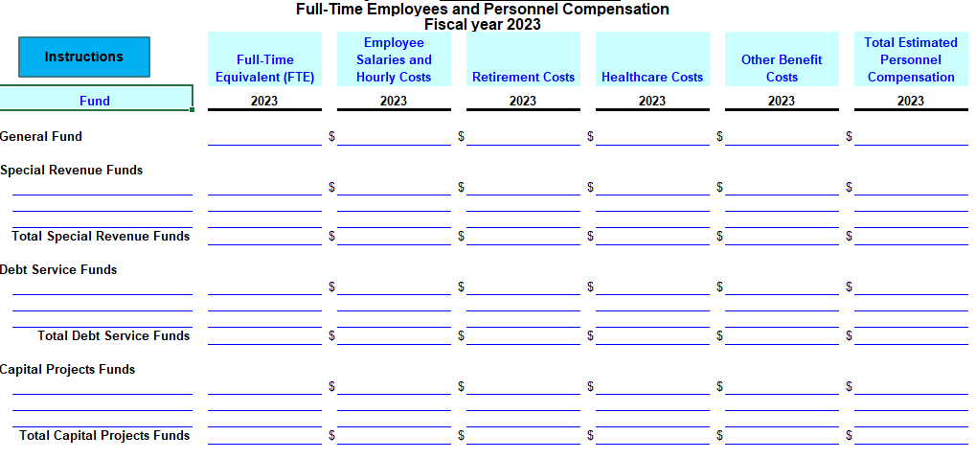
Schedule G – Full-time Employee and Personnel Compensation

Slide 14
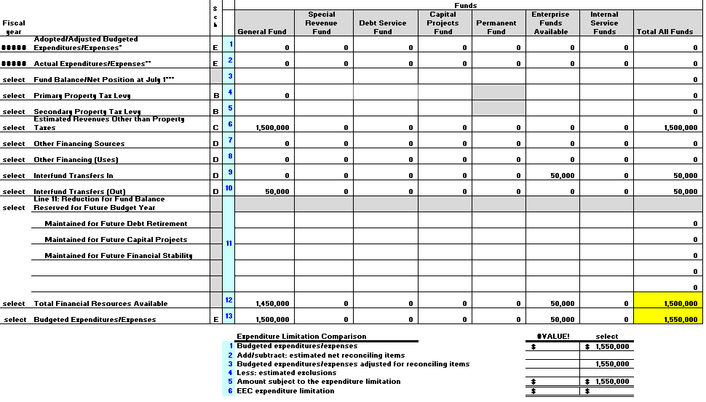
Example Schedule A without fund balance

Slide 15
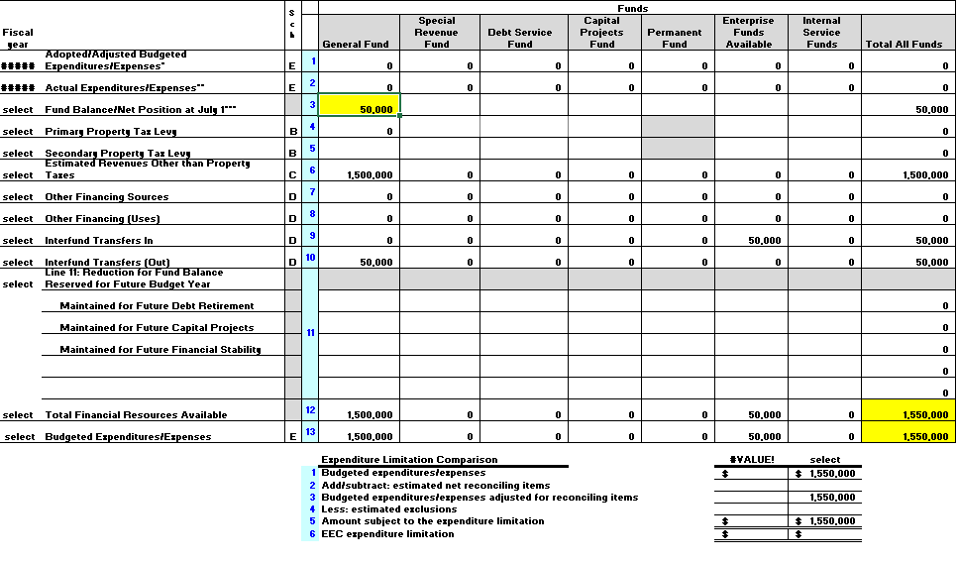
Example Schedule A with fund balance

Slide 16
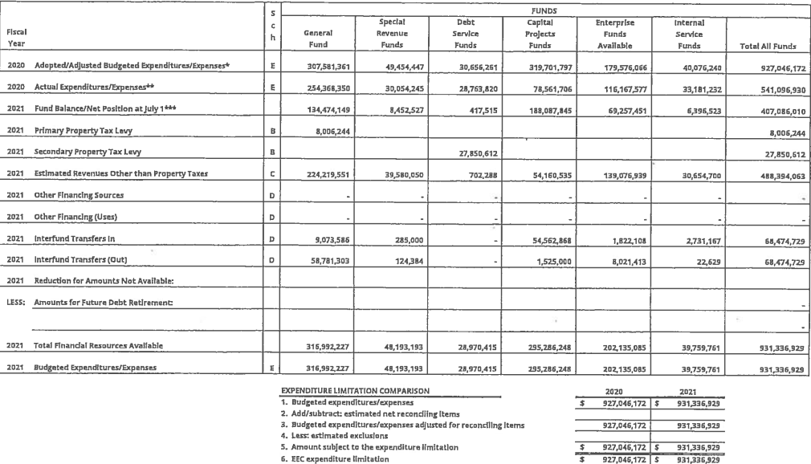
Example Schedule A under Home Rule

Slide 17
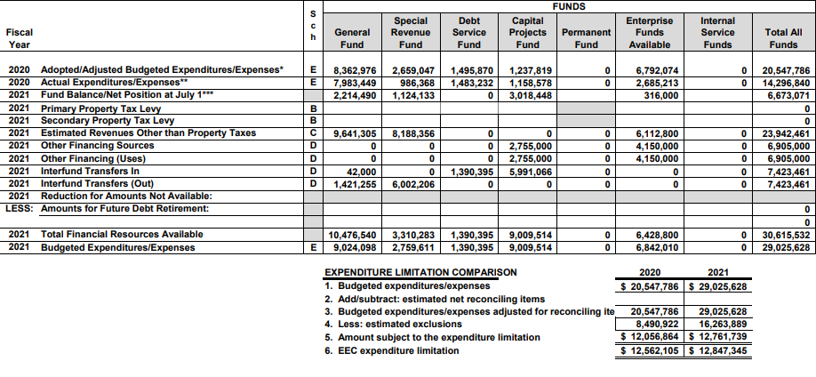
Example Schedule A under EEC limit

Slide 18
Filing Requirements
Post on website:
Proposed and adopted budgets on website for 60 months
Submit to Auditor General:
Only Schedule A, if under a Home Rule

Slide 19
Resources
Our website: www.azauditor.gov
Forms
Manuals/Memorandums
FAQs
Webinars
Contact us:
ASD@azauditor.gov
602-977-2796

Slide 20
Questions?

