Slide 1
Unlocking the Power of Collaboration for a Stronger and More Effective Budget Process
GFOAz Budget Forum – October 21, 2021
Grace H. Yoon (Budget Manager) & Geraldine Alejo (Revenue Officer), City of Long Beach

Slide 2
Agenda
The Why
What Collaboration Looks Like
Deeper Dive

Slide 3
Who Cares? Who’s Got Time for This?
Teamwork
Collaboration
Unity
We’re finance people. We deal with numbers and facts and have a lot of data to analyze.
These things sound nice, but with limited time, they are not as critical or practical as other things.
How do we even do this? It’s less tangible and less concrete than other goals.

Slide 4
Strategic Collaboration is Worth the Attention and Investment
Strategic Collaboration is Key to a Stronger and More Successful Budget Process
Important to actually talk about it because the need for it and the benefits of it tends to be more easily missed
It’s easier to find a mistake on a spreadsheet and make those corrections, rather than really understanding the implications of not investing into collaboration
Collaboration is working with another person or group to achieve a goal.
Strategic collaboration is implementing partnerships that are carefully designed and planned that create an advantage in achieving the goals and purposes.

Slide 5
Why We Should Care About Strategic Collaboration
We have Limited Capacity
Today time & attention are the new currency. Both are finite, but the demands on them are infinite. - Jim Kwik
Time and Energy are some of our most important and valued commodities
Anything that helps us maximize our productivity is worth the investment – Collaboration does just that.
Minimizes wasted energy or energy diversion
Many studies show cost of poor communication – I.e., SIS International Research (2008) noted productivity lost costing $26K per employee
Enhances Sustainability through Challenges
Value of collaboration is greatest when a crisis hit. How much team capital do you have to draw on when there’s a fire?
Allows Smarter Use of Strengths and Resources
No one person has all abilities. Leveraging strengths in a smart way gets more done

Slide 6
Why We Should Care About Strategic Collaboration, continued
Strategic Planning that is actually useful for the organization is difficult to do
Fancy strategic plans often get quickly outdated or collect dust on shelves
Reactionary vs. Strategic
A collaborative budget process actually serves as a vehicle for effective short-term citywide strategic planning. In Long Beach, the Budget Office:
Participates in discussions at the executive level
This allows us to be Team RAT (Relevant, Accurate, Timely) and understand significant issues
Raises and discusses key issues and provides options for approaches
What are the obstacles facing the City? What questions do we need to ask? What needs to go to Council?
Produces a budget book that represents the City’s priorities
Book is a physical representation of collaboration
Notes:
.

Slide 7
Why We Should Care About Strategic Collaboration, continued
As part of the Budget process, the Budget Office takes many conversations throughout the year on major issues or costly issues facing departments and highlight them for City Manager to find how to incorporate funding even when we are making cuts.
- Police Department
The budget process is a multi-year communication strategy to communicate and acquire funding for the legislative mandates or liability issues that are not so publicly exciting. Whether it's pension obligations, liability insurance,....putting things into the budget is part of ongoing education on departmental issues.
- Technology and Innovation Department

Slide 8
So What Does This Really Look Like?
4 Challenges
Tips & Ideas
The Benefit

Slide 9
Challenge to Collaboration #1
A “Central” Budget Office and an Operating Department have inherently different focus and approaches; this becomes more visible when implementing a process citywide
EXAMPLE: City of Long Beach – Service Priority Budgeting
Budget had to lead it and communicate very quickly to departments– even though the task itself was really difficult and hard to standardize. Looking back, there were moments where, I was really frustrated because I needed to use a standard template to tell our story in a way that didn’t fit the standard or in a way that I trouble seeing. I found it hard to describe our business model at the high level required, while still conveying what our program managers needed to include regarding the nuances of what we do and why it’s important…
I guess it boils down to as central and department offices, we know that policy-makers and the public need our information in a standard way, but when we’re looking at dollars from the ground level here in the department, that can be very hard to do, because we need flexibility and nuance in order to manage the day-to-day.
- Development Services Department

Slide 10
Tips (Challenge #1)
Customize
Develop a standardized process, but leave room for customized adjustments
Estimates to Close Analysis Deadlines
Preview
Talk to Departments that have unique situations in advance of rolling out a process
Health Department & Carryover Clean-Up
Learn
Make effort to learn about department operations and build relationships
Budget Office did department tours
Adapt
Be open to change and adaptation – this builds trust
Things to Improve List, Annual Budget Survey
“We only have 2 analysts in our department.... Because we are so thinly staffed, the turnaround time to submit information can seem unattainable. We really appreciate the flexibility of an extra day or two as needed to submit answers.” ~ Library Department

Slide 11
The Benefit (Challenge #1)
Allows Budget Office to have the ability to bend, adjust, and be nimble in the margins, in order to ultimately move forward with a needed standard process and plan. Also produces better results from sharing information, learning, and cross-training.

Slide 12
Challenge to Collaboration #2
Difficult and stressful subject matter makes departments defensive and guarded
EXAMPLE: Issuing reduction targets

Slide 13
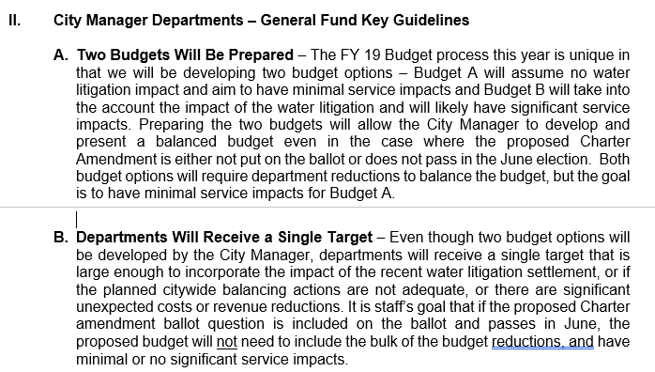
Tips (Challenge #2)
Start with the WHY. This helps departments understand context and not just their instructions. Some “behind the scenes” info can go a long way.
Financial Services Officer (FSO) meetings and Department Head meetings previews; Big Budget Kick off Meeting with instructions
Face to face CM meeting to openly discuss needs, cuts, impacts, etc. (importance of this step can’t be overstated, as unfortunately there aren’t a lot of opportunities to discuss critical budget/operational issues throughout the year)
- Parks, Recreation, and Marine Department
Give Departments a voice
City Manager Budget Decision Meetings

Slide 14
The Benefit (Challenge #2)
Promotes Alignment between Budget Office and Departments. There may not always be agreement – but you can still be in alignment even when you don’t agree.
The Safer Grant Program analysis was a complex issue, which involved calculations on the costs and benefits associated with accepting the grant, including the need for a second fire academy to attain the required staffing levels. While we may have approached this from different interests, we trusted each other and worked collaboratively to come up with accurate and factual information to present to the decision-makers. I appreciated the process even though the outcome was not the best for us.
- Fire Department

Slide 15
Challenge to Collaboration #3
Difficult to collaborate when Departments have limited capacity and are so busy. Multiple, numerous deadlines can result in poor information from departments or burnout/tension.

Slide 16
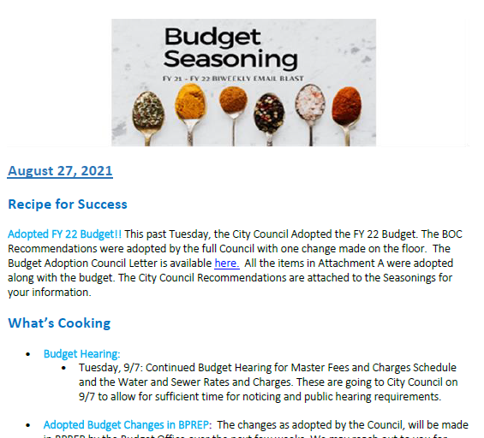

Tips (Challenge #3)
Show respect for their time with frequent and early communications
Budget Seasonings, FSO meetings, PDF calendars, Outlook calendars
Acknowledge the workload – Gratitude is a powerful influencing force

Slide 17
The Benefit (Challenge #3)
Departments are more willing to engage and there is greater morale that helps things moving forward. Develops mindset that we are in it together.
Timeline and expectations are provided ahead of time for departments (extremely important having this communicated early, as most departments will want to create their own timelines and objectives based on their respective needs.
- Parks Department
Budget Office meetings & materials included multiple acknowledgements that this was a difficult task
The instructions included a detailed calendar of due dates
- Development Services

Slide 18
Challenge to Collaboration #4
Difficult to collaborate when we ourselves in the Budget Office have limited capacity, reacting to fires, and don’t have time to think about collaboration

Slide 19
Tips (Challenge #4)
First recognize the importance of investing into collaboration
If you don’t see the value, you won’t even start
Be purposeful, work at it, and make a conscious investment in collaboration
They can be small things – Strengthfinders/DISC trainings, annual budget retreats
“Culture is not an accident; it takes hard work….It’s easy to think that collaboration or connection is something natural and easy – but it’s really not. It takes work and investment and, sometimes, difficult conversations.”
Utilize tools to help you organize and create the space that helps you consider how to implement the budget process through the lens of collaboration
Budget Office internal work calendar (demonstration)
Key in helping us navigate major turbulent and unusual budget years (i.e. move to a new city hall and ERP system change)

Slide 20
The Benefit (Challenge #4)
This investment will create a foundation and culture with long-term benefits, greater productivity, and ultimately a stronger citywide team that is best for the community

Slide 21
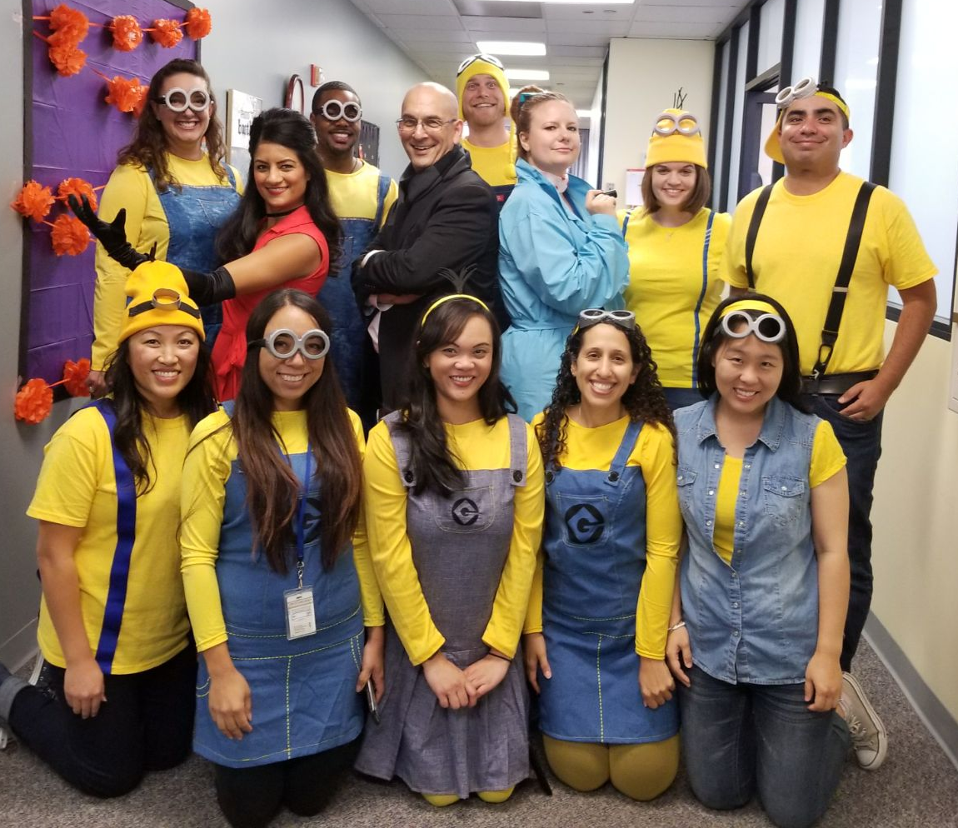
This is not a one-size fits all
Asking the question – how can we better collaborate – is more important than the specific tasks
Hire the right people who are effective at collaborating
Adjust and adapt to your own organization and what will work there

Slide 22
Citywide Fee Study:
Case Study in Collaboration
Deeper Dive with Geraldine Alejo

Slide 23
City of Long Beach’s Financial Policy on User Fees & Charges
User Fees and Charges will be Set at the Cost of the Service
Background - Fees and associated charges are associated with recovering the cost of providing a service. The City can charge up to the full cost of providing a service.
Policy
Fees will be set to fully recover costs, except where there is a greater public benefit through use of a lower fee, such as where full recovery may adversely impact overall revenue or may discourage participation in programs where the participation benefits the overall community.
The City Manager will establish a process in-depth review of all fees over time. The review, while eventually covering all fees, should emphasize those that have or may have significant subvention (may not be at full cost).

Slide 24
Project Background
In FY 19, at City Council’s direction, staff initiated an multi-year citywide fee study to conduct a comprehensive cost of service analysis to determine the full business cost of providing each service and the subvention (subsidy) rates for services
The City started with the first round in FY 20 with Development Services, Parks, Recreation, and Marine, and a portion of Health.
Prior to FY 19, the City last engaged in a citywide fee study in 2006. Fees and charges were typically thought of as more of an “administrative” function
The project is now providing new opportunities for citywide education on fees & charges, revisit & improve our current processes, and engage in public discussion on the City’s financial policy and trade-off’s
Notes:
Before we deep dive, here is some background information and context to the Citywide fee study

Slide 25
Key Players and Roles
City Council
Directed staff to engage in the study, approval authority to implement recommended changes
City Manager
Executive management review and approval of presentation/recommendations
Budget Office
Overall central coordination including: schedule management, higher-level study review, consultant management, public presentation coordination, proposed fee change process management
Departments
Work directly with the consultant to provide and interpret data (budget & actuals), service/operations info, detailed review of study and findings, provide rate recommendations based on the study, present findings resulting recommendations to City Council

Slide 26
Deep-Dive into Challenges
Establishing New and Standardized Processes
Limited knowledge across the city on existing process/policies
Staff capacity During the Pandemic
Create presentation materials that are consistent yet customizable

Slide 27
Results of Collaboration
Presentation Materials to City Council
Fees 101 Website:
Resource and References for City Council, City Staff, and the Public

Slide 28
CONTACT INFORMATION
Grace H. Yoon – Grace.Yoon@longbeach.gov
Geraldine Alejo – Geraldine.Alejo@longbeach.gov

