Slide 1

Budgeting Software
Macy Walker, Fiscal Services Administrator, City of El Mirage
Andrew Donahue, Account Executive, ClearGov

Slide 2

Agenda
Establishing Criteria for Software
Budget Cycle Management with Software
Implementation
Operational Budgeting and Budget Books
Q & A

Slide 3
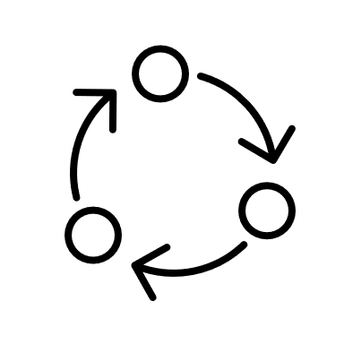



Before vendor demos…
Evaluate current process and tools.
Establish criteria for new software.
There is information to gather to make sure demos are as useful as possible.
By gathering information upfront and taking notes of the process, it will be easier to compare software and will help you establish your new process during implementation.
Create a ranking template or set of questions.
Create group of stakeholders to attend demos.
Notes:
Who uses the current tools and how do they use or access it? What are current pain points? What are your needs (and priority of needs) for the new software?
Being consistent with vendors will make sure you have similar information from each one.
Consistency of attendance in demos.

Slide 4
ClearGov Budgeting Software

Slide 5
Takeaways
Cloud based software is accessible anywhere (teleworking).
Consolidating data makes the budget process easier.
Manage expectations throughout the process.
Audit trail and versions shows changes as you go.
Provide training and resources to users.
Notes:
Who uses the current tools and how do they use or access it? What are current pain points? What are your needs (and priority of needs) for the new software?
Being consistent with vendors will make sure you have similar information from each one.
Consistency of attendance in demos.

Slide 6
Questions?

