Slide 1
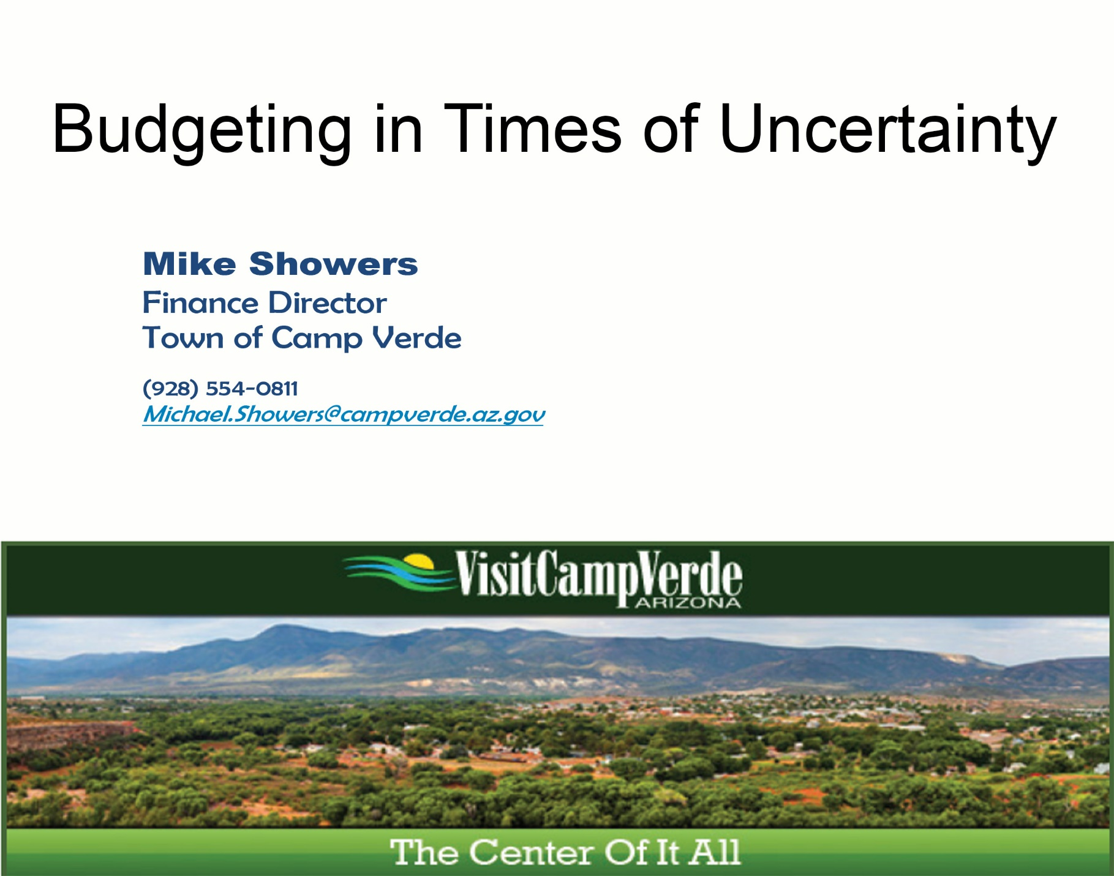

Slide 2
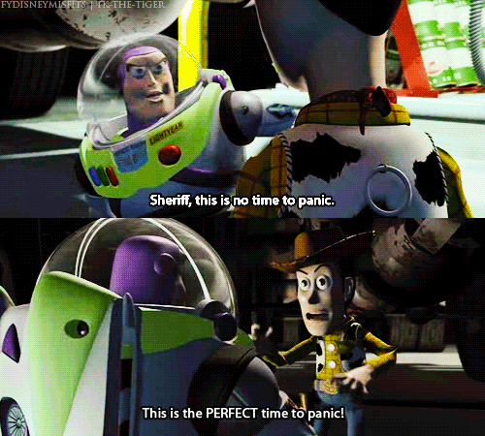

Slide 3
Budgeting in Times of Uncertainty
Know Who You Are

Slide 4
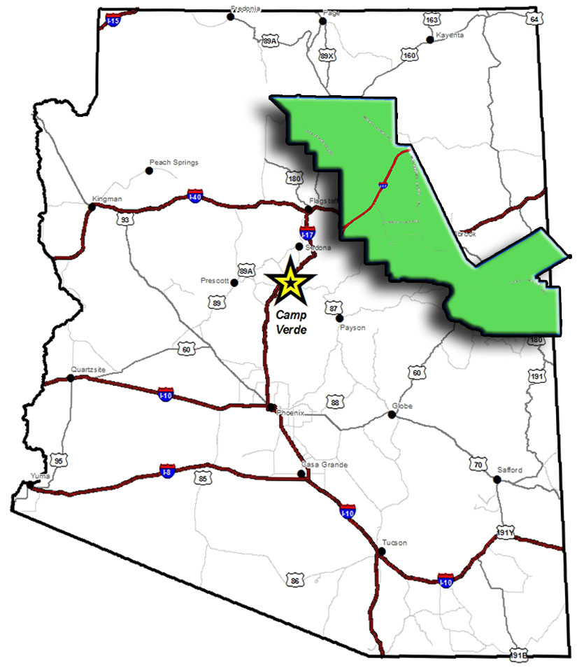

Slide 6


Slide 7
Budgeting in Times of Uncertainty
Know Who You Are
Analyze the Issue as it affect Your Community

Slide 8
Budgeting in Times of Uncertainty
Know Who You Are
Analyze the Issue as it affect Your Community
Listen & Watch

Slide 9


Slide 10
Budgeting in Times of Uncertainty
Know who you are
Analyze the issue as it affect Your community
Listen & Watch
Keep your plan or alter it.

Slide 11


Slide 12
Budgeting in Times of Uncertainty
Know who you are
Analyze the issue as it affect Your community
Listen & Watch
Keep your plan or alter it
Detail your plans to mitigate any shortfalls

Slide 15
Budgeting in Times of Uncertainty
Key take-aways
Do your own analysis first – Don’t just react
Consider your specific community – not just the world at large
Be creative – think outside the box
Find ways to mitigate the risk rather than just cutting
Always detail and communicate how you will handle short-falls

