Slide 1

The Changes to the Budget Awards Program and Budget Document Best Practices
September 17, 2020
October 29,2020
gfoa.org
@GFOA
© 2020 Government Finance Officers Association

Slide 2
Instructor
John Fishbein
  Senior Program Manager
  Technical Services Center
  Government Finance Officers Association (GFOA)
  Email: jfishbein@gfoa.org
2

Slide 3
Content within Today’s Program
How the criteria relates to GFOA’s best practices in budgeting and other initiatives.
Background of the Distinguished Budget Presentation Awards Program.
Explain revisions in the criteria.
Provide examples of how to meet the criteria.
3

Slide 4

https://www.gfoa.org/best-practices/budgeting
4

Slide 5
GFOA’s Distinguished Budget Presentation Awards Program
GFOA established the Distinguished Budget Presentation Awards Program (Budget Awards Program) in 1984 to encourage and assist state and local governments to prepare budget documents of the very highest quality.
Approximately 1,700 participants - about 100 new participants per year.
Approximately 500 reviewers - great way to learn about budgeting.
Application for both participants and reviewers is online.
Only accept PDF’s or web based submissions.
Participants receive their results through an email.
Reviewers can access documents through an email.
5

Slide 6
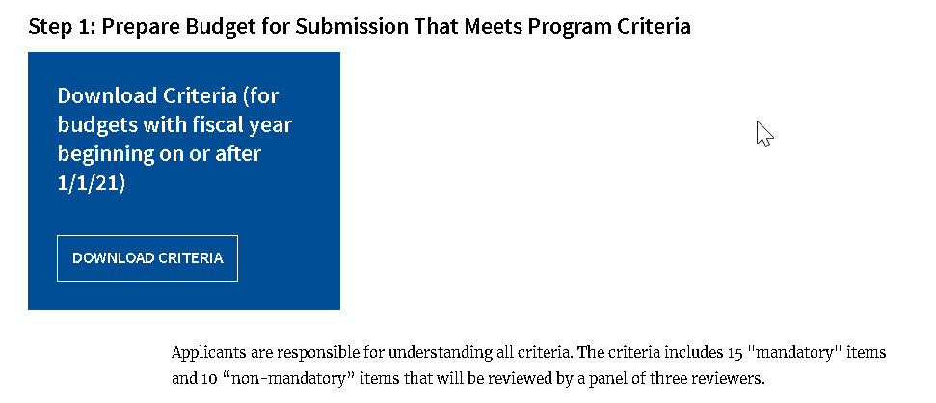
https://www.gfoa.org/budget-award-2021
6

Slide 7
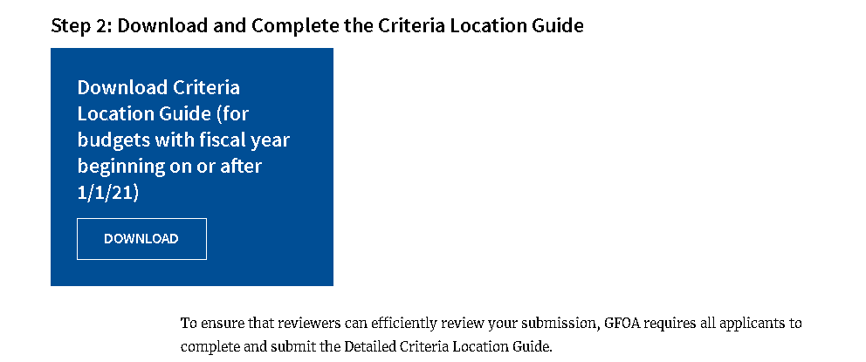
https://www.gfoa.org/budget-award-2021
7

Slide 8
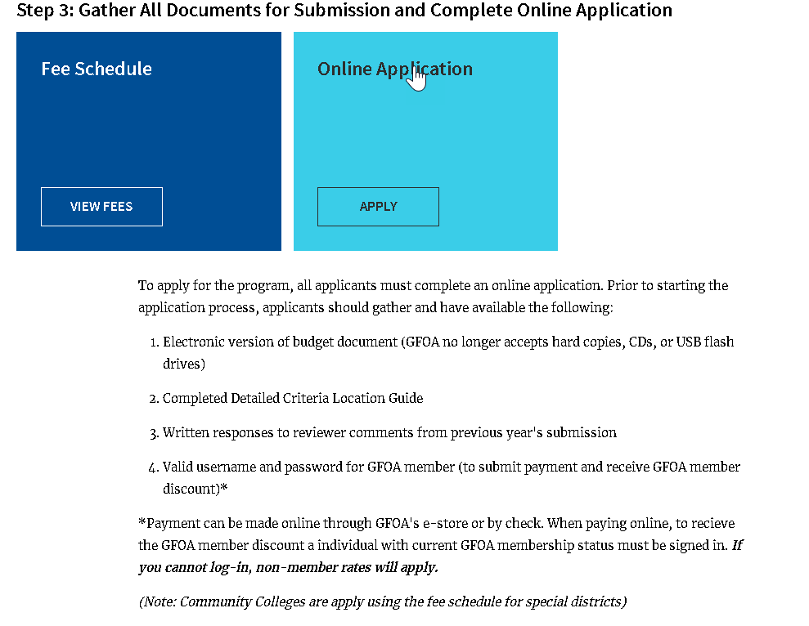
https://www.gfoa.org/budget-award-2021
8

Slide 9

https://www.gfoa.org/budget-award
9

Slide 10
GFOA Distinguished Budget Presentation Awards Program (continued)
Many governments are moving away from the traditional budget document into other forms of budget communication.
There was a task force of seventeen individuals from various governments that worked with GFOA staff on developing these revisions.
The revised criteria takes effect for budgets with a fiscal year beginning January 1, 2021 or later.
There will be a one-year grace period to comply with the revisions.
That brings us where we are today in terms of the revisions in the Budget Awards criteria.
10

Slide 11
Summary of Budget Award Revisions
Table of contents can now refer and even link to items outside of the budget document.
Strategic planning is now mandatory and process should be identified.
Short-terms factors and priorities and issues are combined.
Budget overview should also summarize changes between proposed and adopted budget.
Organization chart may consider how structure helps achieve mission.
Financial policies should note whether budget complies with relevant financial policies.
11

Slide 12
Summary of Budget Award Revisions (continued)
Budget process should also include discussion on legal level of budget control.
Three–year financial schedule is no longer mandatory.
Long-range operating financial plans should consider unfunded liabilities and go beyond just the general fund.
Capital program and operating impact of capital are combined.
Capital program needs to identify process of choosing funded projects.
Debt should include bond ratings, debt to maturity schedules, and purpose of obligations.
12

Slide 13
Summary of Budget Award Revisions (continued)
Performance measures are now mandatory.
Understandability and usability encourages governments to use other forms of communication for budgets including videos, social media, etc.
Understandability and usability criterion also notes that governments need to be aware of ADA requirements.
The goal is to make sure that the criteria remains relevant and that the budget information presented is meaningful.
13

Slide 14
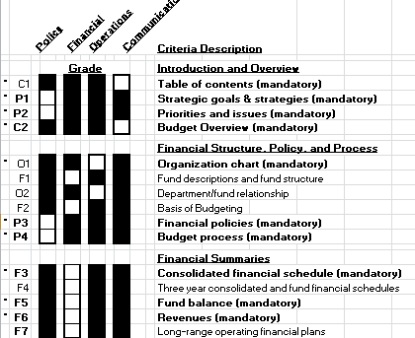
Vote Page

Slide 15

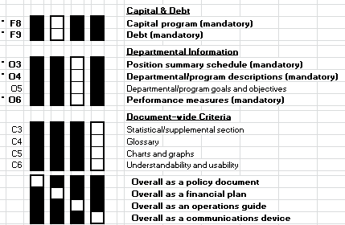
Vote Page (continued)

Slide 16
Table of Contents
#C1. Mandatory: Include a table of contents that makes it simple to locate information.
Is a comprehensive table of contents provided for easy navigation (may take a variety of forms related to the approach used to present budgetary information)?
Do all pages in the table of contents electronically link to the corresponding content location (pages in a traditional document or other content in an electronic form)?
Are the page numbers or similar reference points in the table of contents consistent with the referenced page numbers?
16

Slide 17
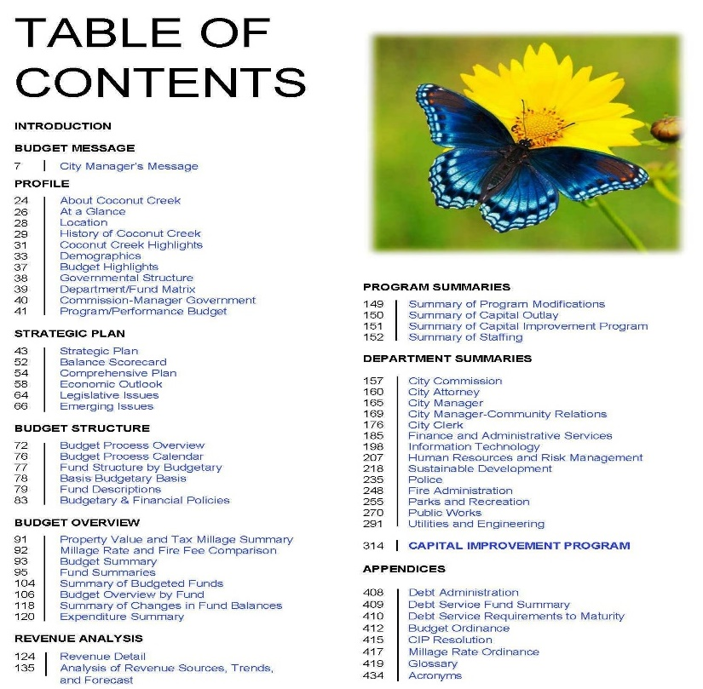
City of Coconut Creek, Florida

Slide 18
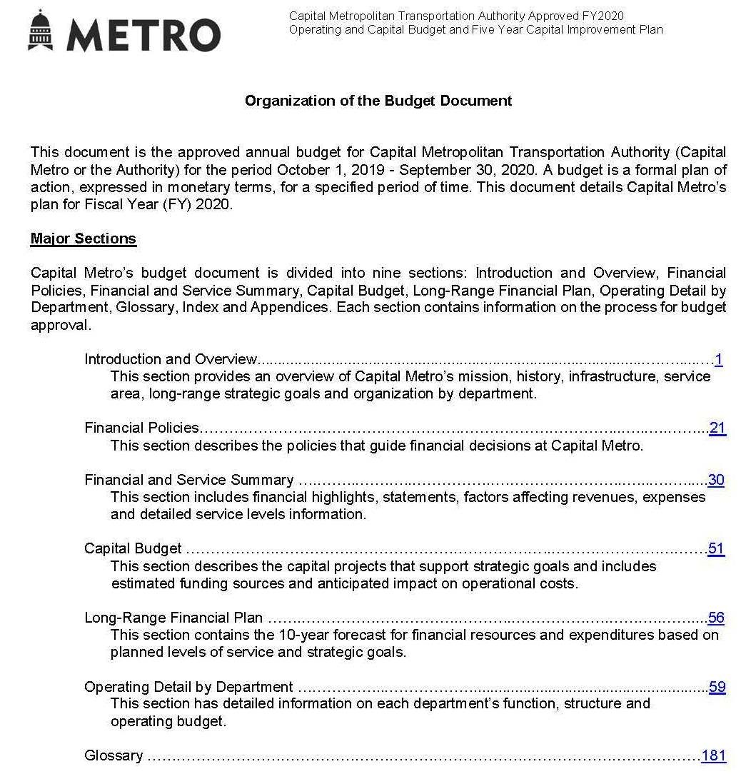
18
Capital Metropolitan Transportation Authority, Texas

Slide 19

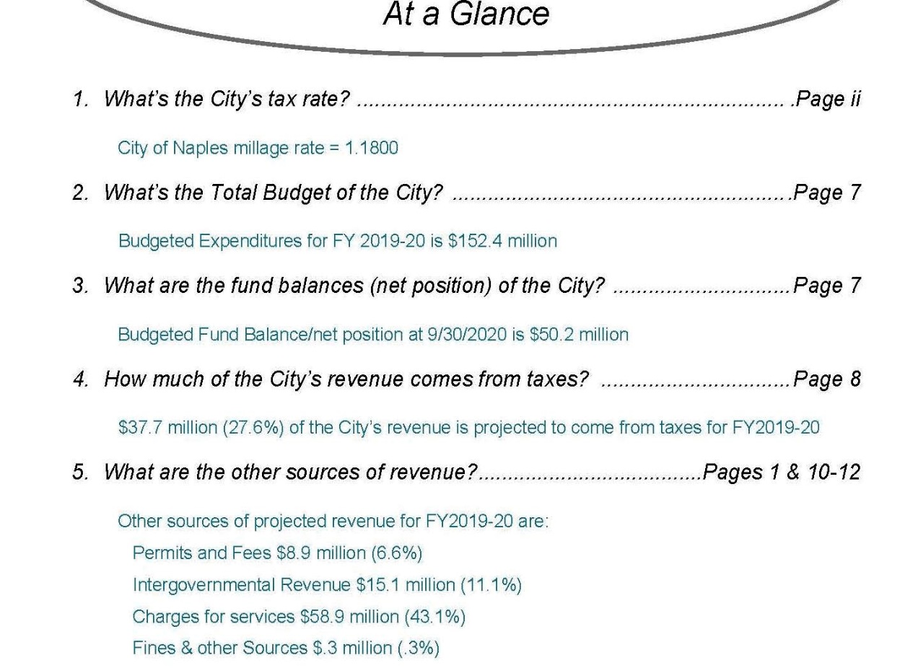
City of Naples, Florida

Slide 20
Montgomery County, Maryland

Slide 21
Strategic Goals and Strategies
#P1. Mandatory: Provide a coherent statement of organization-wide, strategic goals and strategies that address long-term concerns and issues.
Are strategic goals included?
Is the process for creating the strategic goals explained?
Are action plans and/or strategies included to show how these goals will be accomplished?

Slide 22
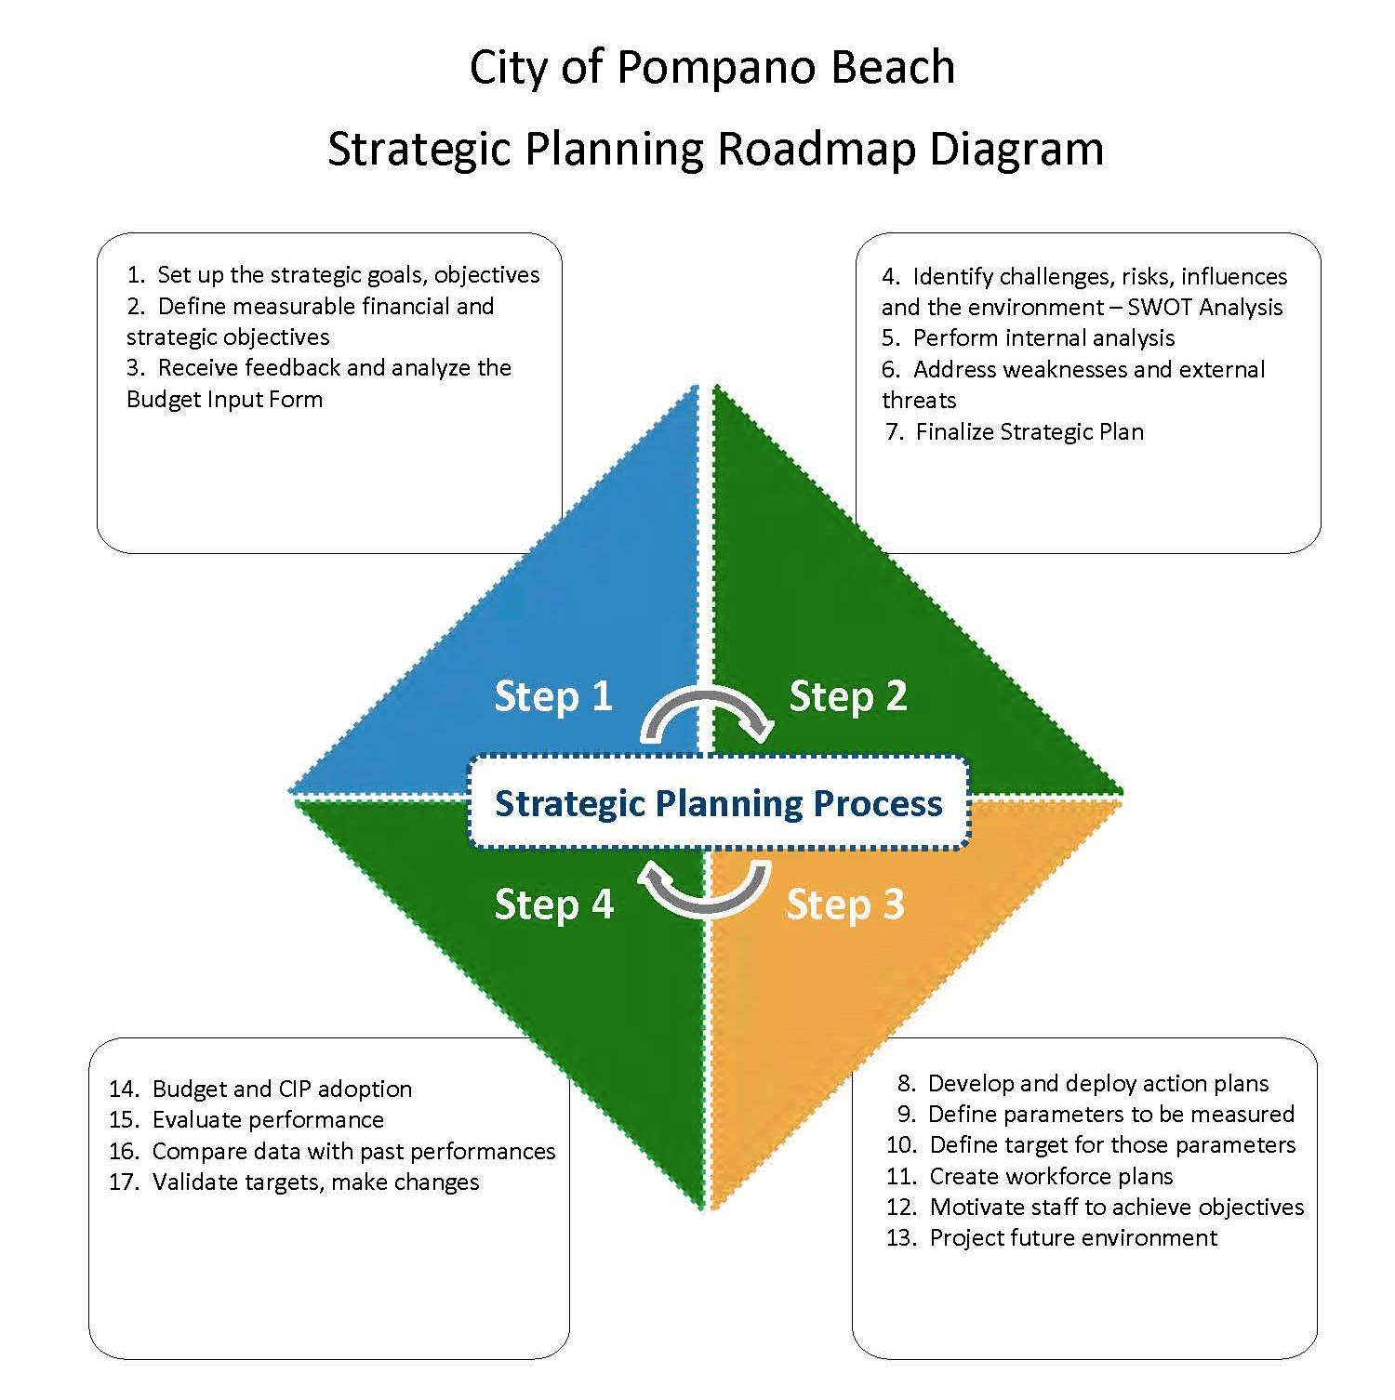
City of Pompano Beach, Florida

Slide 23
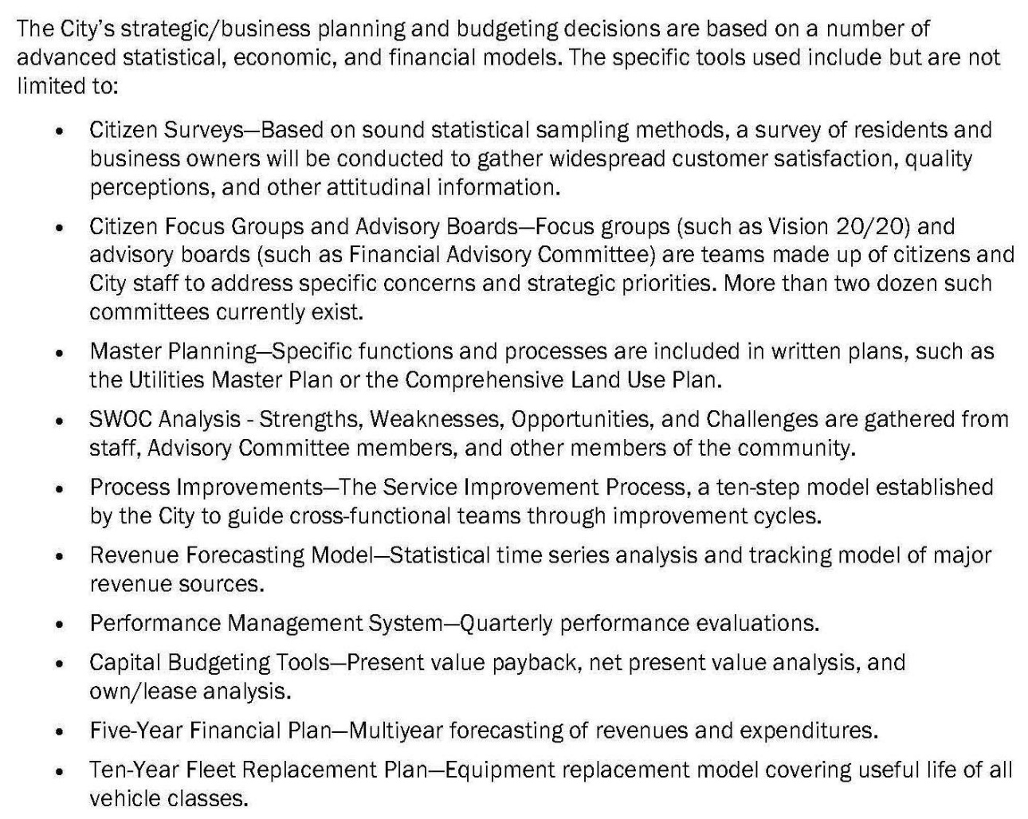
23
City of Coral Springs, Florida

Slide 24
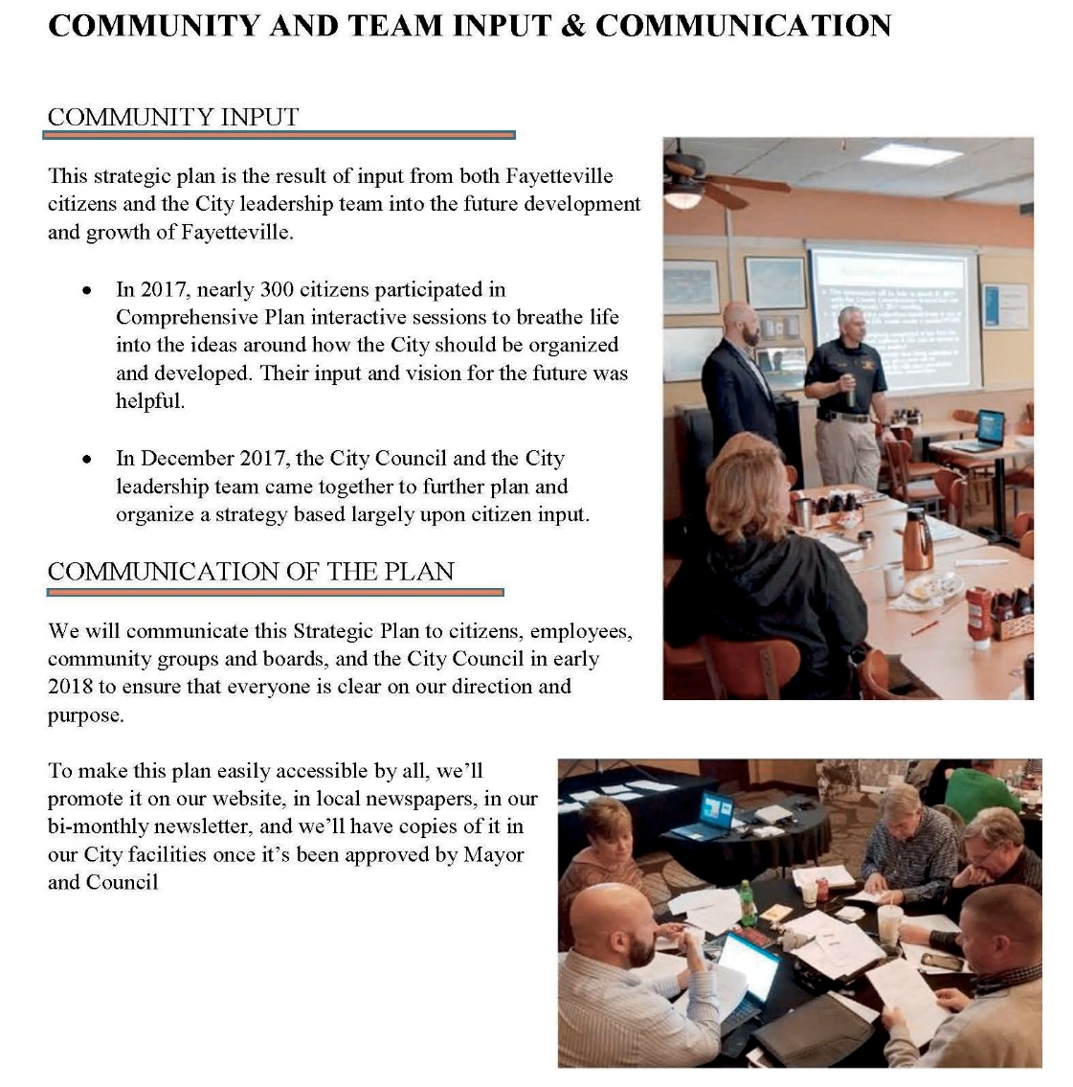
City of Fayetteville, Georgia

Slide 25
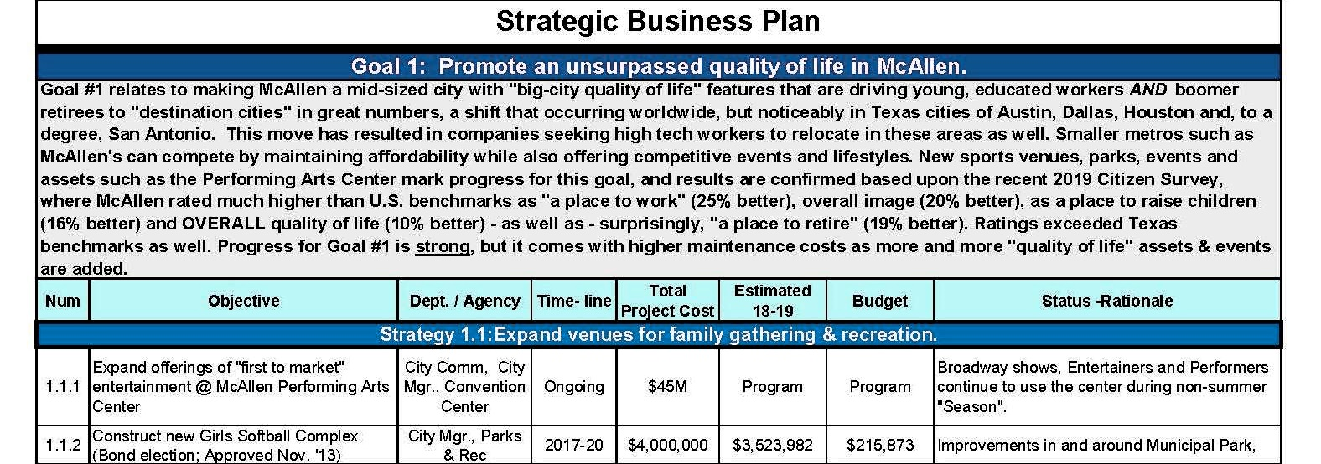
City of McAllen, Texas

Slide 26
Priorities and Issues
#P2. Mandatory: Provide a budget message that articulates priorities and issues for the upcoming year. The message should describe significant changes in priorities from the current year and explain the factors that led to those changes. The message may take one of several forms (e.g., transmittal letter, budget summary section).
Does the message highlight the principal issues facing the governing body in developing the budget (e.g., policy issues, economic factors, regulatory, and legislative challenges)?
Does the message describe the actions to be taken to address these issues?
Does the message explain how the priorities for the budget year differ from the priorities of the current year?
Are major changes in service levels, fees, and/or taxes presented?
26

Slide 27
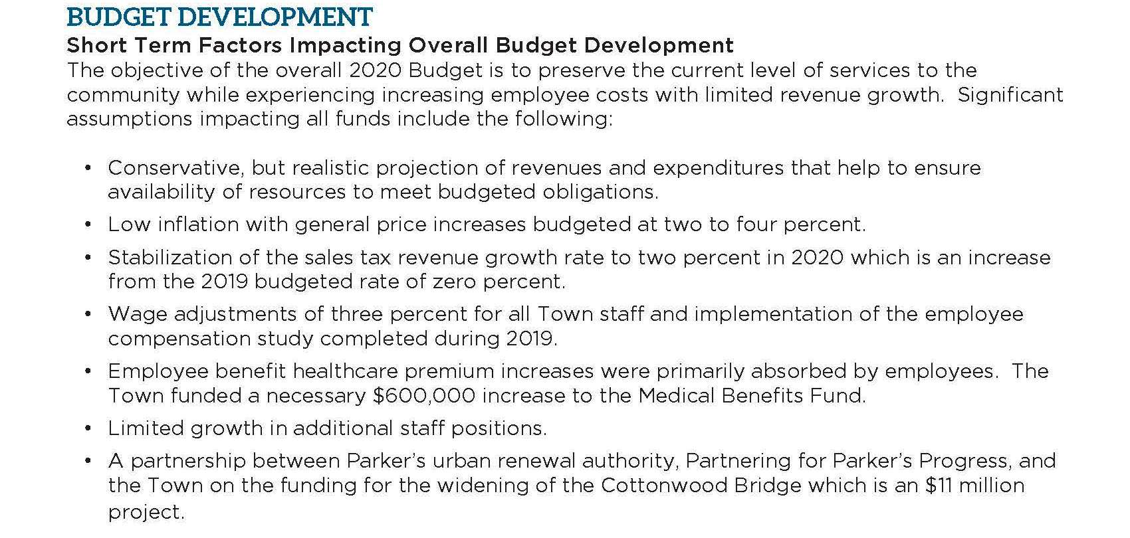
Town of Parker, Colorado

Slide 28
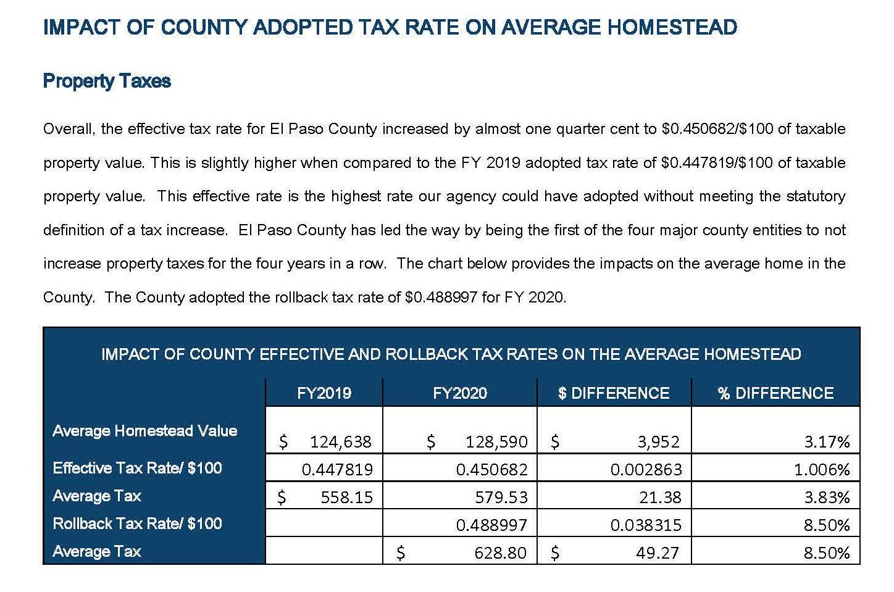
El Paso County, Texas

Slide 29
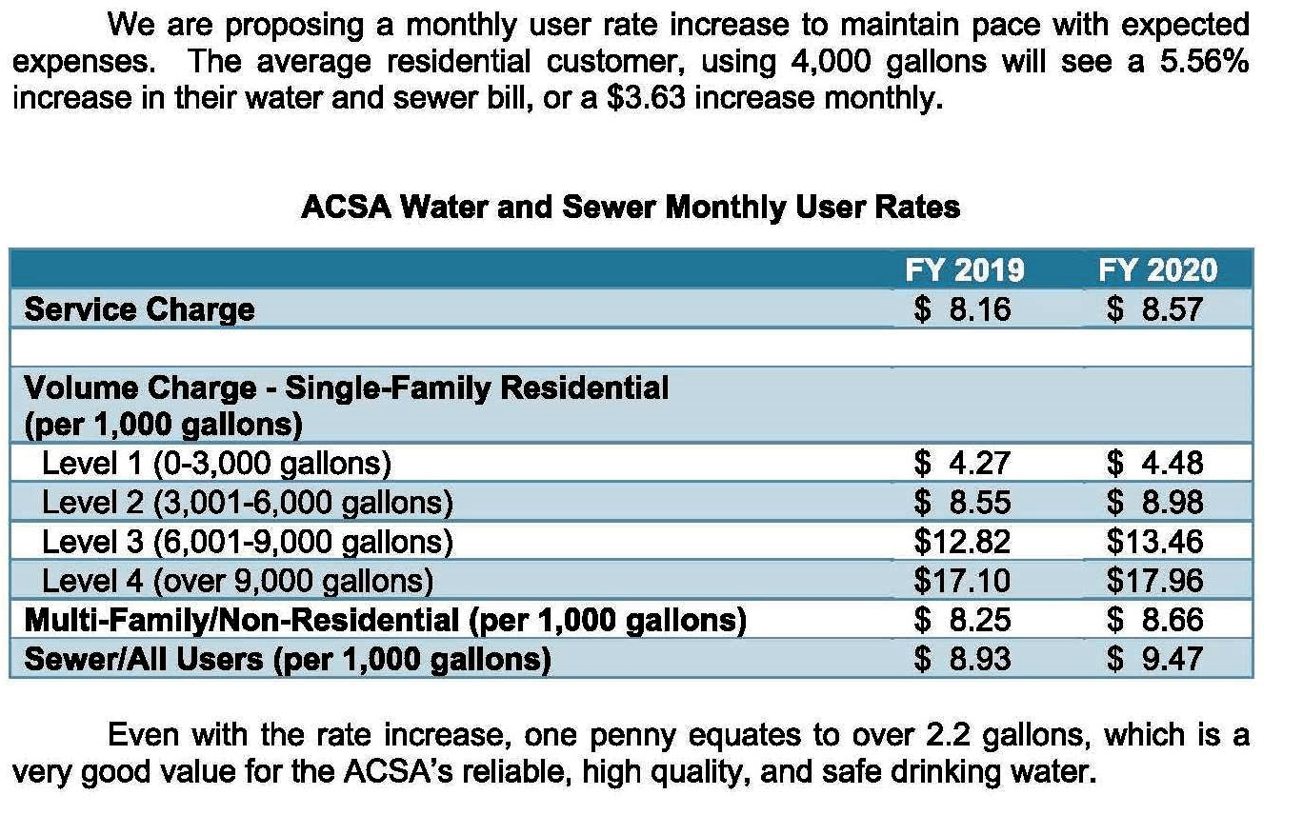
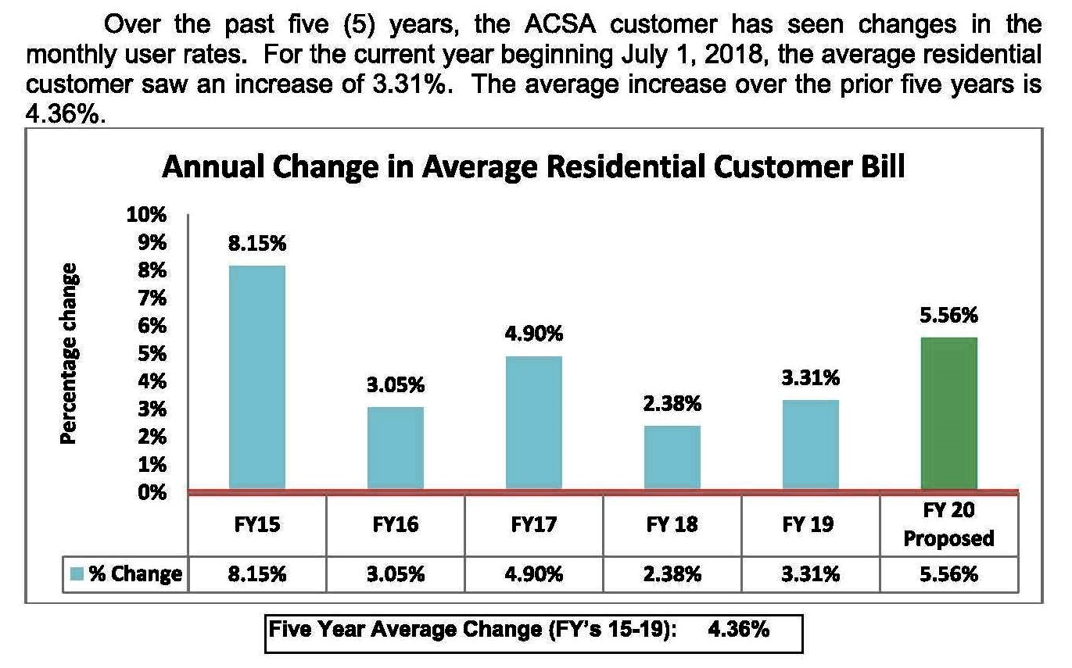
Albemarle County Service Authority, Virginia

Slide 30
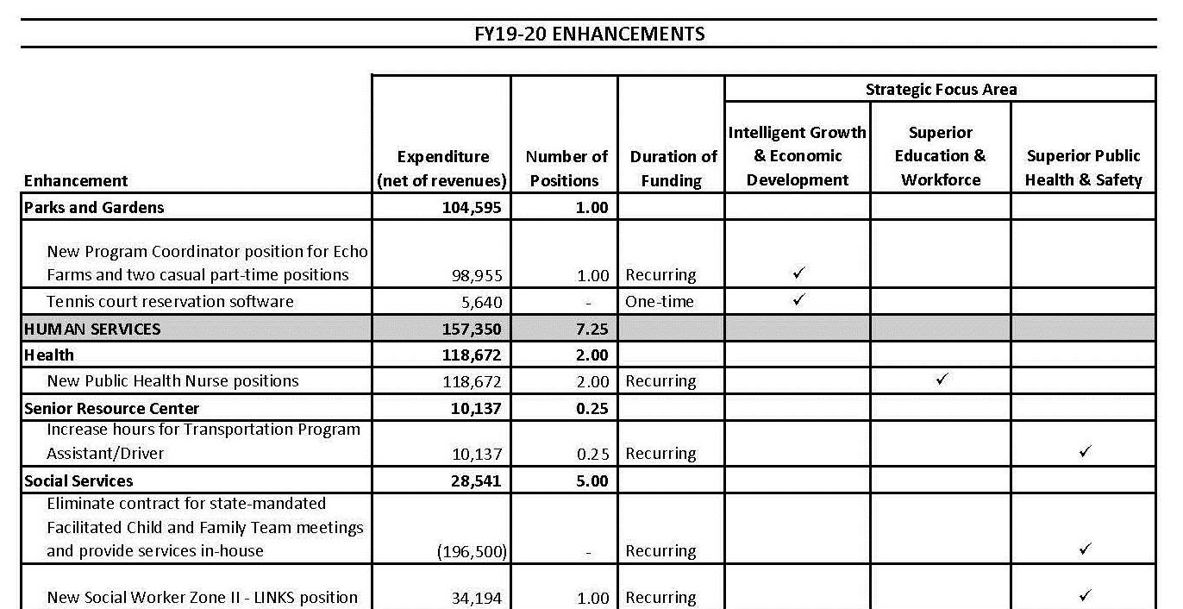
New Hanover County, North Carolina

Slide 31
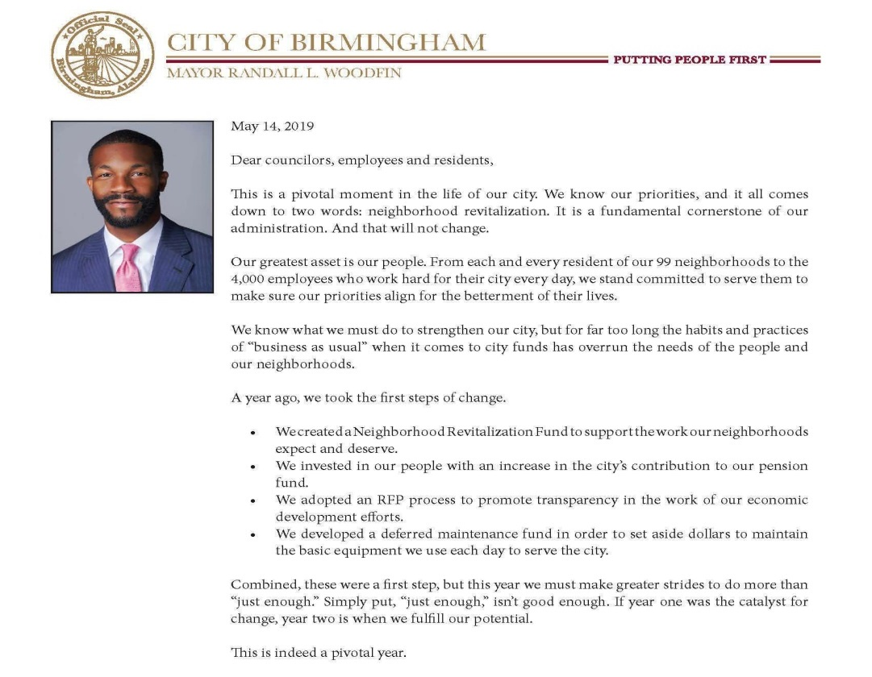
City of Birmingham, Alabama

Slide 32

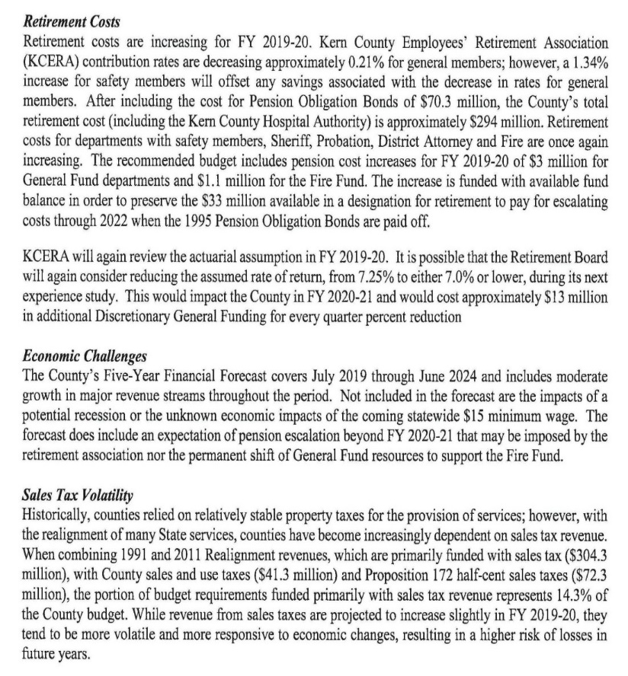
Kern County, California

Slide 33
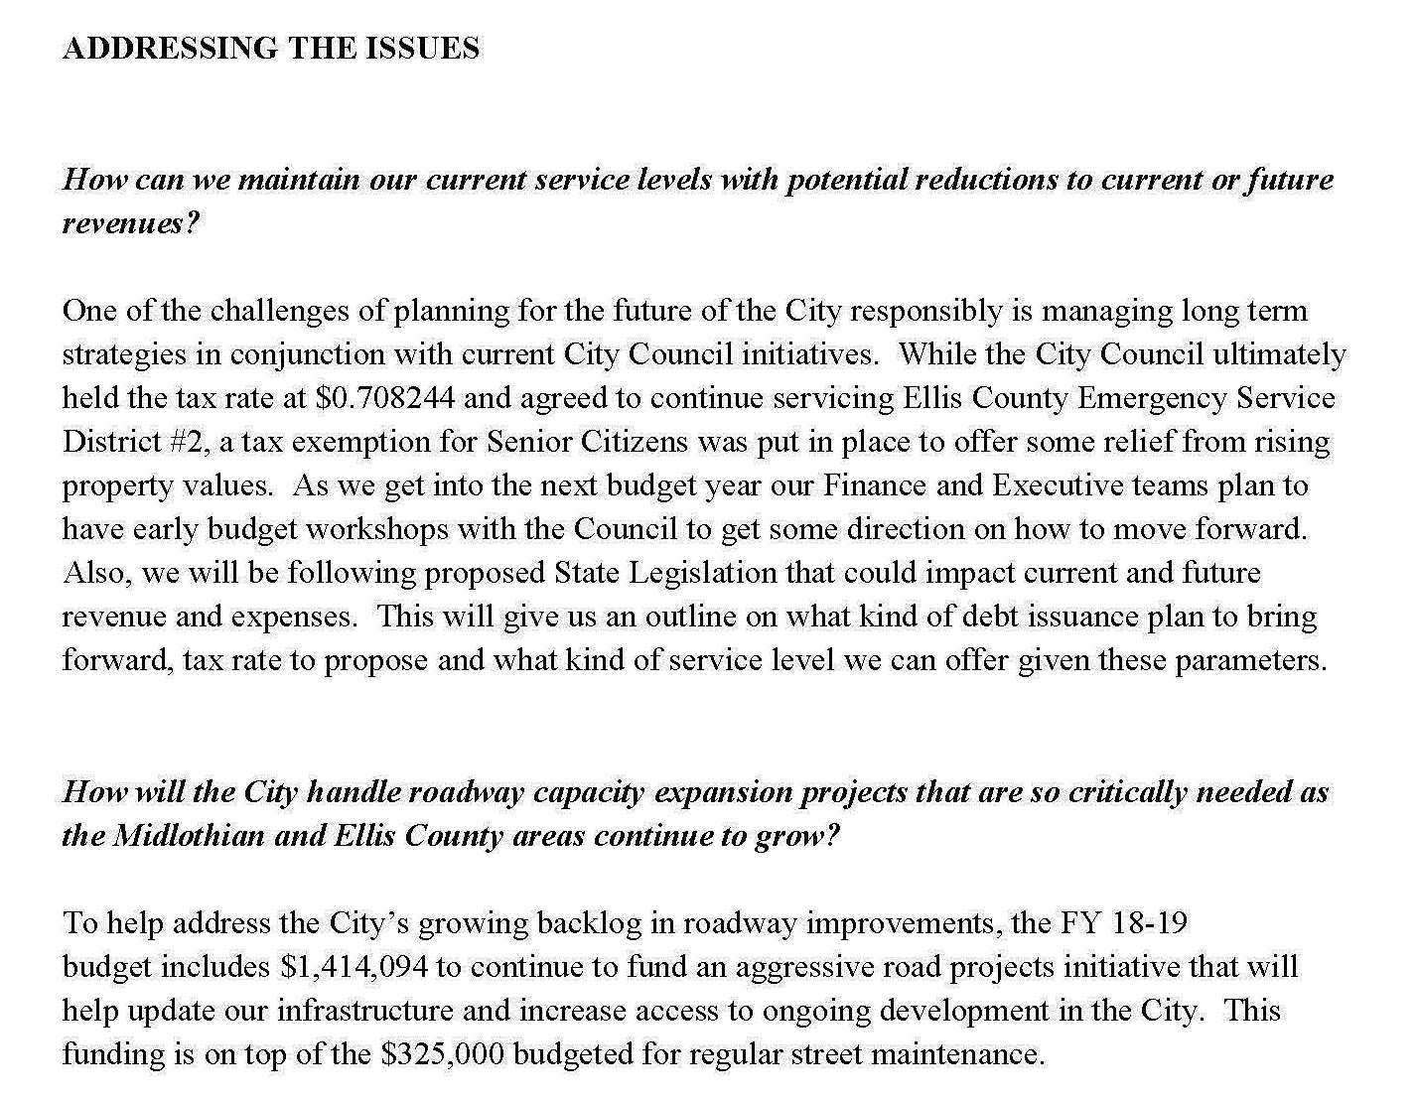
City of Midlothian, Texas

Slide 34
Budget Overview
#C2. Mandatory: An overview of significant budgetary items and trend should be provided. The overview should be presented within the budget as a separate section (e.g., budget-in brief) or integrated within the transmittal letter.
Is an overview contained in the budget message/transmittal letter, executive summary, or in a separate budget-in-brief?
Is summary information on significant budgetary items conveyed in an easy to consume format?
Is summary information on budgetary trends provided?
Is a summary of changes presented between the proposed to adopted budget?
34

Slide 35
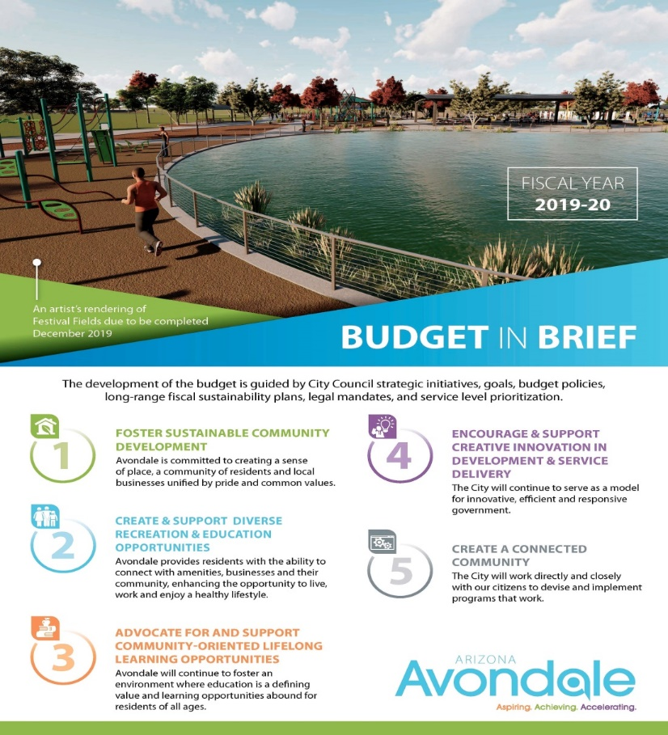
City of Avondale, Arizona

Slide 36
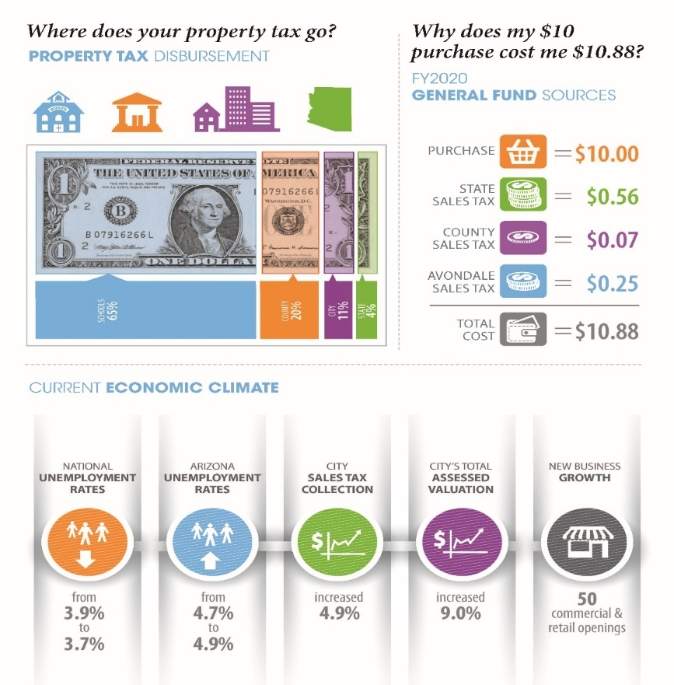
Schools County City State
City of Avondale, Arizona

Slide 37
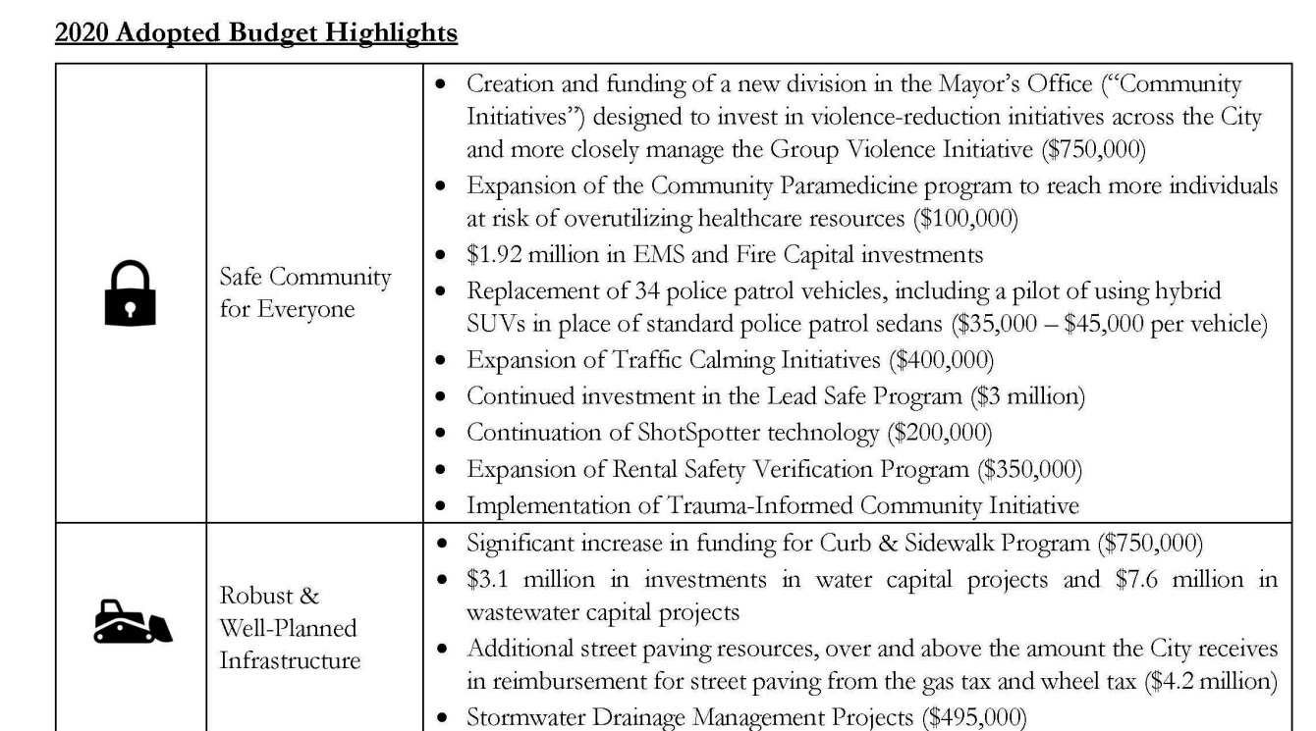
City of South Bend, Indiana

Slide 38
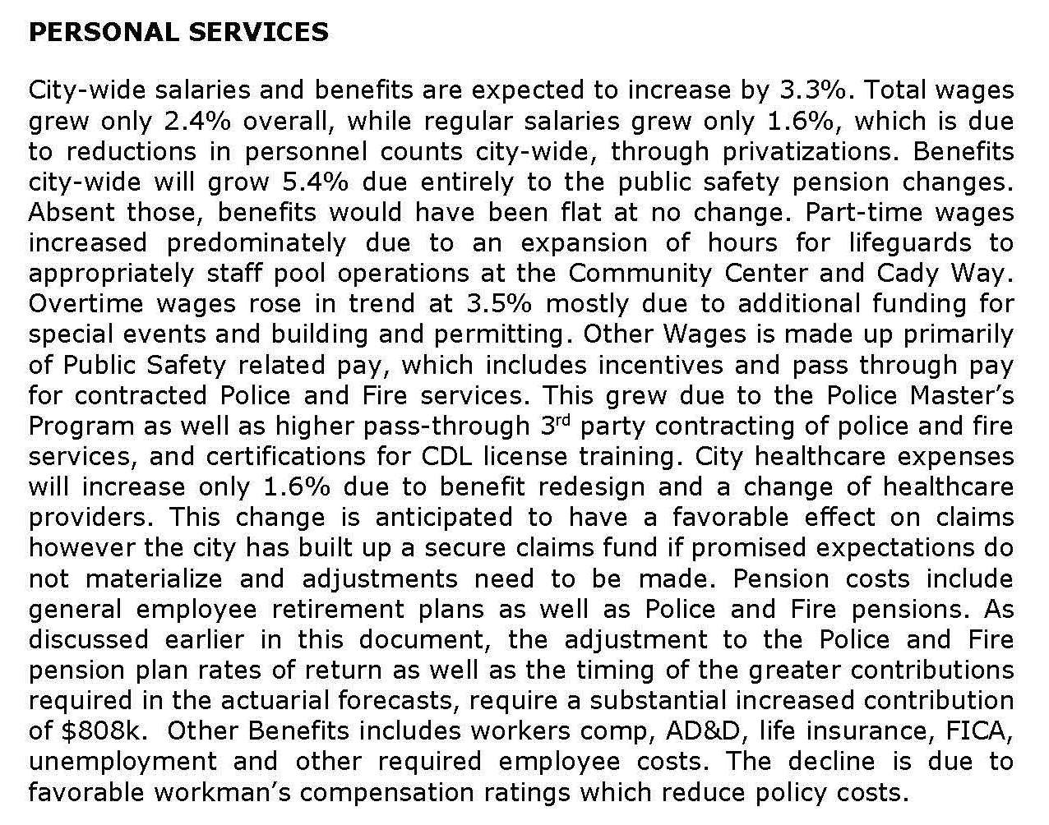
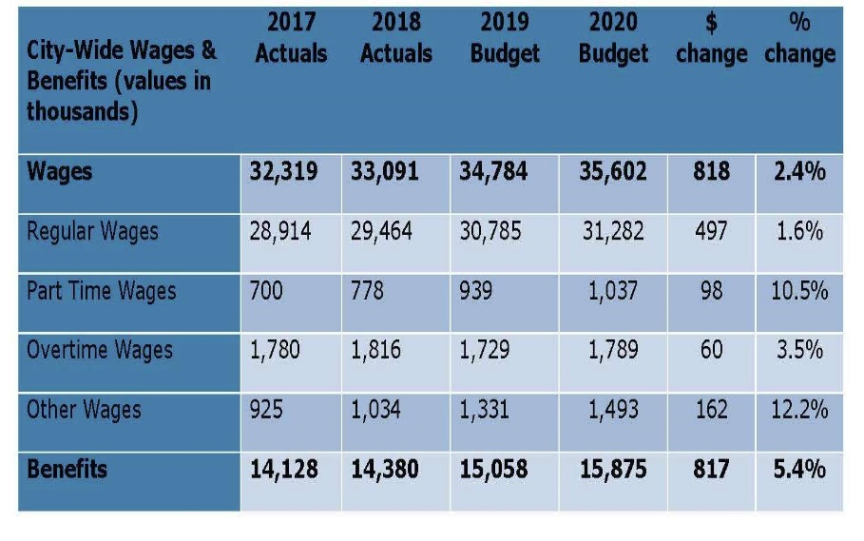
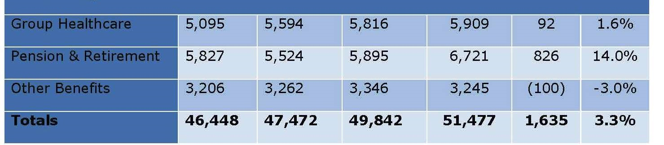
City of Winter Park, Florida

Slide 39
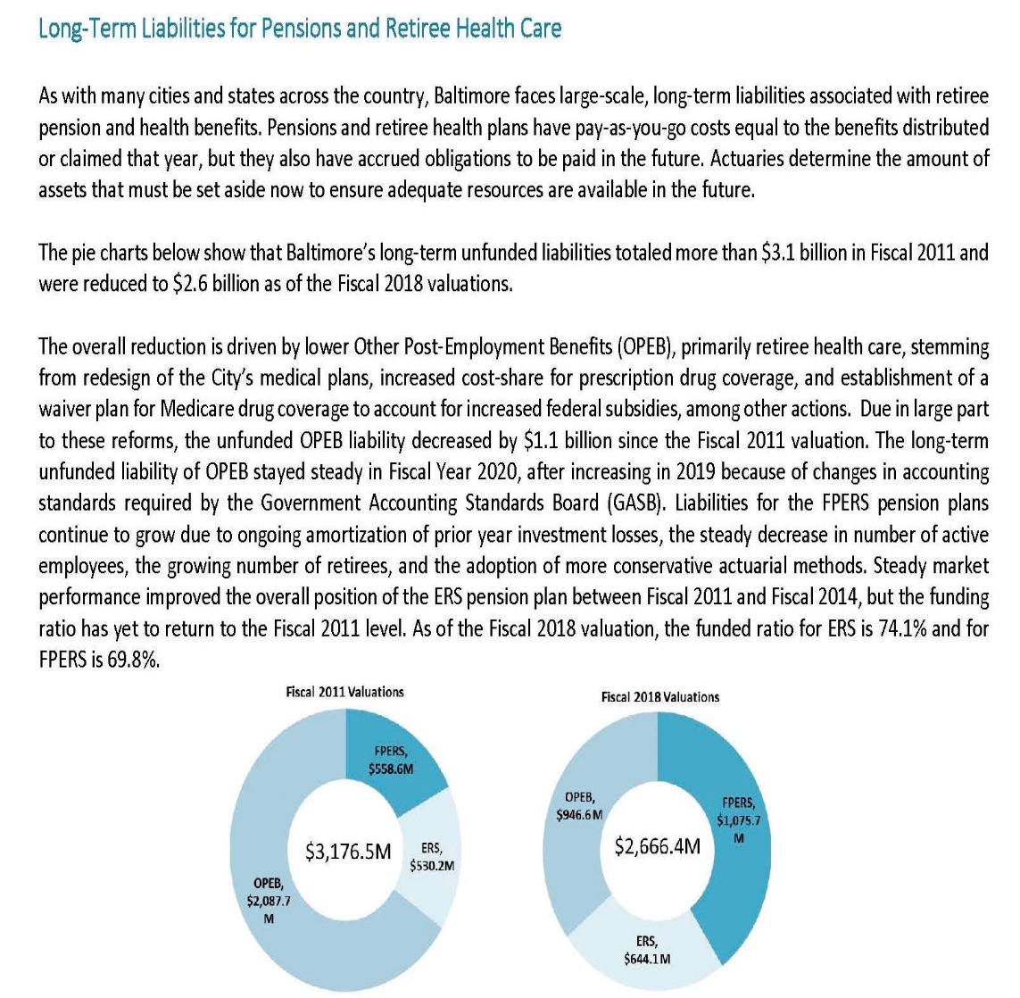
OPEB = Other Post Employment Benefits
FPERS = Fire and Police Employees’ Retirement System
ERS = Employee Retirement System for Civilian Employees
Unfunded Pension and OPEB Liabilities have shrunk by $510 million
City of Baltimore, Maryland

Slide 40
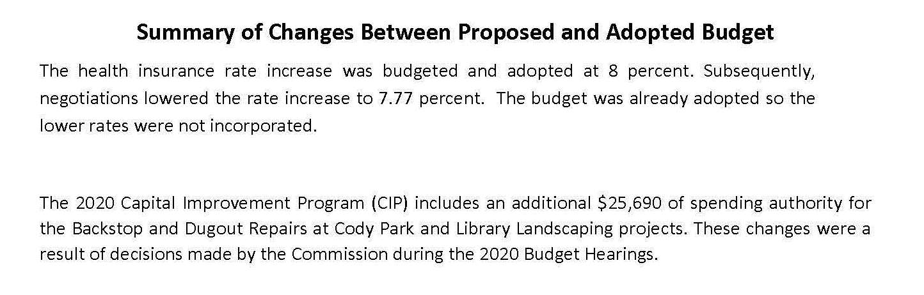
City of Leavenworth, Kansas

Slide 41
Organization Chart
#O1. Mandatory: Provide an organization chart for the entire entity.
Is a legible organization chart provided which shows the entire entity?

Slide 42
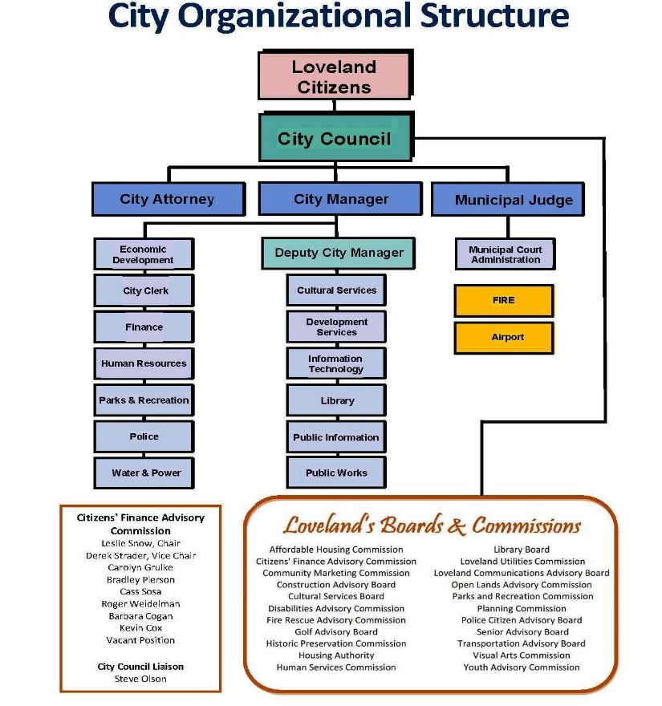
City of Loveland, Colorado

Slide 43
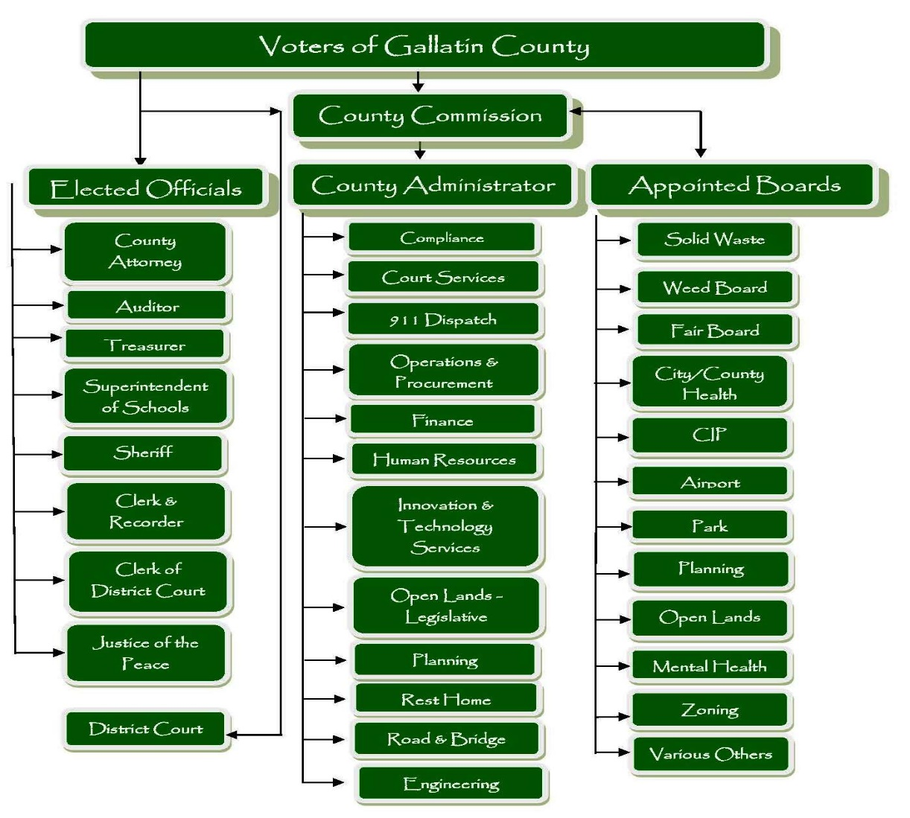
Gallatin County, Montana

Slide 44
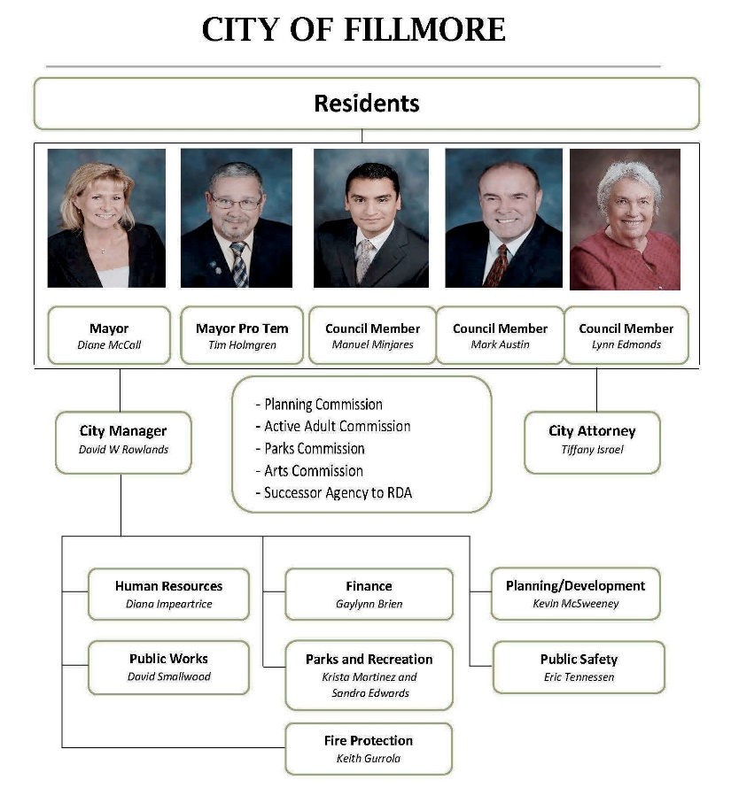
City of Fillmore, California

Slide 45
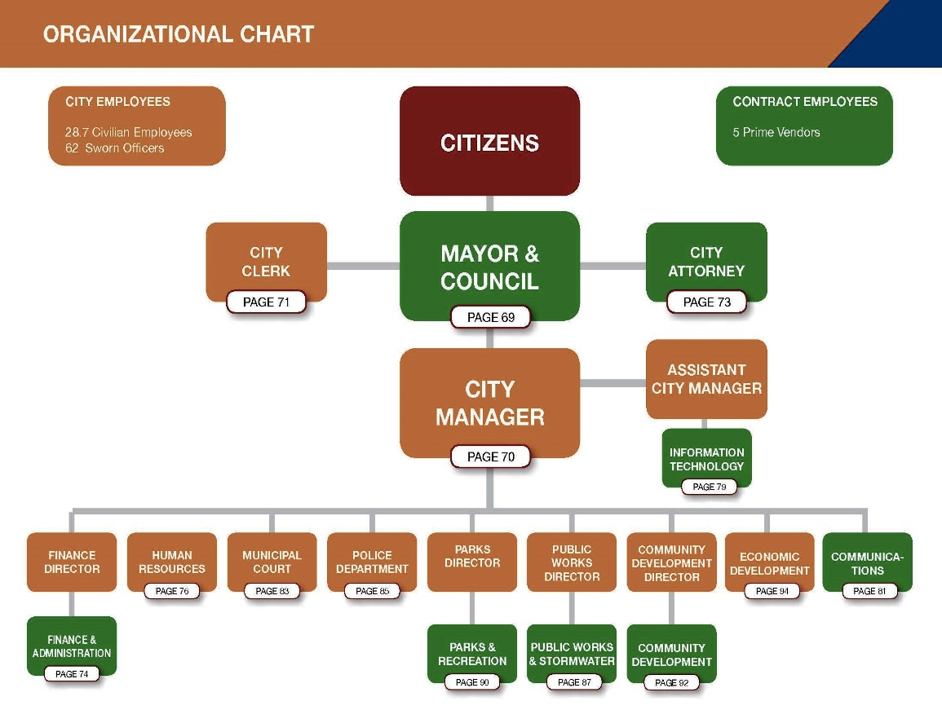
City of Dunwoody, Georgia

Slide 46
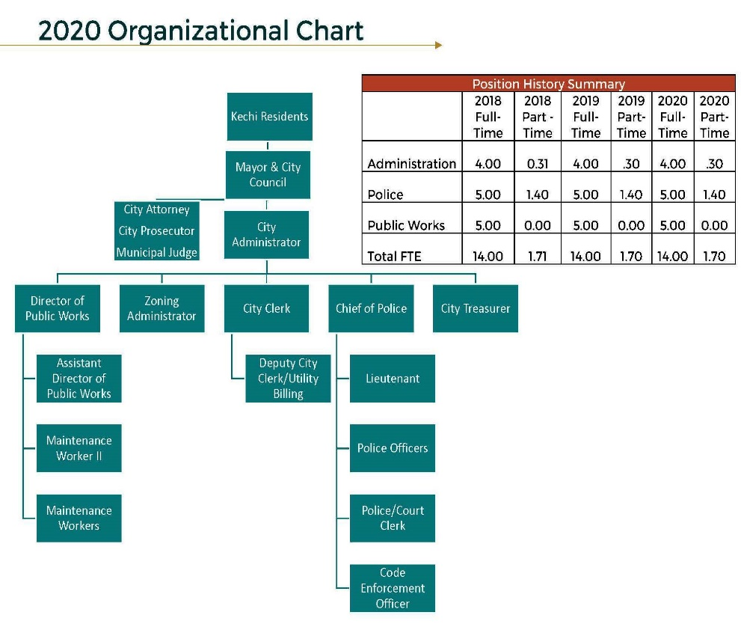
City of Kechi, Kansas

Slide 47
Fund Descriptions and Fund Structure
#F1. Describe all funds that are subject to appropriation.
Are a narrative and/or a graphic overview of the entity’s budgetary fund structure included in the document?
Do the materials indicate which funds are appropriated? (Other funds for which financial plans are prepared also may be included in the document.)
Is each individual major fund described?
If additional or fewer funds are included in the audited financial statements, is this indicated?
47

Slide 48
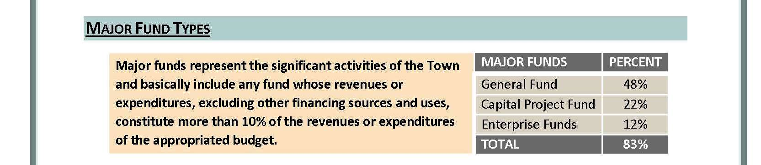
City of Kechi, Kansas

Slide 49
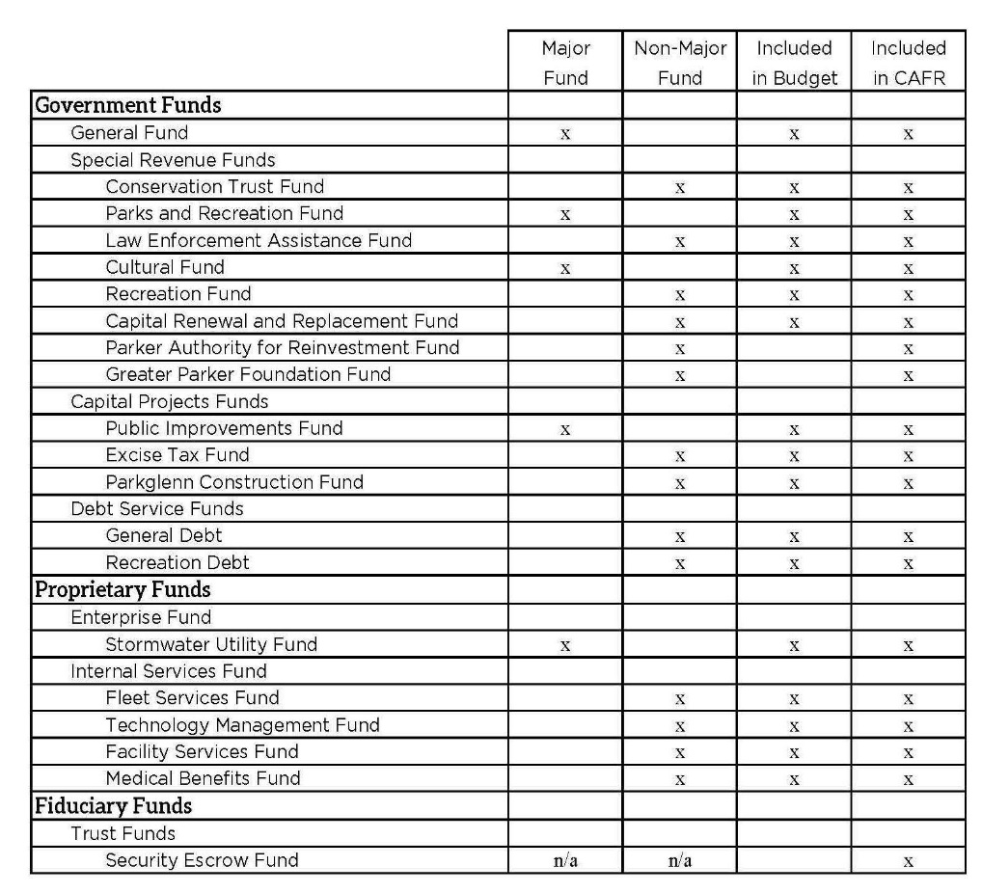
Town of Parker, Colorado

Slide 50
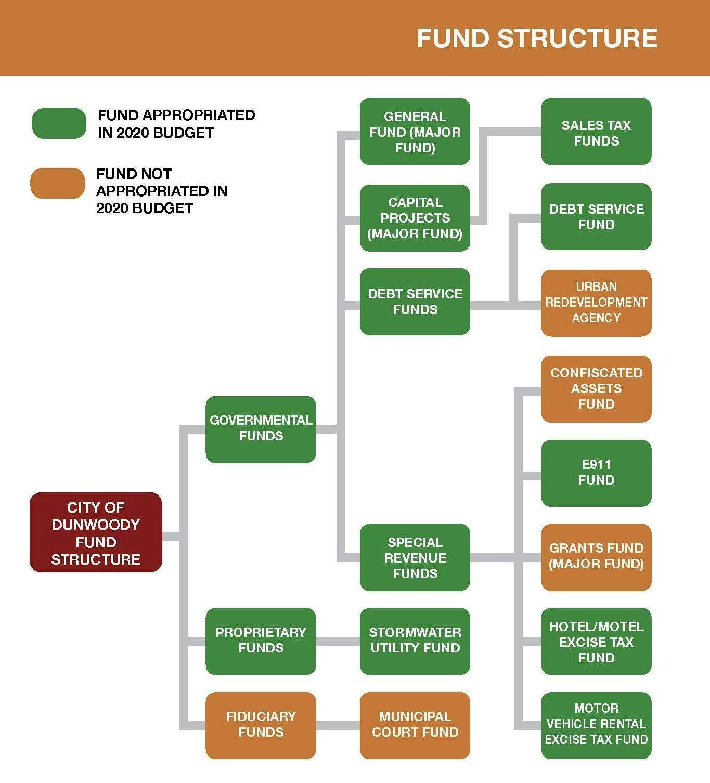
City of Dunwoody, Georgia

Slide 51
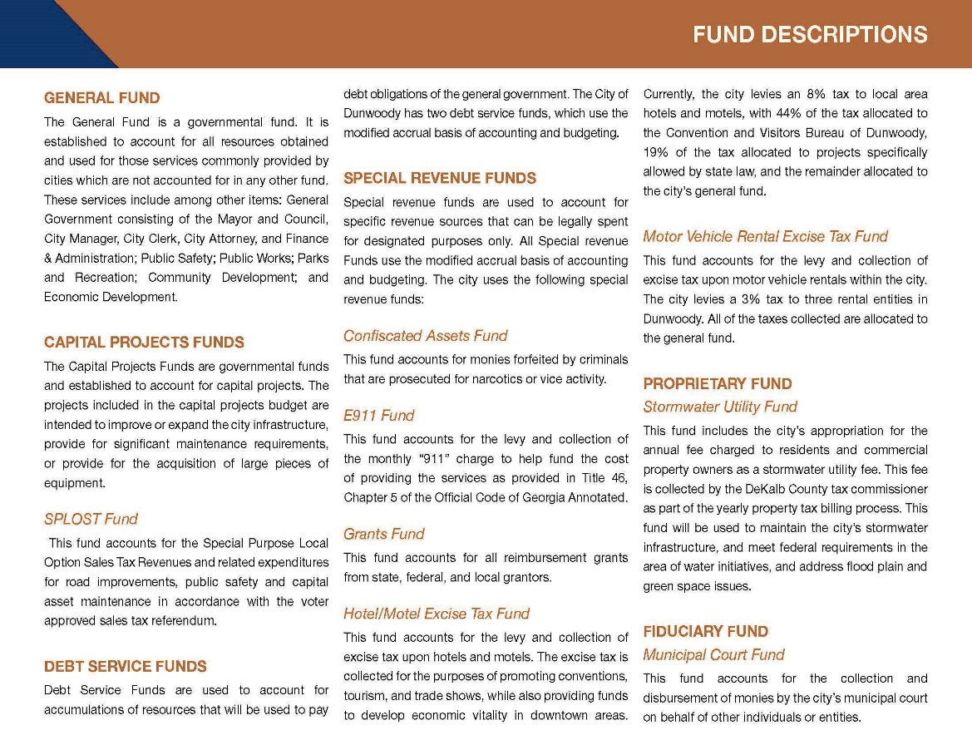
City of Dunwoody, Georgia

Slide 52
Department/Fund Relationship
#O2. Provide narrative, tables, schedules, or matrices to show the relationship between functional units, major funds, and nonmajor funds in the aggregate.
Is the relationship between the entity’s functional units, major funds, and nonmajor funds in the aggregate explained or illustrated?

Slide 53
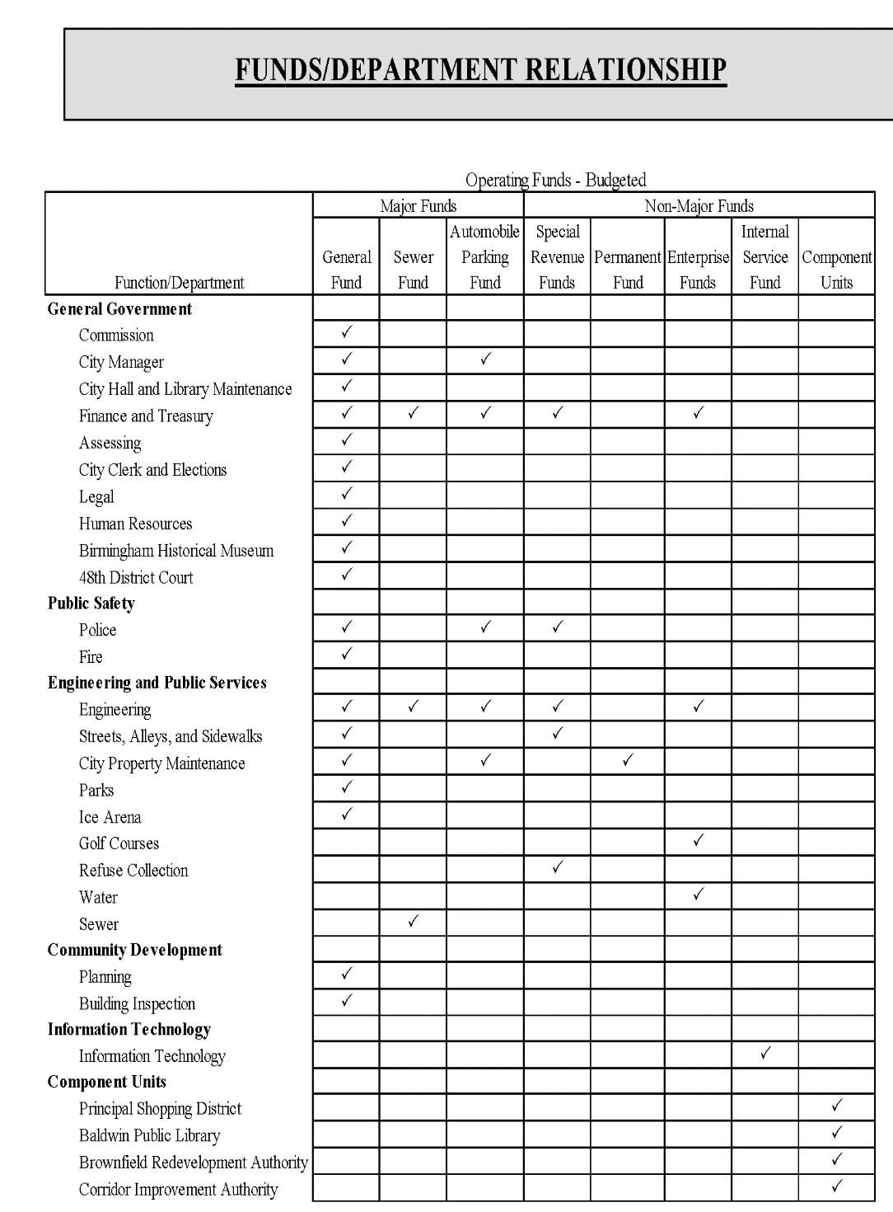
City of Birmingham, Michigan

Slide 54
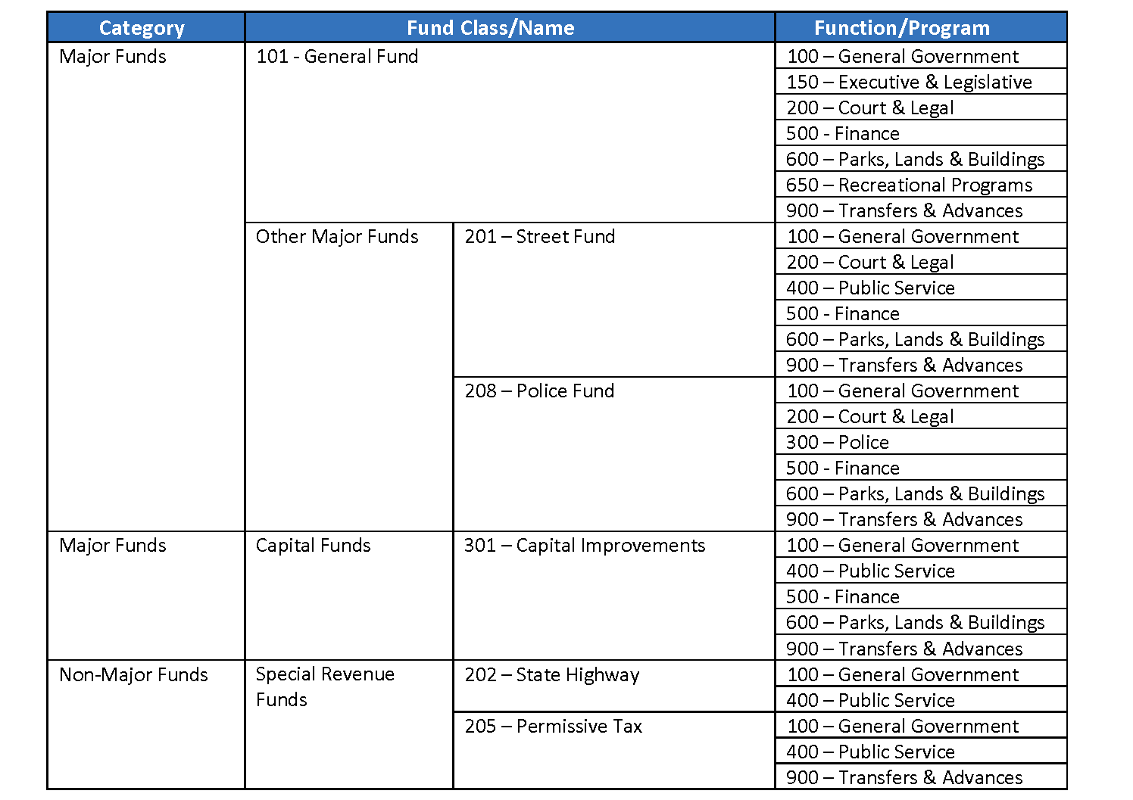
City of Pataskala, Ohio

Slide 55
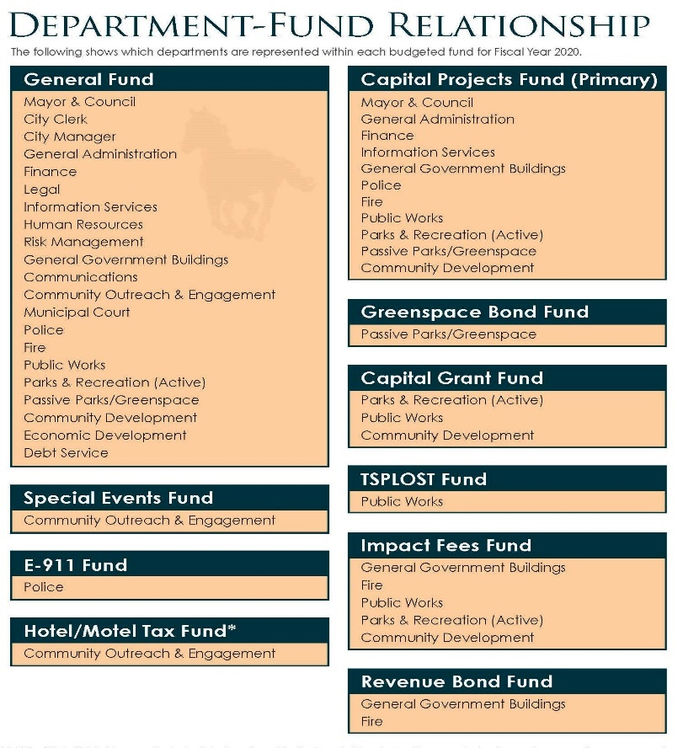
City of Milton, Georgia

Slide 56
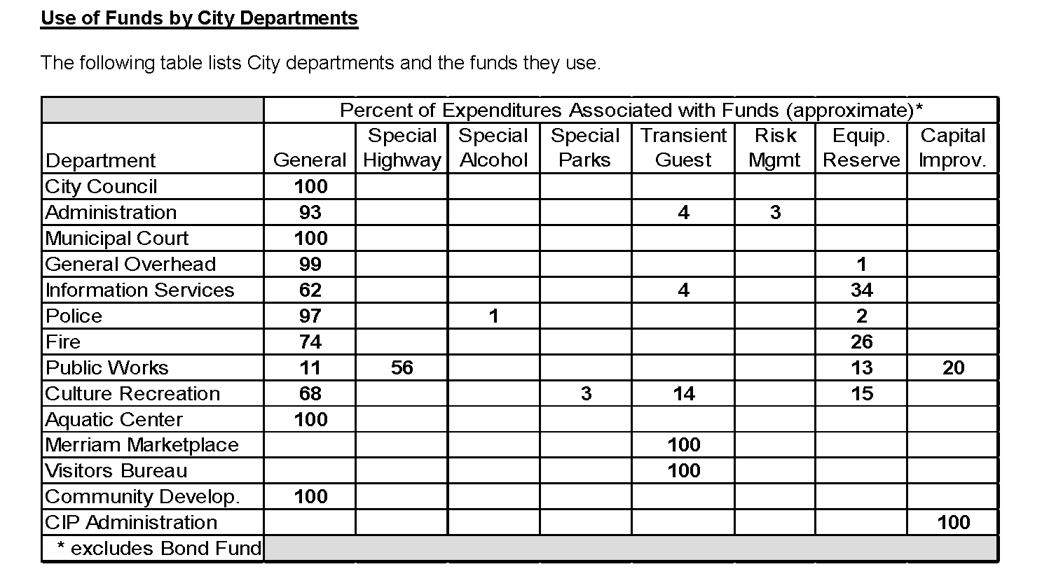
City of Merriam, Kansas

Slide 57
Basis of Budgeting
#F2. Explain the basis of budgeting for all funds, whether cash, modified accrual, or some other statutory basis.
Is the basis of budgeting defined (eg. modified accrual, cash, or accrual) for all funds?
If the basis of budgeting is the same as the basis of accounting used in the entity’s audited financial statements, is that fact clearly stated?
If the basis of budgeting is not the same as the basis of accounting used in the entity’s audited financial statements, are the differences described?
57

Slide 58
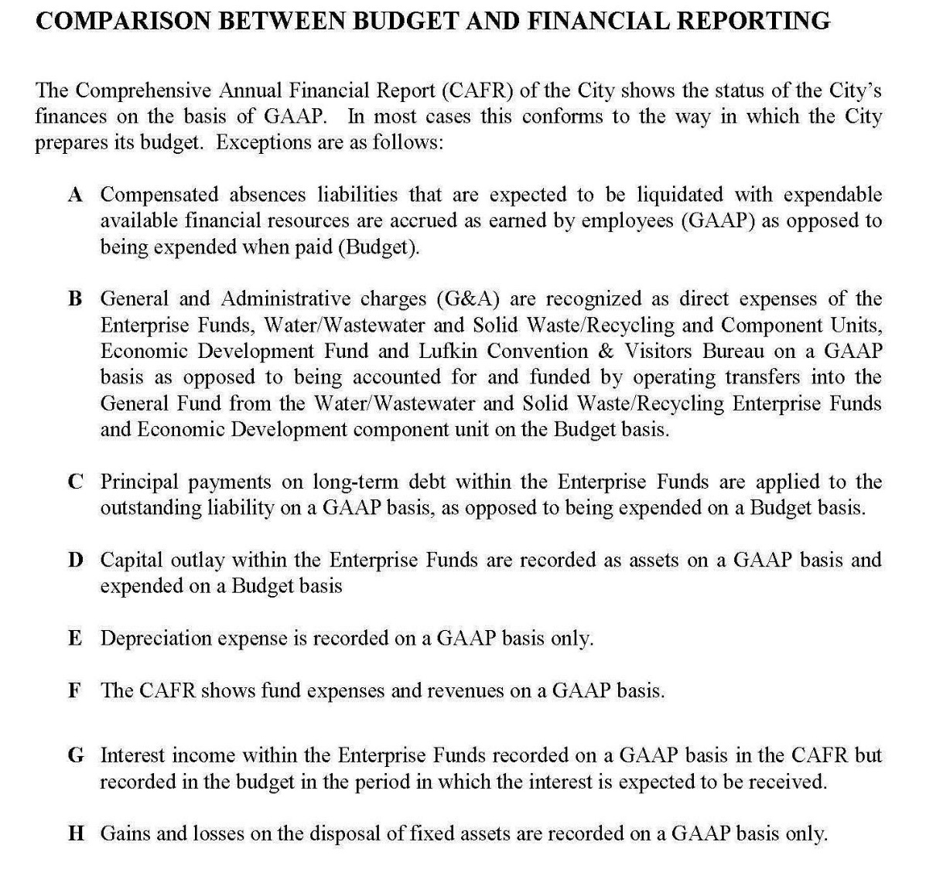
City of Lufkin, Texas

Slide 59
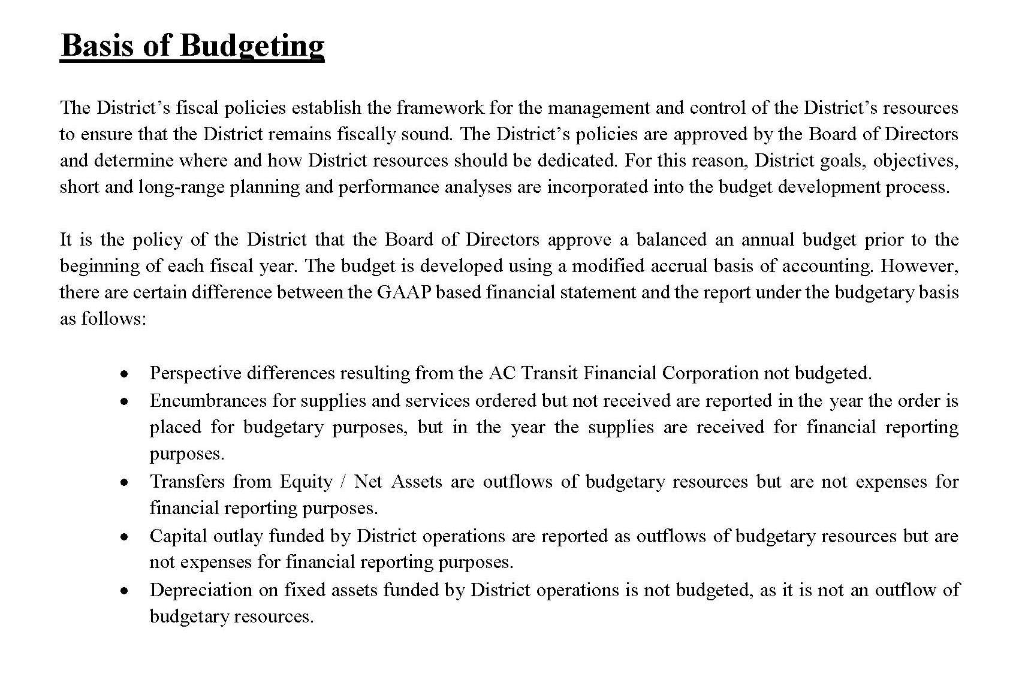
Alameda- Contra Costa Transit District, California

Slide 60
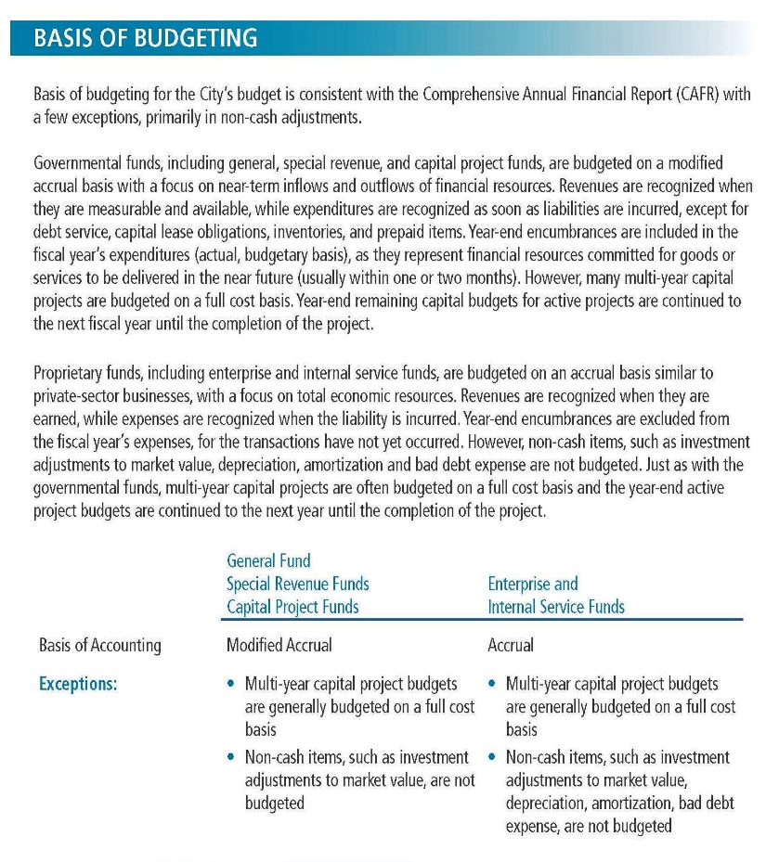
City of Santa Monica, California

Slide 61
Financial Policies
#P3. Mandatory: Include a coherent statement of entity-wide long-term financial policies.
Is there a summary of financial policies?
Do the financial policies include the entity’s definition of a balanced budget?
Does the budget comply with relevant financial policies?

Slide 62

Basic Financial Policy Categories
General fund reserves
Reserves in other funds
Grants
Debt
Investment
Economic development
Accounting and financial reporting
Risk management and internal controls
Procurement
Long-term financial planning
Structurally balanced budget
Capital
Revenues
Expenditures
Operating budget
62
Notes:
62
62
62

Slide 63
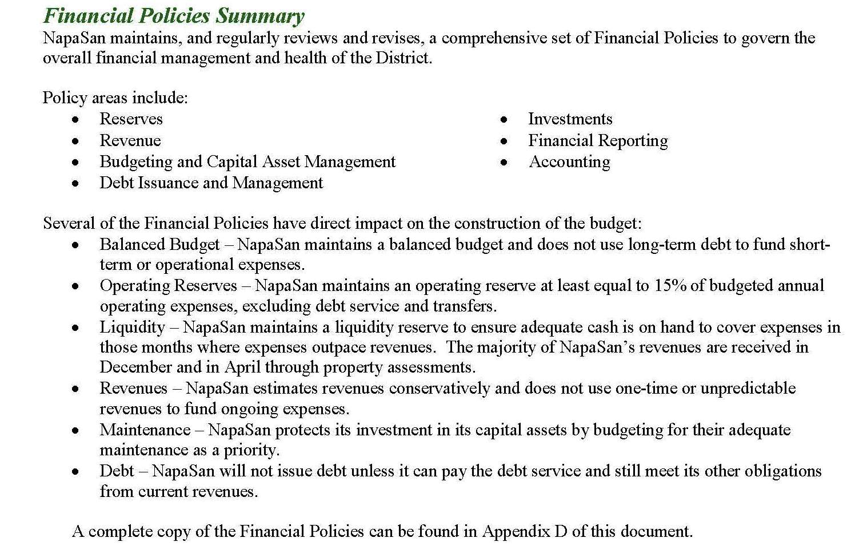
63
NAPA Sanitation District, California

Slide 64
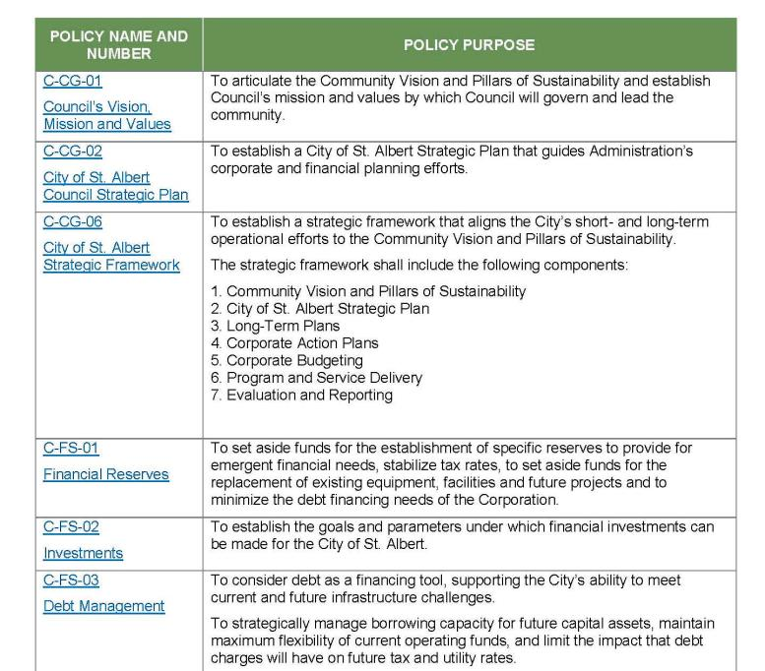
64
City of St. Albert, Alberta

Slide 65
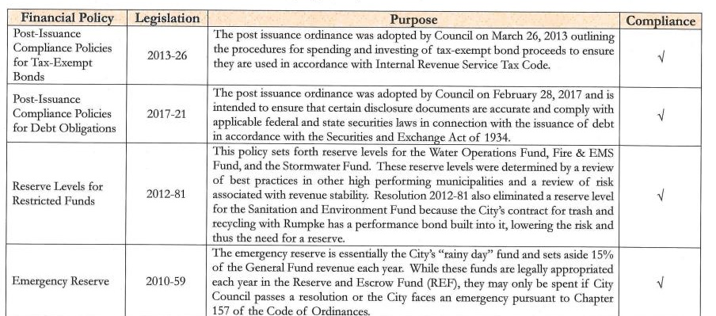
65
City of Loveland, Ohio

Slide 66
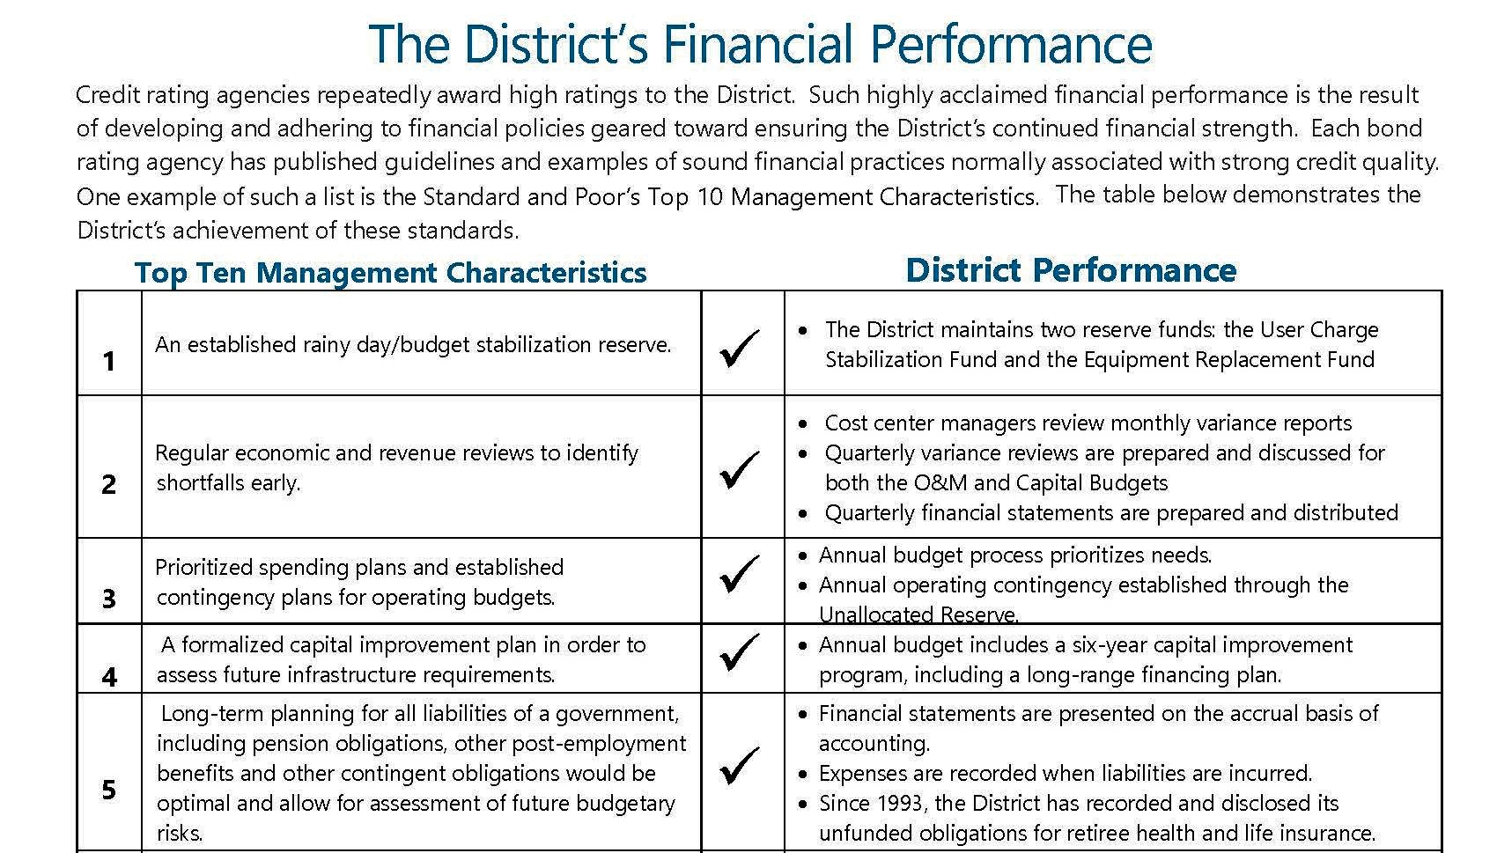
66
Milwaukee Metropolitan Sewerage District, Wisconsin

Slide 67
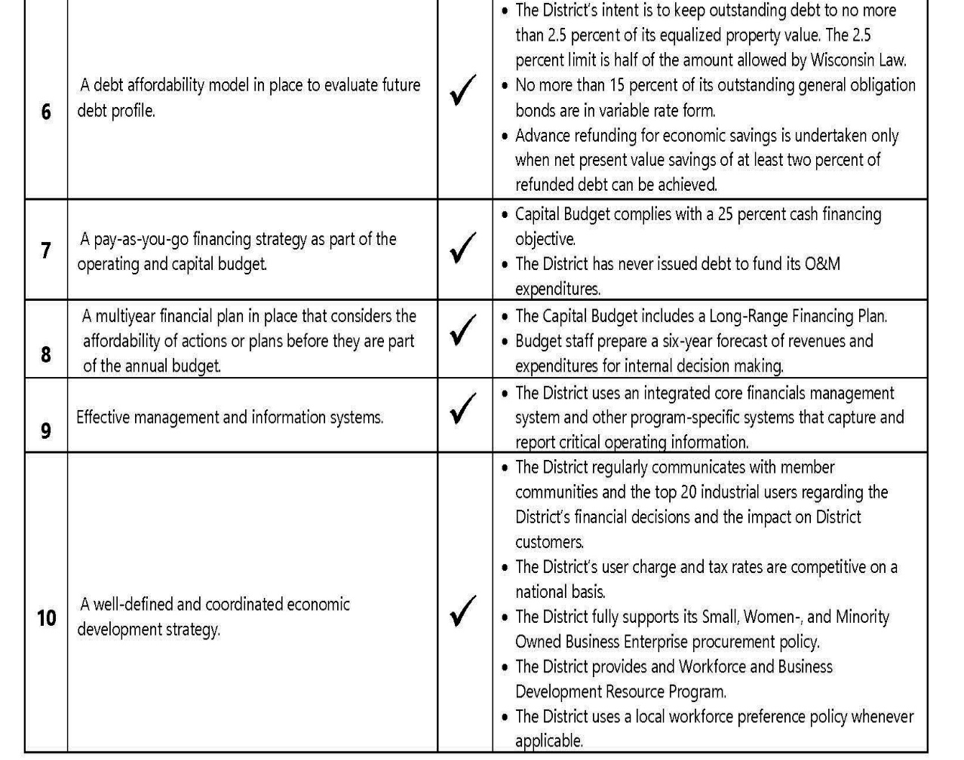
67
Milwaukee Metropolitan Sewerage District, Wisconsin

Slide 68
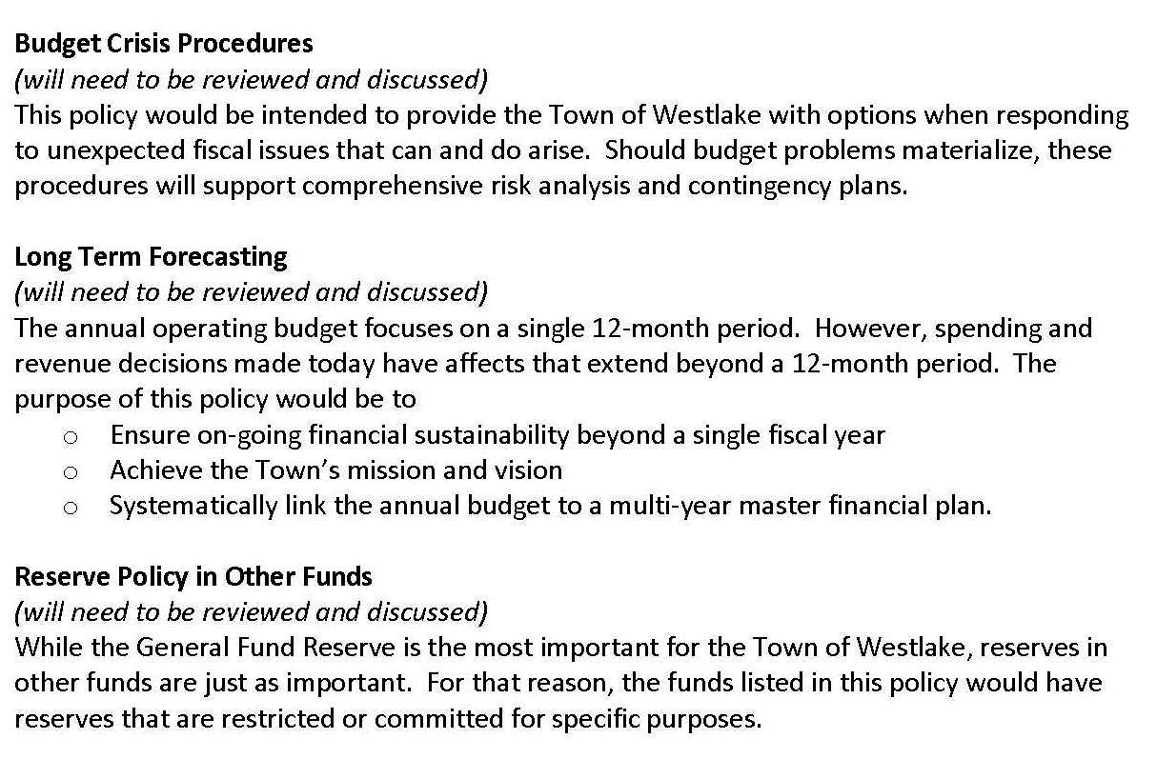
Financial Policies to be Reviewed
68
Town of Westlake, Texas

Slide 69

City of Dunwoody, Georgia

Slide 70


70
City of Friendswood, Texas

Slide 71


71
City of Bloomington, Minnesota
Notes:
71
71

Slide 72
Budget Process
#P4. Mandatory: The document shall describe the process for preparing, reviewing, and adopting the budget for the coming fiscal year. It also should describe the procedures for amending the budget after adoption.
Is a description of the process (including amendments) used to develop, review, and adopt the budget included?
Is a budget calendar provided to supplement (not replace) the narrative information on the budget process?
Is there a discussion of how the public is involved in the budget process?
72

Slide 73

City of Highland Park, Illinois

Slide 74


74
City of Parkland, Florida

Slide 75

City of Bellevue, Washington

Slide 76

City of Coconut Creek, Florida

Slide 77


77
City of Davenport, Iowa

Slide 78

78
City of Davenport, Iowa

Slide 79

Township of Upper St. Clair, Pennsylvania

Slide 80

City of Leduc, Alberta

Slide 81

Gloucester County, Virginia

Slide 82


City of Huntsville, Texas

Slide 83
Consolidated Financial Schedule
#F3. Mandatory: Present a summary of major revenues and expenditures, as well as other financing sources and uses, to provide an overview of the total resources budgeted by the organization.
1. Is an overview of revenues and other financing sources and expenditures and other financing uses of all appropriated funds included?
2. Are revenues and other financing sources and expenditures and other financing uses presented either (1) together in a single schedule or (2) in separate but adjacent/sequential schedules or (3) in a matrix?
3. Are revenues presented by major type in this schedule (e.g., property taxes, intergovernmental, sales taxes, fees and charges)?
4. Are expenditures presented by function, program, or spending component in this schedule?
83

Slide 84

Town of Parker, Colorado

Slide 85

85
Metropolitan St. Louis Sewer District, Missouri

Slide 86

City of Granbury, Texas

Slide 87

87
Clerk & Comptroller, Palm Beach County, Florida

Slide 88
REVENUE BUDGET
The FY21 Adopted Budget is supported by $3.61 billion in total revenue, an increase of $119 million, or 3.4%, from budgeted FY20 total revenue. The FY21 adopted budget includes $3.57 billion in recurring revenue and $40.0 million in non-recurring revenue. The City’s recurring revenue budget can be divided into three categories: Property Tax (73% of total recurring revenue), State Aid (13%) and Other Local Receipts (including excise taxes, fines, etc.; 14%)
City of Boston, Massachusetts

Slide 89
Three Year Consolidated and Fund Financial Schedules
#F4. Include summaries of revenues and other financing sources, and of expenditures and other financing uses for the prior year actual, the current year budget and/or estimated current year actual, and the proposed budget year.
Are revenues and other financing sources and expenditures and other financing uses for the prior year, the current year, and the budget year presented together on the same schedule(s) or on schedules presented on adjacent/sequential pages? Is this information presented for the appropriated funds in total?
Is this information also presented at a minimum for each major fund and for other (i.e. nonmajor) funds in the aggregate (or for each significant fund and other funds in the aggregate if no appropriated funds are included)?
Are revenues presented by major type in this schedule (e.g., property taxes, intergovernmental, sales taxes, fees and charges)?
Are expenditures presented by function, program, or spending component in this schedule?
89

Slide 90


City of Granbury, Texas

Slide 91

Metropolitan St. Louis Sewer District, Missouri

Slide 92

City of Mansfield, Texas

Slide 93

City of Mansfield, Texas

Slide 94

Village of Westmont, Illinois

Slide 95
Fund Balance
#F5. Mandatory: Include projected changes in fund balance/net position for appropriated funds included in the budget presentation.
Is the entity’s definition of fund balance (net position if no governmental funds) included?
Is the fund balance /net position information presented for the budget year?
Is there a schedule showing (1) beginning fund balances, (2) increases or decreases in total fund balances, and (3) ending fund balances for appropriated governmental funds?
Is this information presented at a minimum for each major fund and for nonmajor governmental funds in the aggregate?
If fund balances of any major fund or the nonmajor funds in the aggregate are anticipated to increase or decline by more than 10%, does the document include a discussion of the causes and/or consequences of these changes in fund balance?
If an entity has no governmental funds, is the change in net position presented for (1) the entity as a whole, (2) the main operating fund, and (3) each significant fund?
If an entity has no governmental funds and the net position is anticipated to change by more than 10%, do the materials include a discussion of the causes and/or consequences of those changes?
95

Slide 96
Within governmental funds, equity is reported as fund balance; proprietary and fiduciary fund equity is reported as net position. Fund balance and net position are the difference between fund assets plus deferred outflows of resources and liabilities plus deferred inflows of resources reflected on the balance sheet or statement of net position.
96

Slide 97

Village of Roselle, Illinois

Slide 98

City of Kirksville, Missouri

Slide 99

City of Kirksville, Missouri

Slide 100

Town of Superior, Colorado

Slide 101
Revenues
#F6. Mandatory: Describe major revenue sources, explain the underlying assumptions for the revenue estimates, and discuss significant revenue trends.
Are individual revenue sources described?
Do the revenue sources that are described represent at least 75 percent of the total revenues of all appropriated funds?
Are the methods used to estimate revenues for the budget year described (e.g., trend analysis, estimates from another government or consulting firm)?
If revenues are projected based on trend information, are both those trends and the underlying assumptions adequately described?
101

Slide 102

102

Slide 103
Federal aid amounts to some 5% of total municipal revenue, while state aid is 20% to 25%. In other words, a city’s tax structure accounts for 70% to 75% of what it can spend to meet the health, safety, and welfare needs of its residents and visitors.
A city that generates the majority of its revenue from sales or income taxes will be hit hard and immediately when it experiences such consumer declines and job losses.
A city that relies on property taxes, however, will not experience such an immediate collapse in its revenues. Local assessment practices require that cities wait to estimate the value of land and property until the property is exchanged on the market or an assessment is conducted. Current property tax bills, therefore, typically reflect values of the property anywhere from 18 months to several years prior to collection. Property tax collection is less responsive, or “elastic,” in the short term—but over time, as rising unemployment dampens real-estate demand, even these property-tax-dependent cities will feel COVID-19’s impact.
In addition to taxes, approximately one-third of city-sourced revenues are derived from fees and charges for services such as trash collection and water. Although COVID-19 will adversely affect some fee-driven services (think transit and parking) because demand is reduced, it will affect other services (water, sewer, etc.) less severely, as residents remain in place and continue to use them. Source: Metropolitan Policy Program At Brookings Institute
103

Slide 104

City of Highland Park, Illinois

Slide 105

City of South Padre Island, Texas

Slide 106


106
South Padre Island, Texas

Slide 107

Town of Parker, Colorado

Slide 108

El Paso County, Texas

Slide 109


Village of Roselle, Illinois

Slide 110
Long-range Operating Financial Plans
#F7. Explain long-range operating financial plans and its effect upon the budget and the budget process.
Do your long-range financial plans for major funds (beyond just the General Fund) extend out at least two years beyond the budget year?
Are the assumptions used in the long-range operating financial plans identified?
Is there a concise explanation of the significance of the long-range operating financial plans in its relation to achieving strategic goals?

Slide 111

City of Lufkin, Texas

Slide 112

City of Sugar Land, Texas

Slide 113

Napa Sanitation District, California

Slide 114

City of Upland, California

Slide 115

115
City and County of Denver, Colorado

Slide 116


116
Capital Metropolitan Transportation Authority, Texas

Slide 117

City of Santa Rosa, California

Slide 118

City of Santa Rosa, California

Slide 119


City of Boca Raton, Florida

Slide 120


City of Westminster, California

Slide 121
Capital Program
#F8. Mandatory: Include budgeted capital expenditures, whether authorized in the operating budget or in a separate capital budget.
Are “capital expenditures” defined?
Do the materials indicate the total dollar amount (for both sources and uses) of the capital program for the budget year(s) and/or multiyear capital plan?
Are significant nonrecurring capital expenditures described along with dollar amounts?
What is the process to identify funded projects?
121

Slide 122

City of Alameda, California

Slide 123


El Paso County, Texas

Slide 124

State of North Dakota

Slide 125

State of North Dakota

Slide 126
Priority I: IMPERATIVE (Must-Do) – Projects that cannot reasonably be postponed in order to avoid harmful or otherwise undesirable consequences.
A. Corrects a condition dangerous to public health or safety
B. Satisfies a legal obligation
C. Alleviates an emergency service disruption or deficiency
D. Prevents irreparable damage to a valuable public facility.
Priority II: ESSENTIAL (Should-Do) – Projects that address clearly demonstrated needs or objectives.
A. Rehabilitates or replaces an obsolete public facility or attachment
B. Stimulates economic growth and private capital investment
C. Reduces future operating and maintenance costs
D. Leverages available state or federal funding.
Priority III: IMPORTANT (Could-Do) – Projects that benefit the community but may be delayed without detrimental effects to basic services.
A. Provides a new or expanded level of service
B. Promotes intergovernmental cooperation
C. Reduces energy consumption
D. Enhances cultural or natural resources.
Priority IV: DESIRABLE (Other Year) – Desirable projects that are not included within five-year program because of funding limitations.
126
Town of Windsor, Colorado

Slide 127

City of Alameda, California

Slide 128


City of East Point, Georgia

Slide 129

129
City of Portsmouth, New Hampshire

Slide 130



130
New Hanover County, North Carolina

Slide 131

131
City of Lakeland, Florida

Slide 132
Debt
#F9. Mandatory: Include financial data on current debt obligations, describe the relationship between current debt levels and legal debt limits, and explain the effects of existing debt levels on current operations.
Are debt limits and coverage requirements described and calculated?
Is the amount of principal and interest payments presented through maturity for each fund?
Are bond ratings shown?
Is the purpose of the different debt obligations included?

Slide 133

Santaquin City, Utah

Slide 134

City of Dunwoody, Georgia

Slide 135



City of Melissa, Texas

Slide 136

Flagler County, Florida

Slide 137

Village of Howard, Wisconsin

Slide 138

St. Louis County, Missouri

Slide 139


City of Andover, Minnesota

Slide 140
Position Summary Schedule
#O3. Mandatory: A schedule or summary table of personnel or position counts for prior, current and budgeted years shall be provided.
Is a summary table of position counts provided for the entire entity?
Does the table include the prior year, the current year, and budget year position counts?
Are changes in staffing levels for the budget year explained?

Slide 141

City of Rye, New York

Slide 142

City of Anchorage, Alaska

Slide 143



City of Davenport, Iowa

Slide 144

City of Melissa, Texas

Slide 145

Collier County, Florida

Slide 146

City of Maryville, Missouri

Slide 147
Departmental/Program Descriptions
#O4. Mandatory: Include departmental/program descriptions.
Are organizational units clearly presented (e.g., divisions, departments, offices, agencies, or programs)?
Are descriptions provided along with major priorities in each organizational program?

Slide 148
Department Presentation in the Operating Budget Document
Design. Enhances clarity, consistency, graphics
Brevity. Especially in financial schedules, text
Services. A description of services or functional responsibilities must be included.
Issues. Challenges, issues, opportunities
Revenues. May include any fees or charges that the department generates
Expenditures. Analysis in a broad manner
148
Notes:
148
148
148

Slide 149


City of Olympia, Washington

Slide 150


City of Sanibel, Florida

Slide 151

City of Alameda, California

Slide 152


El Paso County, Colorado

Slide 153


City of Cedar Rapids, Iowa

Slide 154
Departmental/Program Goals and Objectives
#O5. Include clearly stated goals and objectives of the department or program.
Are departmental/program goals and objectives described?
Are departmental/program goals clearly linked to the strategic goals of the entity?
Are objectives quantifiable?
Are timeframes on objectives noted?

Slide 155

City of Milton, Georgia

Slide 156

City of Fayetteville, Georgia

Slide 157


City of Irving, Texas

Slide 158


City of Alameda, California

Slide 159



City of College Station, Texas

Slide 160


Village of Winnetka, Illinois

Slide 161
Performance Measures
#O6. Mandatory: Provide objective measures of progress toward accomplishing the government’s mission as well as goals and objectives for specific departments and programs.
Are performance data for individual departments or programs included in the document?
Are performance data directly related to the stated goals and objectives of the department or program?
Do performance measures focus on results and accomplishments (e.g., output measures, efficiency and effectiveness measures) rather than inputs (e.g., dollars spent)?
161

Slide 162


City of Hialeah, Florida

Slide 163

City of North Port, Florida

Slide 164

City of Anaheim, California

Slide 165

Town of Parker, Colorado

Slide 166


New Hanover County, North Carolina

Slide 167

City of San Luis Obispo, California

Slide 168

Chicago, IL Performance Metrics – Tracks information in eight areas. Easily scannable views with lots of customization options.
San Mateo County, CA SMC Performance – Provides dashboards in three broad areas: progress towards the county's broad 2025 vision goals, departmental goals, and progress on a specific voter-passed initiative.
Virginia Department of Transportation Dashboard – Although not a local municipality, this DOT dashboard takes the name fairly literally creating a visually interesting and easily readable dashboard for citizens.
Williamsburg, VA Performance Management – Nice tabbed view of performance metrics in eight key areas. Dashboard is customizable for each user.
168
Source: MRSC

Slide 169
Statistical/Supplemental Section
#C3. Include statistical and supplemental data that describe the organization, its community, and population. It should also furnish other pertinent background information related to the services provided.
Is statistical information that defines the community included (e.g., population, composition of population, land area, and average household income)?
Is supplemental information on the local economy included (e.g., major industries, top taxpayers, employment levels, and comparisons to other local communities)?
Is other pertinent information on the community (e.g., local history, location, public safety, education, culture, recreation, transportation, healthcare, utilities, and governmental structure) included?
169

Slide 170


Town of Bluffton, South Carolina

Slide 171

City of Cambridge, Massachusetts

Slide 172

City of Markham, Ontario

Slide 173


City of El Paso, Texas

Slide 174

Lethbridge County, Alberta

Slide 175

City of Baytown, Texas

Slide 176


City of Miramar, Florida

Slide 177
Glossary
#C4. A glossary should be included for any terminology (including abbreviations and acronyms) that is not readily understandable to a reasonably informed lay reader.
Is a glossary that defines technical terms related to finance and accounting, as well as non-financial terms related to the entity?
Are acronyms or abbreviations used in the document defined in the glossary?
Is the glossary written in non-technical language?

Slide 178

City of Martinez, California

Slide 179

Lethbridge County, Alberta

Slide 180

Santa Clara Valley Transportation Authority, California

Slide 181

Douglas County, Wisconsin

Slide 182

Puget Sound Regional Council, Washington

Slide 183
Charts and Graphs
#C5. Charts and graphs should be used, where appropriate, to highlight financial and statistical information. Narrative interpretation should be provided when the messages conveyed by the graphs are not self-evident.
Are charts and graphs used in the document to convey essential information (e.g., key policies, trends, choices and impacts)?
Are graphics explained?

Slide 184

Clerk & Comptroller Palm Beach County, Florida

Slide 185

St. Louis Metropolitan Sewer District, Missouri

Slide 186

City of Dunwoody, Georgia

Slide 187

City of Portland, Oregon

Slide 188

Coachella Valley Water District, California

Slide 189

City of Cambridge, Massachusetts

Slide 190
Understandability and Usability
#C6. The budget information should be produced and formatted in such a way as to enhance its understanding by the average reader. It should be attractive, consistent, and oriented to the reader's needs.
Are page formatting and font consistent?
Is the level of detail appropriate?
Are text, tables, and graphs legible and accurate?
Are links included to other forms of budget communication, like videos, social media, etc.?

Slide 191

City of Dunwoody, Georgia

Slide 192

City of Winter Park, Florida

Slide 193

Douglas County, Wisconsin

Slide 194

City of Milton, Georgia

