Slide 1

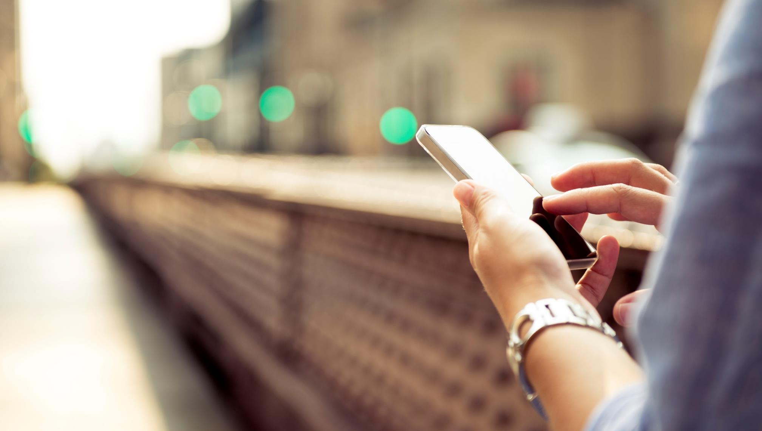

2020 GFOAz – February 13
The Newest Strategies & Advanced Technologies for Electronic Payment Acceptance
Christine Miles, Director of Sales
cmiles@paymentus.com
(540) 739-2054

Slide 2
MARKET TRENDS IMPACTING ONLINE BILL PAYING
How People Pay Their Bills Is Changing
Digitization
of Payments
Mass Adoption
of Mobile Devices
Importance of
Millennials
Notes:
The world of financial services is being redefined by mobile and digitization.
Mobile is changing everything.
Blurring the distinction between offline and online and putting the power of a bank branch in the palm of a consumer’s hand.
And this is opening up huge opportunity for us.

Slide 3
We’re In The Midst Of A Major Shift
How payments are made is rapidly changing:
In the U.S., digital wallets like PayPal, Venmo, Amazon Pay and Apple Pay are projected to overtake credit cards as the most popular online payment method in 2020 - Worldpay
Technological advancements are transforming how consumers and businesses interact:
By 2021, 40% of consumers will use voice assistants like Alexa instead of websites or apps when service needs arise - Capgemini
By 2020, 85% of all interactions between millennials and businesses will occur without human interaction, as self-service and chatbots become fully ubiquitous - Gartner
Those agencies that embrace the shift, will have a significant advantage in the pursuit of maximum customer satisfaction and operational excellence while maximizing adoption.

Slide 4
We’ve heard it before…
Millennials…millennials…millennials…

Slide 5



Slide 6


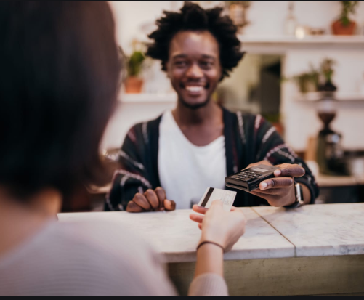

Slide 7

MARKET TRENDS IMPACTING ONLINE BILL PAYING
The Millennial Generation…
“America’s largest generation” with 75.4M million people
75% of the workforce and 46% of U.S. income by 2025¹
Digital natives, raised in the era of digital payments
67% are more likely to trust tech-based companies²
>20% have never written a check¹
63% don’t have a traditional credit card³
86% are smartphone users¹
38% use apps and mobile tools to pay bills
¹Source: First Data, The Unbanked Generation, 2015
²Source: Koski Research Study, 2015 (N=2,024)
³Source: A survey commissioned by Bankrate and compiled by Princeton Survey Research Associates
http://www.bankrate.com/finance/credit-cards/more-millennials-say-no-to-credit-cards-1.aspx
Notes:
It’s primarily the tech-savvy millennials generation that is driving change.
Their attitude towards technology sets them apart from other generations.
They are driving the dematerialization of content and the way people view material possessions, and approach consumption. Millennials have redefined the concept of ownership and the act of consumption no longer requires physical possession.
They are shaping digital-payment expectations.
Their comfort with technology is driving organizations to provide new and more innovative ways of enabling transactions.
They don’t write checks, they transfer money through their phones

Slide 8

MARKET TRENDS IMPACTING ONLINE BILL PAYING
… And the Popularity of Digital Wallets Exploding
Aware of
Currently use
By 2021, alternative payment methods are projected to
account for ~75% of ecommerce payments worldwide¹
Digital wallets to surpass credit cards by 2021²
76% of US consumers think Digital Wallets are a
secure form of payment technology³
73% of US consumers claim security is more important
than convenience when shopping online³
77% of US consumers believe PayPal is more convenient
than other payment methods³
Store
App
Bank digital
wallet
Apple
Pay
Google Wallet/Pay*
In Q1 2018, mobile represented 24% of digital
commerce sales⁴
Source: The Future of Money, Koski Research, Fall 2017
*Study was fielded before the Android Pay/Google Wallet re-brand.
Android Pay use was 5%.
¹Source: yStats.com, Global Alternative Online Payment Methods: Second Half 2017, retrieved 3/2018
²Source: Forrester Research, "The Next Phase Of Digital Wallet Adoption,” Sept 2017
³Source: Digital Trends Impacting Commerce, Kelton Research, June 2018
⁴Source: comScore, "State of the U.S. Online Retail Economy in Q1 2018”
Notes:
It’s primarily the tech-savvy millennials generation that is driving change.
Their attitude towards technology sets them apart from other generations.
They are driving the dematerialization of content and the way people view material possessions, and approach consumption. Millennials have redefined the concept of ownership and the act of consumption no longer requires physical possession.
They are shaping digital-payment expectations.
Their comfort with technology is driving organizations to provide new and more innovative ways of enabling transactions.
They don’t write checks, they transfer money through their phones

Slide 9
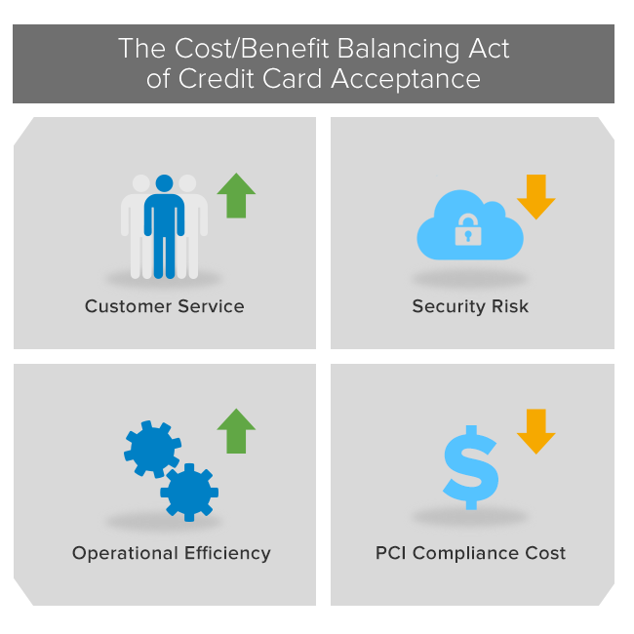

Slide 10
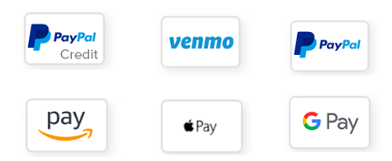
Digital Wallets

Slide 11
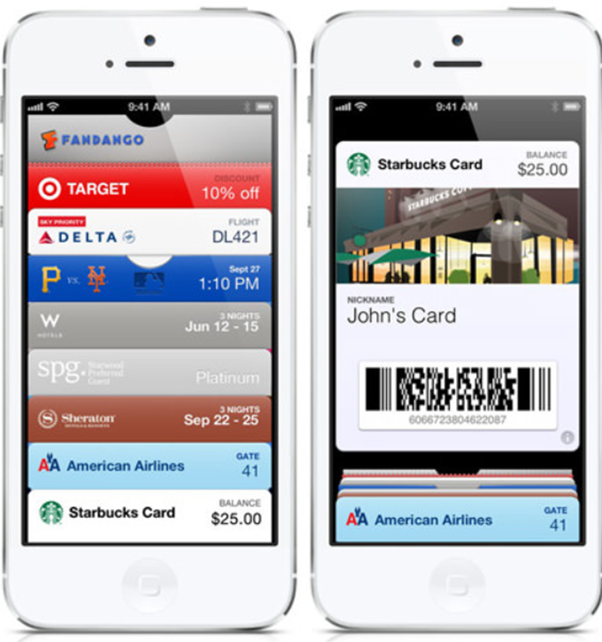
Digital Wallets
Digital version of a traditional wallet
Hold credit and debit cards for making payments, store coupons and loyalty programs, specific information about personal identity and more
Faster, easier, and safer than using physical cards
Millennial preferred – the payment option 75.4M people aged 24-39 already use
Digital wallets are projected to overtake credit cards as the most popular online payment method THIS YEAR

Slide 12

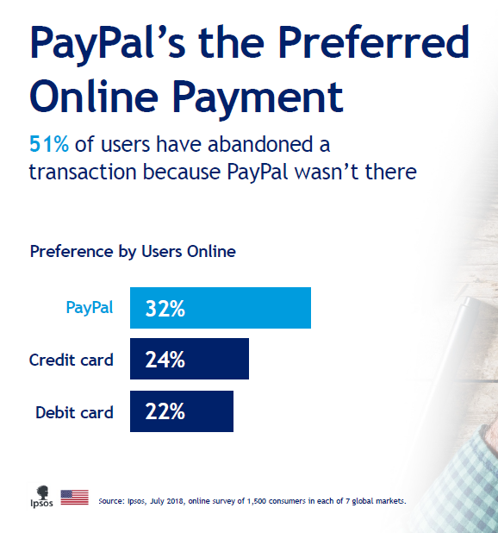
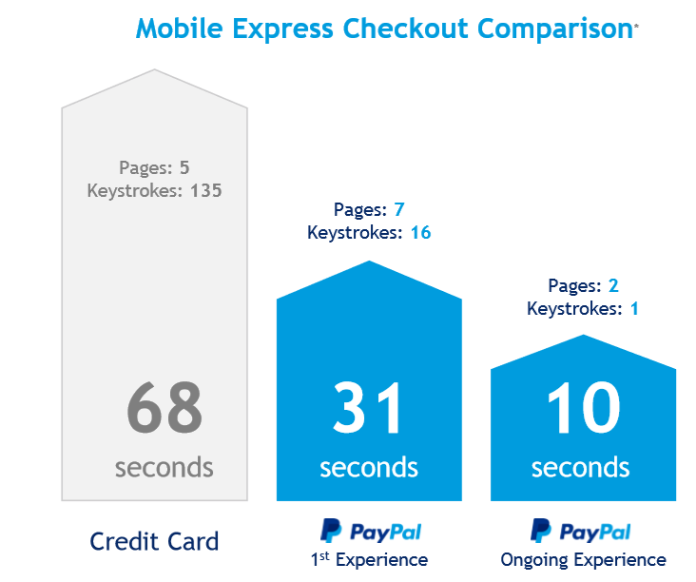
PAYMENTUS
About PayPal
Most used digital wallet in world
Over 305 million active users worldwide, 100 million+ in U.S.
64% of U.S. adults have used PayPal for an online transaction in the last year
One Touch™ checkout results in 88% fewer keystrokes

Slide 13
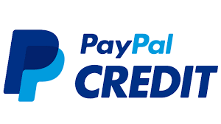
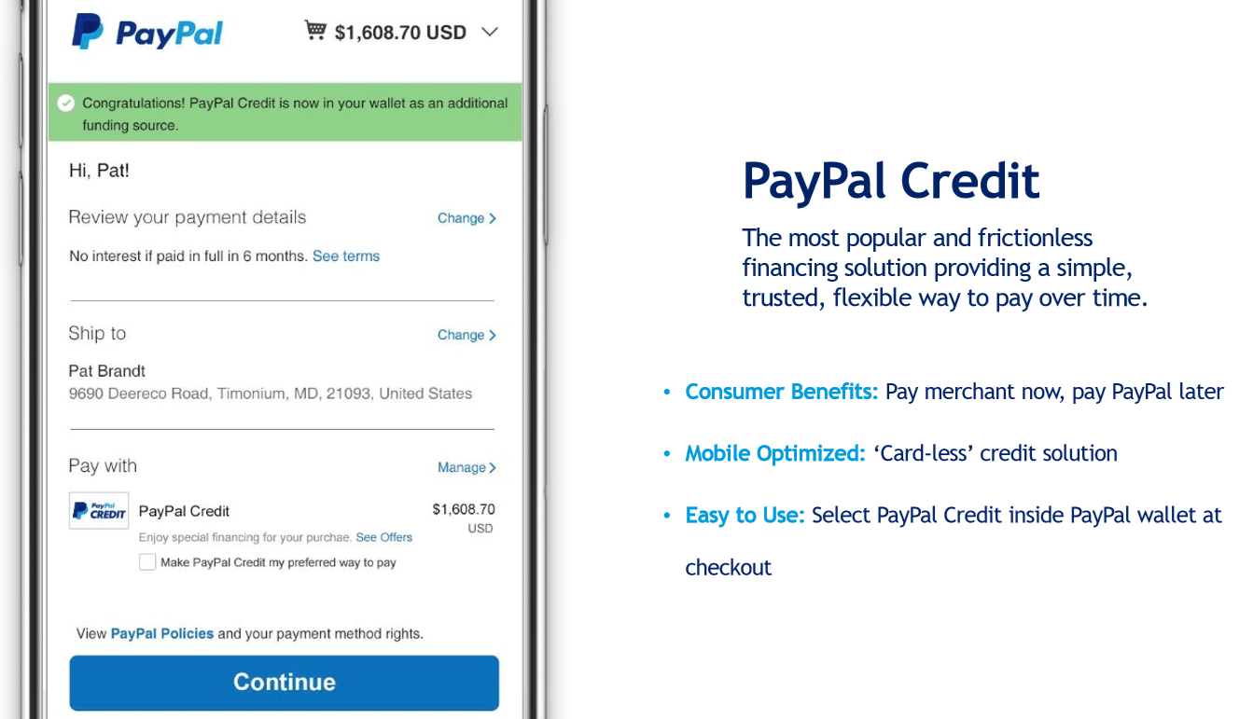
ADVANCED PAYMENT METHODS
About PayPal Credit
Flexible revolving line of credit
Interest free if balance is paid within 6 months
Allows customers to pay over time
78% use PayPal Credit for everyday expenses and bills
33% of PayPal Credit users are millennials

Slide 14
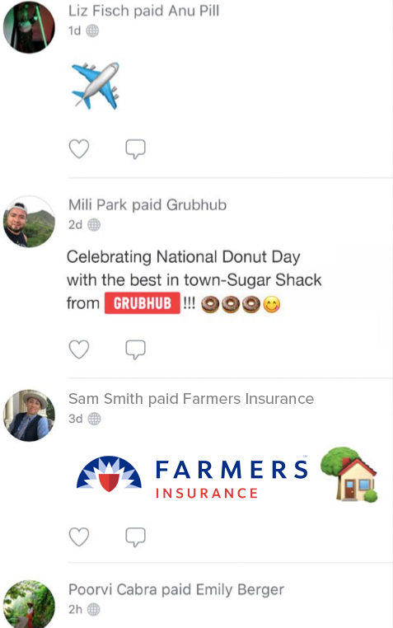

ADVANCED PAYMENT METHODS
About Venmo
40 million active users, growing 80% YOY
Preferred payment method of Millennials – 66% used Venmo in last 12 months
The ‘social’ payment method with a strong network effect that is accelerating utilization

Slide 15


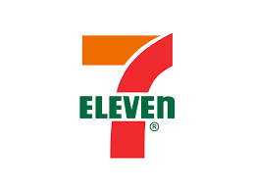
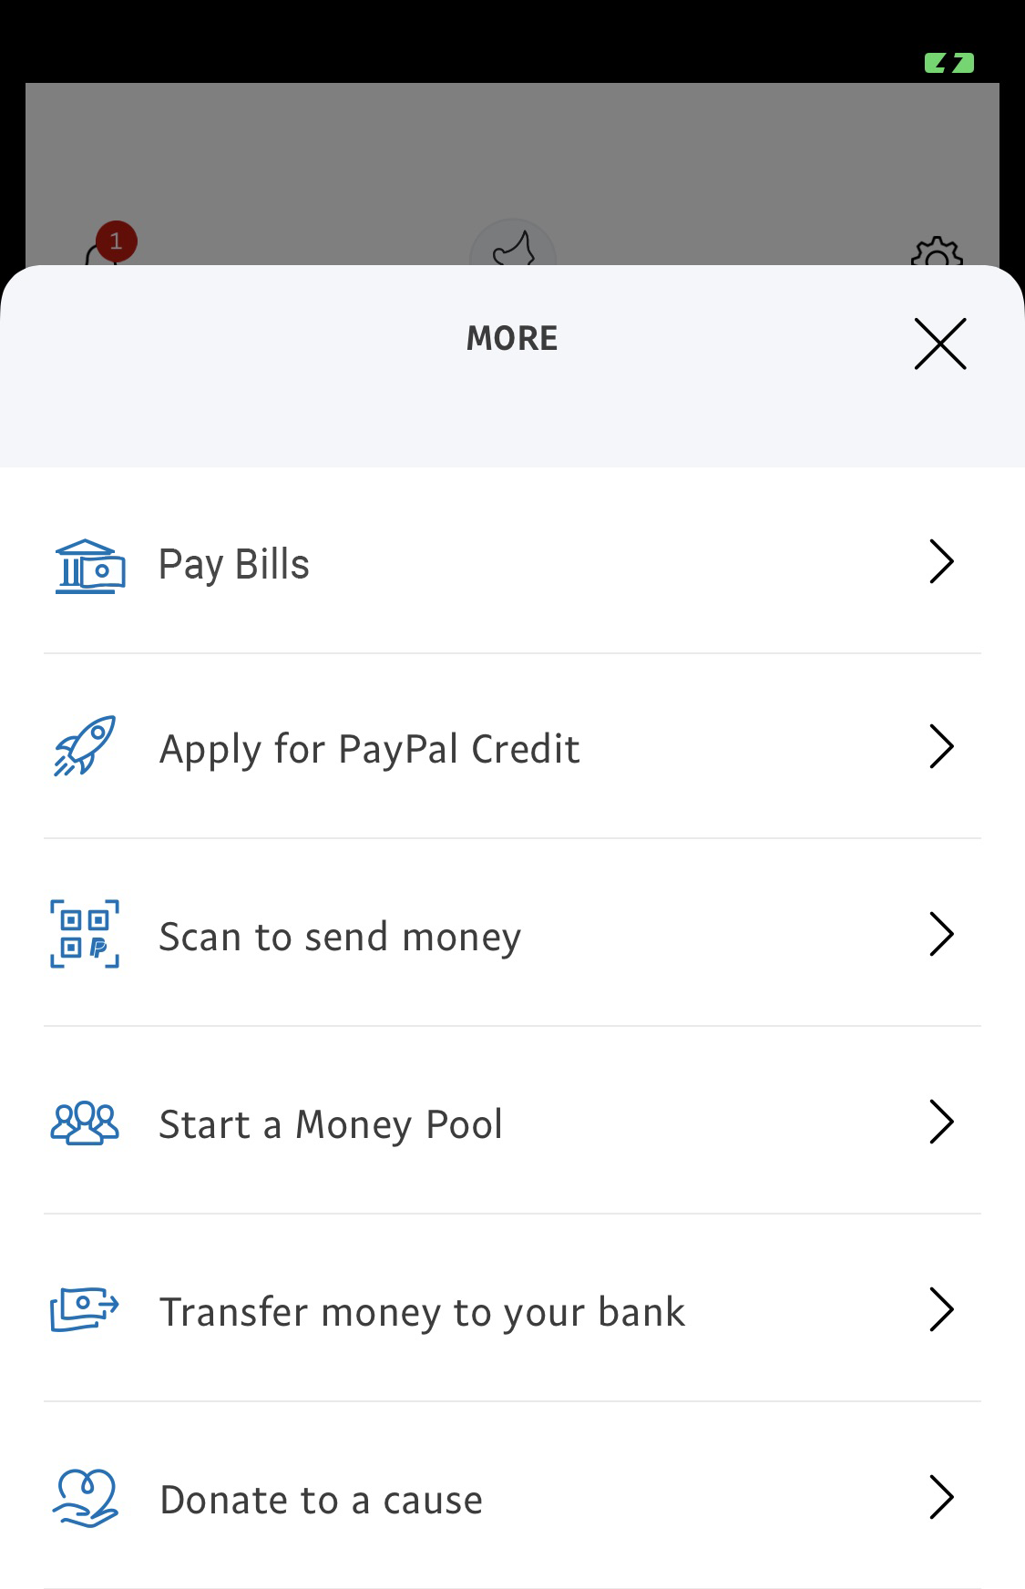
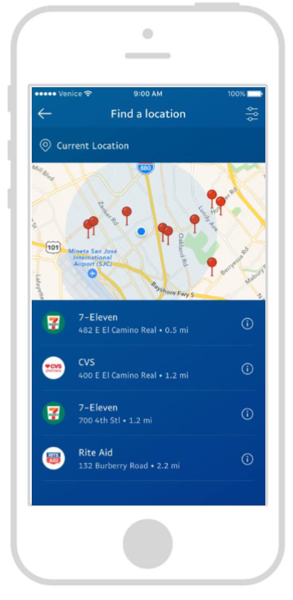




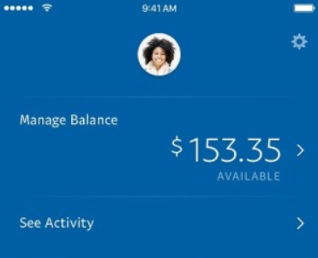



ADVANCED PAYMENT METHODS
Digitized Cash – Solutions For The Underbanked
25 Million U.S. Households are ‘Underbanked’ and have limited options for how to pay bills, until now….
Consumer has cash and wishes to pay bill(s). Locates closest store on PayPal App
Powered By
Consumer’s cash is ‘digitized’ and made available in PayPal wallet
Biller selected, bill paid from PayPal wallet
Digital Payment
Posts in Real-Time
Over 70,000 Store Options

Slide 16

ADVANCED PAYMENT METHODS
About Amazon Pay
“I trust Amazon. At websites online that are not Amazon, I will choose the merchants that offer Amazon Pay over another. I believe that the fewer places that have my payment information the better.”
“I was very surprised when the payment required came up with credit cards or Amazon Pay. It was so quick and easy. Everything about Amazon is quick and easy. I LOVE IT!”
300 million Amazon accounts
Over 100 million Prime members
91% of consumers who have used Amazon Pay would use it again if given the opportunity
84% rate Amazon Pay a 10 out of 10 on ease of use and speed of transaction
83% rate Amazon Pay a 10 out of 10 for ‘security’ and ‘brand trust’
2018 Annual Brand Rankings (Kantar MillwardBrown)

Slide 17
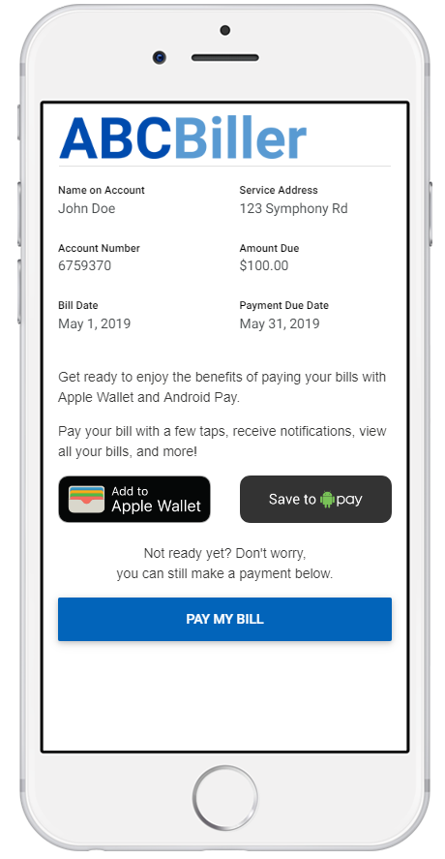
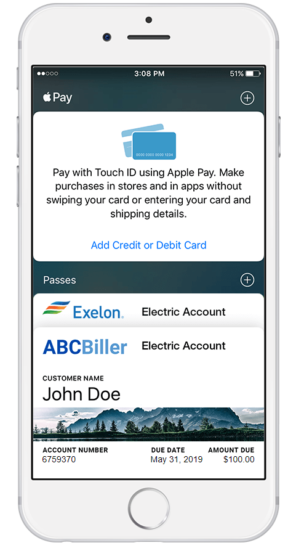
Bill Presentment Directly To Device-Based Wallets
Paymentus enables bill presentment, notifications and payment capabilities that leverage native wallet functionality available through Apple and Android devices
Customers are able to enroll easily and have future bills sent directly to their mobile wallet

Slide 18
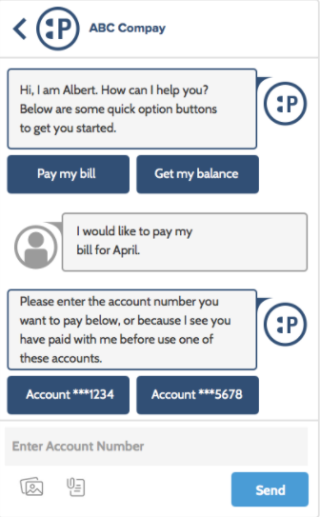
Chatbots
Used to serve customers and collect payments
Rapid growth By 2020, 85% of all interactions between millennials and businesses will occur without human interaction (*Gartner)
Financial implications Bot/AI-based customer service costs up to 80% less than human-based service (*IBM)
44% of consumers currently prefer chatbot experiences over human ones with CSRs
(*Aspect Research Study)

Slide 19
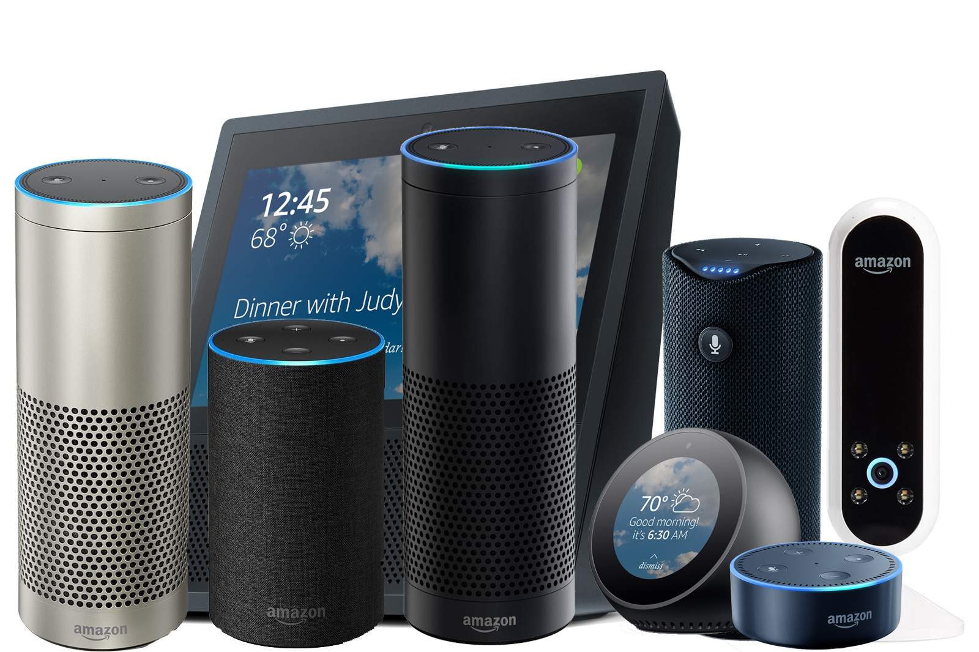
Voice Based Assistants
Artificial intelligence is an integral part of the customer experience
BILL PAYERS use assistants to receive important bill reminders, schedule payments, communicate with billers and more
BILLERS use assistants to extract information from systems; “Alexa, how many payments above $500 have been processed in the last 37 days?”
  By 2021, 40% of consumers will use voice assistants like Alexa instead of websites or apps when service needs arise – (*Capgemini)

Slide 20
Single Vendor, Enterprise-Wide Integration
CHANNEL 1
CHANNEL 2
CHANNEL 3
CHANNEL 4
CHANNEL 5
CHANNEL 6
NOTIFICATIONS
Single Integration Layer - Provider
PAYMENT PROCESSING SERVICES
eCheck
Debit Cards
Credit Cards
CIS

Slide 21

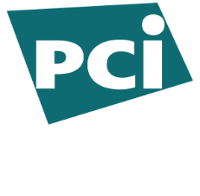
Offloading PCI Compliance
Use a Level 1 PCI Compliant 3rd party provider
100% hosted; payment data is completely removed from your network
Provider handles the full customer experience and all aspects of payment acceptance and security
Shift risk and liability away from your business and on to the third party provider.

Slide 22
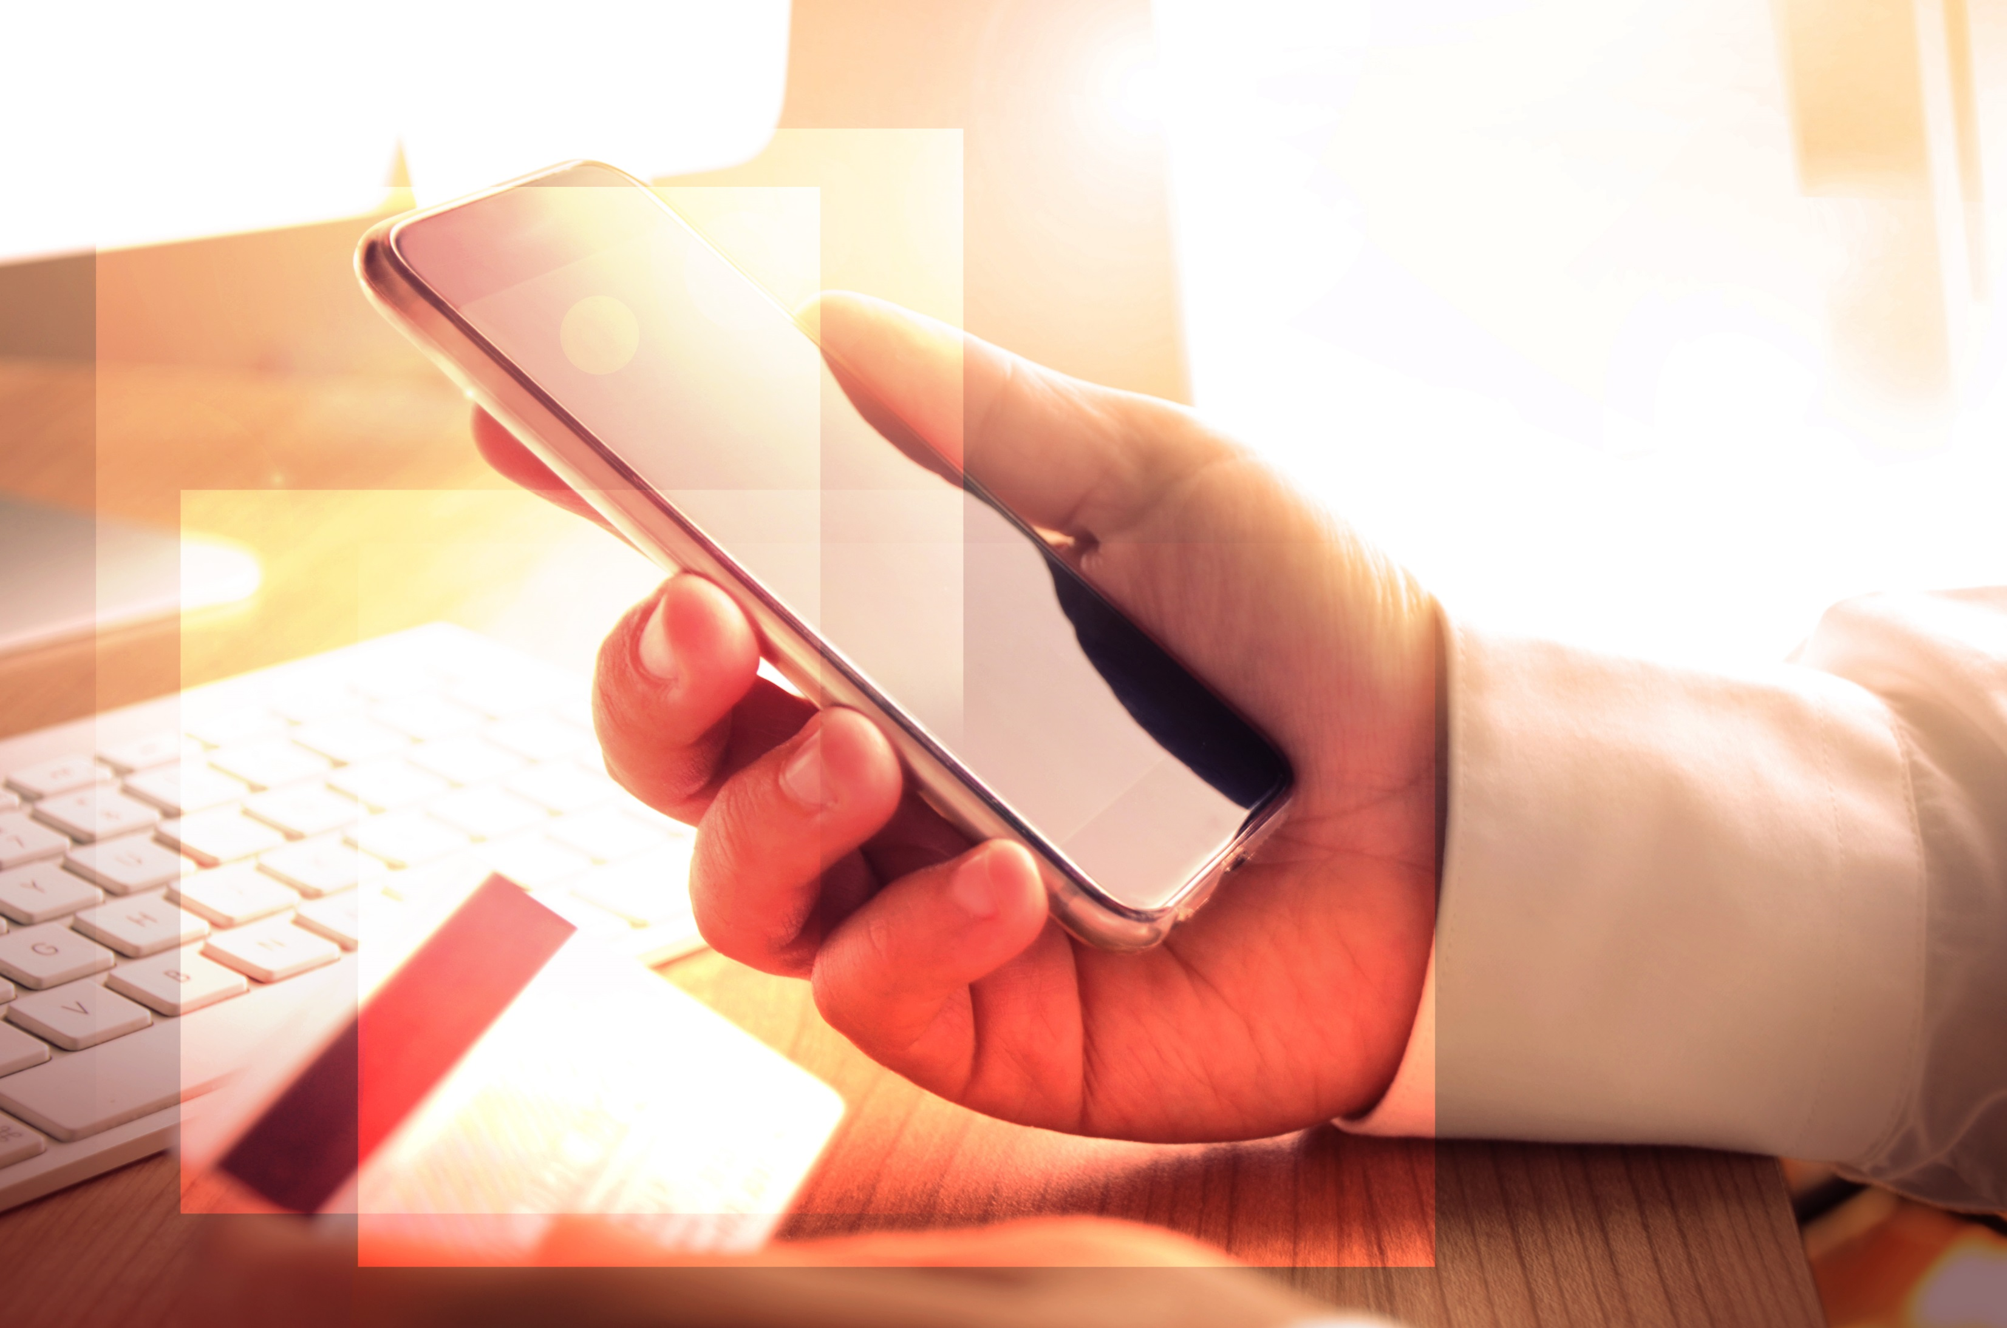
QUESTIONS?
Thank You
Christine Miles, Director of Sales
cmiles@paymentus.com
(540) 739-2054

