Slide 1


Slide 2
Sales Tax Update
Presented by
Lee Grafstrom
Tax Policy Analyst
League of Arizona Cities & Towns
GFOAz Winter Training
January 9, 2020

Slide 3
Local Code Status
Many cities and towns have 2011 version
One amendment coming for 2012-2014
Some have 2015 version
No changes by MTCC from 2015 to 2018
MTCC met Dec-18, Feb-19, and May-19
One amendment coming for 2018-2019
All will have 2020 version by year end

Slide 4
Local Code Status
Regardless of the Local version:
Statutory preemptions are controlling
The Master version of the MTCC is controlling
If the legislature acted, it overrides your code
If the MTCC acted, it overrides your code
It doesn’t matter when, or even if, your Council adopts MCTC changes
League will propose adoption by reference to end redundant Council approval

Slide 5
Recent Code Changes
December 2018
No MTCC activity, 2015-2018
Considerable activity over these years at the legislature required catch-up by the MTCC
15 Sections amended to capture all changes
Affected MCTC Sections:
110, 410, 415, 415.1, 422, 445, 450, 455, 462, 465, 470, 475, 480, 530, 660

Slide 6
Recent Code Changes
December 2018
415: Contracting – this is the culmination of several bills during 2013, 2014, 2015, and 2018 that resulted in the new exemptions for MRRA
Maintenance, Repair, Replacement and Alteration activities are exempt from Contracting, taxed on materials only, either at the vendor or jobsite
Guidance has been issued, but that guidance continues to be adjusted and edited

Slide 7
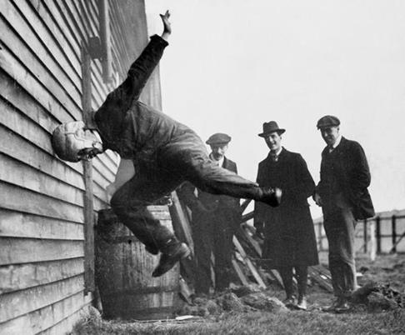
Meetings Continue Regarding MRRA

Slide 8
Recent Code Changes
December 2018
422: new exemption for Jet Fuel sales, limiting imposition to only the first 10 million gallons sold to any individual purchaser in a calendar year
Additionally, new language restricts the use of all funds collected from this classification to support the local airport

Slide 9
Recent Code Changes
December 2018
455: Restaurants & Bars 462: Food for Home Consumption
New language for food sold using SNAP benefits
New language related to exemption for food sold at certain MLB and pro golf events
Additionally, new language prohibits cities and towns from enacting any “discriminatory” tax on food or beverages – No Sugar Tax

Slide 10
Recent Code Changes
February 2019
416: Speculative Builder changes
Clarified tax is on first sale of a new structure
Allowed commercial developers to sell to other commercial developers without tax
Created an exemption and valuation method to exempt the value of in-place leases
Retail conformity for Wayfair (Round 1)

Slide 11
Recent Code Changes
May 2019
445: Real property rental
Created an exemption for Life Care Contracts
A life care contract is a form of regulated insurance that provides a resident with housing and care, even if their funds are exhausted
Only allowed for facilities authorized by the Dept. of Insurance to sell such contracts
Refunds to 2012, capped at $10K

Slide 12
Recent Code Changes
May 2019
470: Telecommunications
Created an exemption for Over-the-Top programming (TV or audio)
Basically, streaming content of live broadcast television and radio programming (Sling)
Also allows exemption for on-demand programming provided at no charge
Pay-per-view remains taxable

Slide 13
Coming MCTC Changes
Retail conformity for Wayfair (Round 2)
Statute is controlling, 42-6017
Adoption into MCTC is a formality
Transient Lodging for Brokers
Separate Residential and Commercial Leasing
Move the Use Tax out of Options
Collapse Options into one group
Clean-up Administration in Article V

Slide 14
Questions?
Lee Grafstrom
Tax Policy Analyst
lgrafstrom@azleague.org
GFOAz Winter Training
January 9, 2020

