Slide 1
Sales Tax Forecasting
Does One Size Fit All?
Town of Queen Creek
City of Phoenix
City of Glendale

Slide 2
Queen Creek

Slide 3
Introduction
Scott McCarty, Finance Director
  scott.mccarty@queencreek.org
  480-358-3170

Slide 4
Data Sources
Demographic Information
Population Projections
DOR
Community and Economic Development departments
External analyses
RL Brown Housing Data – Magic Tool Subscription
Joint Legislative Budget Committee
City of Phoenix Tax B.I.

Slide 5
Demographic Overview
Year Incorporated | 1989
Square Miles | 39 Town Boundary (Planning Area ~70)
Population June 30, 2019 (AZ Office of Economic Opportunity) | 52,405
Average Household Size (2015 Census) | 3.49
Median Age (2013-2017 ACS* 5-Yr Estimates) | 33.3 years
Median Household Income (2017 ACS 1-Year Supplemental Estimate) | $96,802
Median Value of Housing (2017 ACS 1-Year Supplemental Estimate) | $363,200

Slide 6
Population Projections
Fast Growing Community
Current Population = 52K
Buildout Population = 175K
10-Year Projection = 88K (+36K, 70%)

Slide 7
Models, Tools, and Processes
Fast Growing Community
Sales Tax is Our Largest Revenue Source
Utilize additional sales taxes for CIP needs
Type of Sales Tax | Rate | FY 19-20 Annual Amount
General Fund | 2.00% | $26.2M
Public Safety (Dedicated) | +0.25% | $3.3M
Town Center (Dedicated) | +0.25% | $1.0M
Construction Sales Tax (Dedicated) | +2.00% | $4.9M
Total All Purposes |  | $35.4M

Slide 8
Models, Tools, and Processes (continued)
Non-Residential Taxable Retail and Restaurant and Bar Study
Potential Impact Fee Credit Analysis (per Impact Fee law)
Recessionary Sensitivity Analysis
Annexation Economic Impact Studies
  Encanterra – Occupied Subdivision
  Arizona State Lands

Slide 9
Models, Tools, and Processes (continued)
Non-Residential Spending Study conclusions (2018 data)
  Evaluated taxable retail and restaurant and bar sales in Queen Creek and how much spending is occurring by non-residents
  Non-residents contributed approximately $5.4 million in sales tax revenue in fiscal year 2018
  38% of taxable retail sales and 47% of restaurant and bar sales are estimated to come from non-residents
  Leakage of spending by Town residents for electronics, autos, furniture, and entertainment

Slide 10
Models, Tools, and Processes (continued)
Development Fee Credit Analysis
  Assess potential revenue that may be generated from new development within the Town – should that revenue be viewed as a credit against imposed development fees
  Any revenue generated from new development will be used for operations, maintenance, repair, and replacement of existing facilities
  New development occurring in the Town will not pay twice for the cost of growth-related facilities
  Receipt of new revenue does not mean it’s net new revenue

Slide 11
Models, Tools, and Processes (continued)
Recessionary Sensitivity Analysis & Strategic Planning
  Sales taxes are largest revenue source – how to improve/maintain sales tax growth
  Rate comparisons with surrounding communities – examine opportunities to prevent leakage
  Strategies
    Median forecast and recessionary forecast
    Zoning
    Incentives

Slide 12
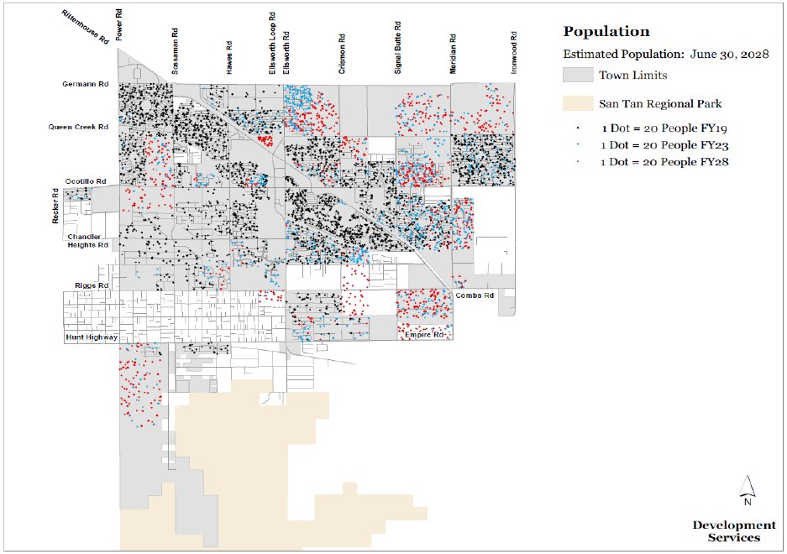
Collaboration with Other Departments
Strong emphasis on construction sales tax activity & permitting
Community Development
  New development projections
    Track permits on monthly basis, certificates of occupancy for revenue collections
  Analyze potential annexations and impacts of zoning changes
Economic Development
  New development economic impact studies
  Potential commercial development permits and square footage

Slide 13
Sales Tax Database
Access database developed in-house
Monthly DOR sales tax data downloaded to database
Easily organize data, run queries, and see trends

Slide 14
Monthly Reporting
Monthly Reporting
  Prepare monthly financial report after DOR distribution reports are available
  Have report completed by end of third business week for prior month activity
Sales Tax Appendix in Monthly Financial Report
  Year-to-date performance vs. current year budget and prior YTD
  YTD performance by broad sales tax category (construction, retail trade, restaurants & bars, etc.)
  Construction summary – 12-month rolling home closings/completions, monthly closings & average new home sale price by builder
  Utilize sales tax database to organize data
    Formatted to easily spot anomalies
  Historical performance charts

Slide 15
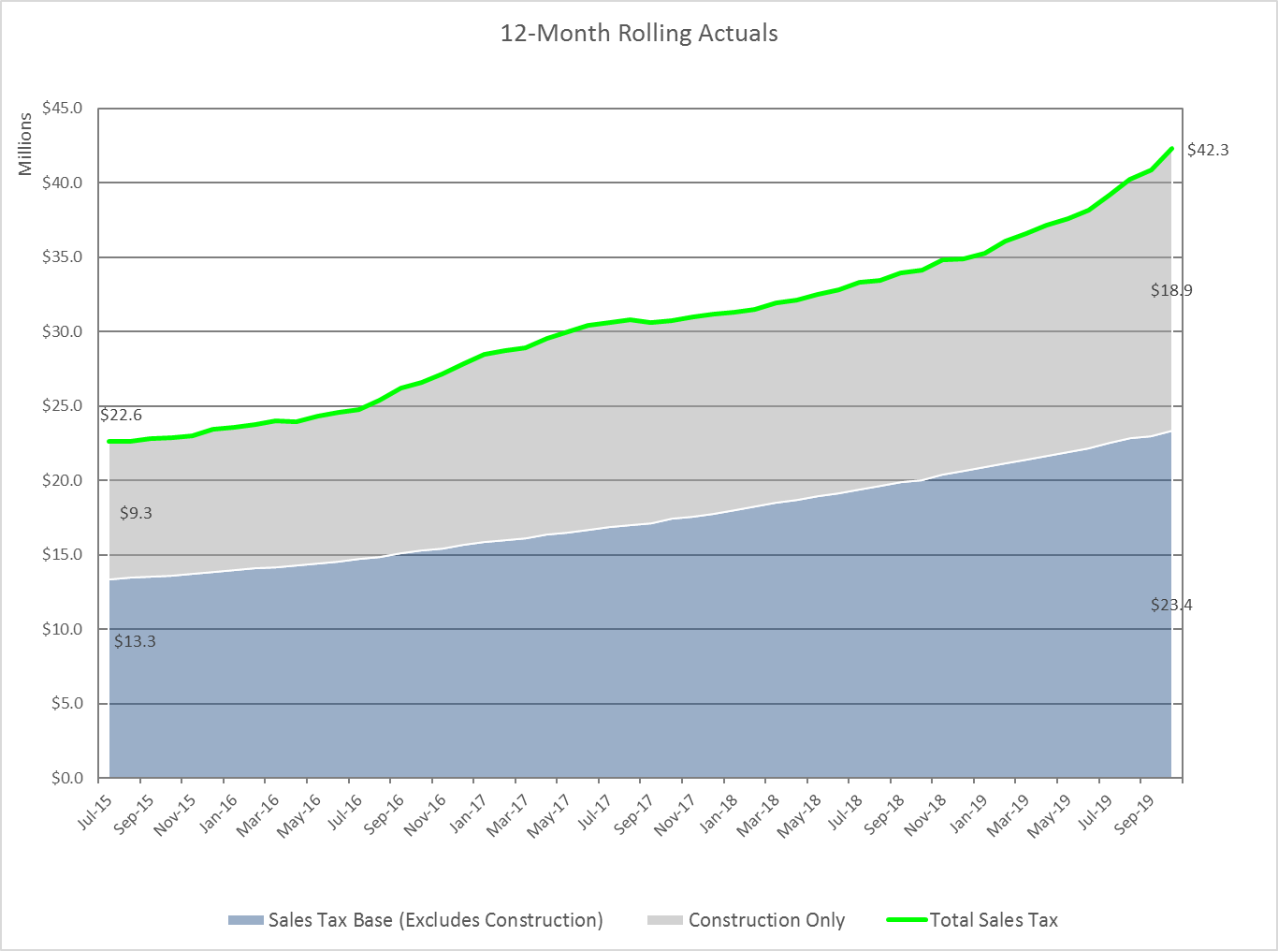
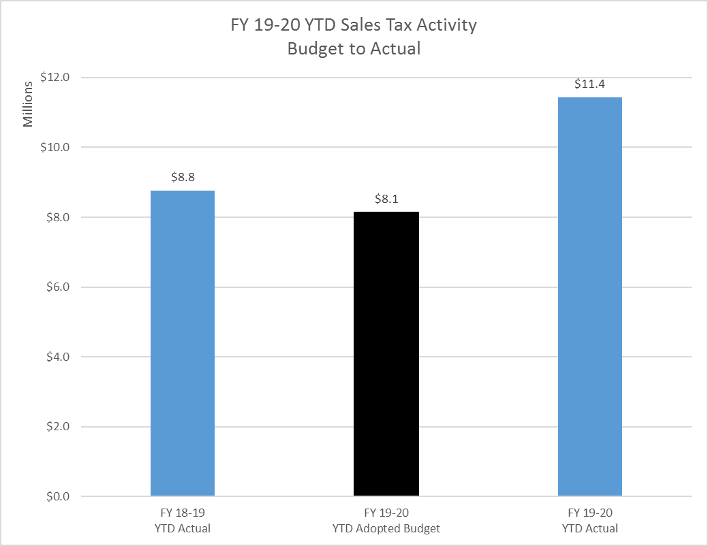
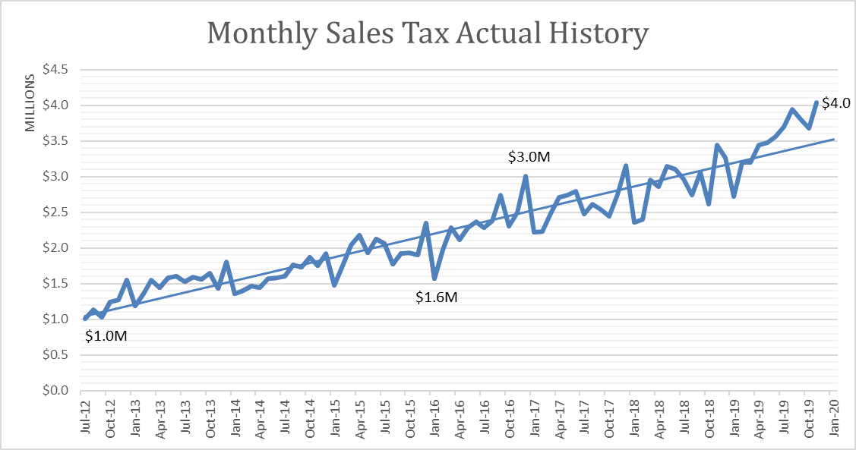
Monthly Reporting (continued)
Sample of Sales Tax Appendix Charts

Slide 16
Annual Processes
Annual Budget Projections
  Year-over-year trends for current establishments
  Estimates for newly permitted commercial establishments
  Potential economic development updates – closings, market concerns impacting larger establishments
    As of October 2019, the top 10 payers in the retail trade sales tax category accounted for 54% of total retail sales tax collections
  Revenue adjustments are made in January each year

Slide 17
Annual Processes (continued)
Contracted Sales Tax Auditing
  Conduct sales tax audits and follow-ups on trends or irregularities in sales tax collection data
  Collections from tax audits cover the cost of audits by about 4x
  In FY18-19, sales tax audit collections represented 1% of total sales tax collections
  Main audit focus is construction speculative builders
 | Fiscal Years 16-18 | Fiscal Year 18-19 | Fiscal Year 19-20 (YTD) | Total
Completed Audits | 23 | 21 | 3 | 47
Total Assessments | $370K | $300K | $120K | $790K

Slide 18
Accuracy
The Town is improving its budgeting process
Most of variance between budget and actual is from construction sales tax
Sales Tax Revenues – Budget to Actual
Fiscal Year | Adopted Budget (millions) | Revised Budget (millions) | Actuals (millions) | Difference (vs. Revised) (millions) | Difference (vs. Revised) (%)
2019 | $29.0 | $32.3 | $38.2 | $5.9 | 18%
2019 (net of construction sales tax) | $20.6 | 22.0 | 22.1 | 0.1 | <1%
2018 | 29.4 | 30.2 | 32.8 | 2.6 | 9%
2017 | 25.2 | 27.9 | 30.4 | 2.5 | 9%
2016 | 20.8 | 23.6 | 24.6 | 1.0 | 4%
2015 | 18.9 | 18.9 | 22.2 | 3.3 | 17%
2014 | 13.2 | 13.2 | 18.6 | 5.4 | 41%

Slide 19
Challenges
Significant growth
  Construction activity
  Annexations
Complete Recessionary Study
Numbers are Growing – Data Management Time Consuming
DOR Data Quality
Improve DOR Data Preparation Process/Timeliness
Understanding Online Impact and Trends
Validating payment of sales taxes relating to Town’s construction contracts/projects – internal tracking
Tracking sales tax revenues relating to Town’s utility services

Slide 20
Contact Information
Scott McCarty, Finance Director
  scott.mccarty@queencreek.org
  480-358-3170
Kristen Stone, Revenue Analyst
  kristen.stone@queencreek.org
  480-358-3177

Slide 21
Phoenix

Slide 22
City of Phoenix
Introductions
Sales Tax in Phoenix
Sales Tax as a Percentage of Total Revenue
Importance of Sales Tax Forecasting
Variables for Sales Tax Forecasting
Forecasting Methods
Accuracy & Challenges
Contact Information

Slide 23
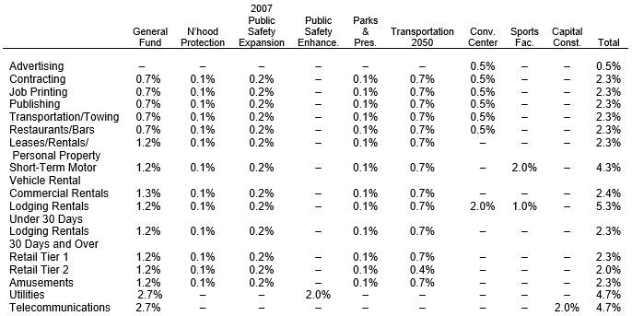
Sales Tax in Phoenix
Local Sales Tax
Stated-Shared Sales Tax: distribute based on jurisdictions’ population share

Slide 24
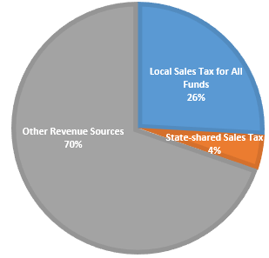
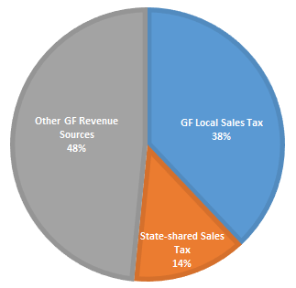
Sales Tax as a Percentage of Total Revenue
All Funds
General Fund Only

Slide 25
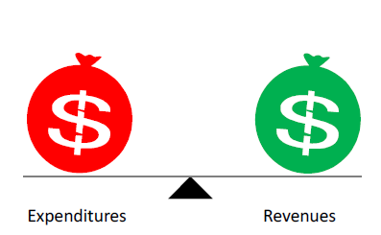

Importance of Sales Tax Forecasting

Slide 26
Variables for Sales Tax Forecasting
Sales Tax
Tax Base
Tax Rates
Demographic indicators
Economic indicators
Tax Policies
Tax Policies

Slide 27
Forecasting Methods

Slide 28
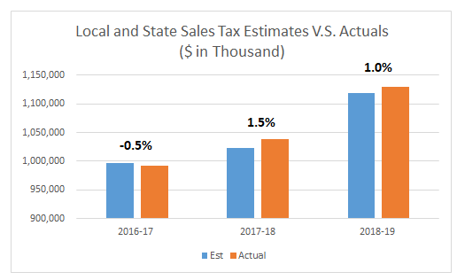
Forecasting Accuracy and Challenges
Accuracy
Challenges
Data Quality/Limited Access to Tax Data

Slide 29

Contact Information
Jeff Barton, Budget and Research Director
Email: Jeff.Barton@phoenix.gov
Tel: (602)262-4800
Dan Wang, Fiscal Manager
Email: Danielle.Wang@phoenix.gov
Tel: (602)534-1787

Slide 30
Glendale

Slide 31
City Sales Tax
Sales Tax Rate (2.9%)
  7/10 of one (1) cent increase in June 2012 with a 5-year sunset provision
    Does not apply to single transaction over $5,000
  Sunset provision removed in June 2014
    Sales tax reviewed annually through the budget process
  General Fund (1.9%)
  General government operations
    Public Safety
    Parks and recreation
  Contractual obligations
  Municipal Property Corporation and Excise Tax debt service
Notes:
Amy
Percentages of Revenue by Fund
Actual Percentages for State Shared Revenue Increases and City Sales Tax

Slide 32
City Sales Tax
  Transportation (0.5%)
  Voter approved in November 2001
  Create and implement a transportation plan
  Provide regional transit connection
  Improve traffic flow
  Reduce air pollution
Public Safety (0.5%)
  Police (2/3) and fire (1/3) services
  Voter approved original tax rate of 0.1% in March 1994
  Voter approved increasing tax rate to 0.5% in November 2007
    0.4% increase excludes food for home consumption
Notes:
Amy
Percentages of Revenue by Fund
Actual Percentages for State Shared Revenue Increases and City Sales Tax

Slide 33
General Fund Revenue
Notes:
Vicki

Slide 34
FY19-20 Debt Service
Notes:
Police Services 96,096,734
Fire Services 48,105,904
Non-Departmental 11,841,250
PFR&SE 14,149,400
Field Operations 9,706,831
Community Services 7,243,059
Development Services 6,759,146
Budget and Finance 5,231,609
City Court 5,185,785
City Attorney 3,791,124
Public Affairs 2,507,099
Engineering 2,128,325
HR & Risk Mgt 2,202,620
Mayor & Council 1,686,022
Transportation 1,142,459
Economic Development 1,350,719
City Manager 1,673,591
City Clerk 769,898
City Auditor 410,043
Total $221,981,618

Slide 35
Forecast Methodology
Conservative city sales tax growth
  Averages 2.4% over five-year forecast
  Slightly higher growth in FY20 and FY21
Moderate State-Shared Revenue increases
  Consistent with State JLBC Forecast
  Assumes continued stable statewide economy
  Accurate in expenditure forecast
Notes:
Amy
Percentages of Revenue by Fund
Actual Percentages for State Shared Revenue Increases and City Sales Tax

Slide 36
General Fund Operating Budget
Notes:
Vicki

Slide 37
General Fund
Notes:
Amy
Percentages of Revenue by Fund
Actual Percentages for State Shared Revenue Increases and City Sales Tax

Slide 38
Transportation
Notes:
Amy
Percentages of Revenue by Fund
Actual Percentages for State Shared Revenue Increases and City Sales Tax

Slide 39
Public Safety - Police
Notes:
Amy
Percentages of Revenue by Fund
Actual Percentages for State Shared Revenue Increases and City Sales Tax

Slide 40
Public Safety - Fire
Notes:
Amy
Percentages of Revenue by Fund
Actual Percentages for State Shared Revenue Increases and City Sales Tax

Slide 41
Questions?
    Lisette Camacho
    City of Glendale
    Budget and Finance Director
    lcamacho1@glendaleaz.com
    623.930.2492
Notes:
Amy
Percentages of Revenue by Fund
Actual Percentages for State Shared Revenue Increases and City Sales Tax

Slide 42
QUESTIONS??

