Slide 1
Sales Tax Forecasting
Does One Size Fit All?
Town of Queen Creek
City of Phoenix
City of Glendale

Slide 2
Queen Creek

Slide 3
Introduction
Scott McCarty, Finance Director
  scott.mccarty@queencreek.org
  480-358-3170

Slide 4
Sales Tax Revenues in Queen Creek: $29.5M

Slide 5
Data Sources Used in Analysis
Demographic Information
Population Projections
DOR
Community and Economic Development departments
External analyses
RL Brown Housing Data – Magic Tool Subscription
Joint Legislative Budget Committee
City of Phoenix Tax Business Intelligence System

Slide 6
Demographic Overview
Year Incorporated | 1989
Square Miles | 39 Town Boundary (Planning Area ~70)
Population June 30, 2019 (AZ Office of Economic Opportunity) | 52,405
Median Household Income (2017 ACS 1-Year Supplemental Estimate) | $96,802
Average Household Size (2015 Census) | 3.49
Median Age (2013-2017 ACS* 5-Yr Estimates) | 33.3 years
Median Value of Housing (2017 ACS 1-Year Supplemental Estimate) | $363,200

Slide 7
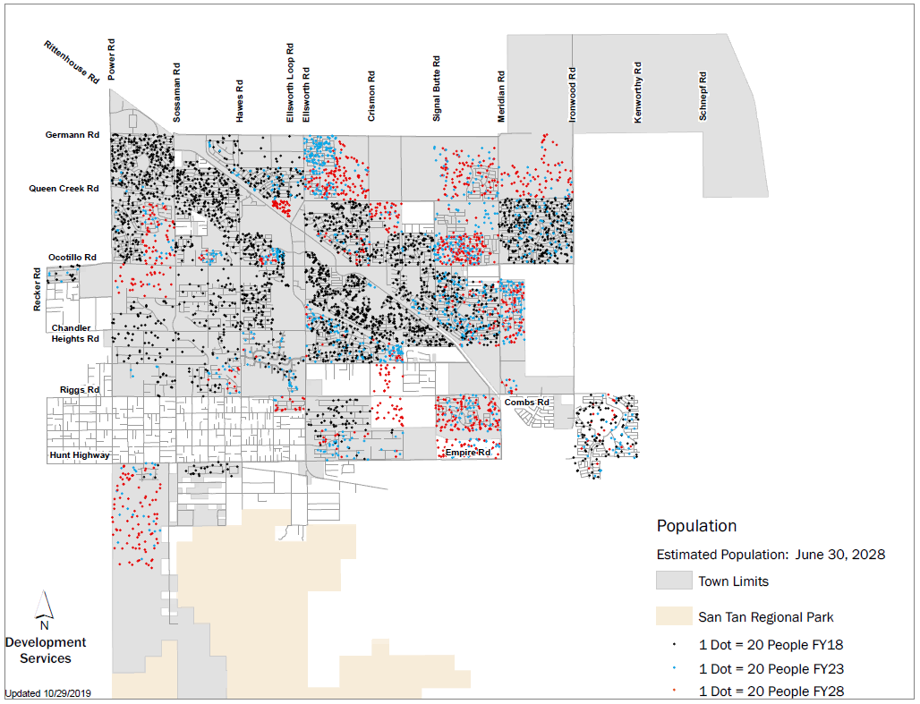
Population Projections
Fast Growing Community
Current Population = 54K
Buildout Population = 175K
10-Year Projection = 88K (+36K, 70%)

Slide 8
Models, Tools, and Processes
Sales tax rates
Type of Sales Tax | Rate | FY 19-20 Annual Amount
*General Fund | 2.00% | $26.2M
*Public Safety (Dedicated) | +0.25% | $3.3M
Town Center (Dedicated) | +0.25% | $1.0M
Construction Sales Tax (Dedicated) | +2.00% | $4.9M
Total All Purposes |  | $35.4M
* FY19-20 Operating Budget $29.5M

Slide 9
Models, Tools, and Processes (continued)
Studies & Analyses
Non-Residential Taxable Retail and Restaurant/Bar Study
Potential Impact Fee Credit Analysis (per Impact Fee law)
Recessionary Sensitivity Analysis
Internal Economic Impact Studies – Annexations & Zoning Cases
  Encanterra – Occupied Subdivision
  Arizona State Lands

Slide 10
Models, Tools, and Processes (continued)
Non-Residential Spending Study Conclusions (2018 data)
  100k+ population in surrounding area (non-residents)
    Eastmark, Cadence, and San Tan Valley
  Evaluated taxable retail and restaurant and bar sales in Queen Creek and how much spending is occurring by non-residents
  Non-residents contributed approximately $5.4 million in sales tax revenue in fiscal year 2018
  38% of taxable retail sales and 47% of restaurant and bar sales are estimated to come from non-residents
  Leakage of spending by Town residents for electronics, autos, furniture, and entertainment

Slide 11
Models, Tools, and Processes (continued)
Development Fee Credit Analysis
  Assess potential revenue that may be generated from new development within the Town – should that revenue be viewed as a credit against imposed development fees?
Conclusions:
  Receipt of new revenue does not mean it’s net new revenue
  Any revenue generated from new development will be used for operations, maintenance, repair, and replacement of existing facilities
  New development occurring in the Town will not pay twice for the cost of growth-related facilities

Slide 12
Models, Tools, and Processes (continued)
Recessionary Sensitivity Analysis & Strategic Planning
  Sales taxes are largest revenue source – how to improve/maintain sales tax growth?
  Rate comparisons with surrounding communities – examine opportunities to prevent leakage
  Strategies
    Median forecast and recessionary forecast
    Zoning
    Incentives (i.e. auto cap)

Slide 13
Economic Analysis of New Construction
Planning/Zoning Fees
Building Permit Fees
Construction Sales Tax
Property Taxes
Sales Taxes
Other Taxes
Strong emphasis on construction sales tax activity & permitting
  “Development Pipeline”
Collaboration with other departments
  Community Development
    New development projections
      Track permits on monthly basis, certificates of occupancy for revenue collections
    Analyze potential annexations and impacts of zoning changes
  Economic Development
    New development economic impact studies
    Potential commercial development permits and square footage
One-Time Revenues
Annual Revenues

Slide 14
Sales Tax Analysis Tools
Access database developed in-house
Monthly DOR sales tax data downloaded to database
Easily organize data, run queries, and see trends

Slide 15
Monthly Reporting
Monthly Reporting
  Prepare monthly financial report after DOR distribution reports are available
  Have report completed by end of third business week for prior month activity
Sales Tax Appendix in Monthly Financial Report
  Year-to-date performance vs. current year budget and prior YTD
  YTD performance by broad sales tax category (construction, retail trade, restaurants & bars, etc.)
  Construction summary – 12-month rolling home closings/completions, monthly closings & average new home sale price by builder
  Utilize sales tax database to organize data
    Formatted to easily spot anomalies
  Historical performance charts

Slide 16
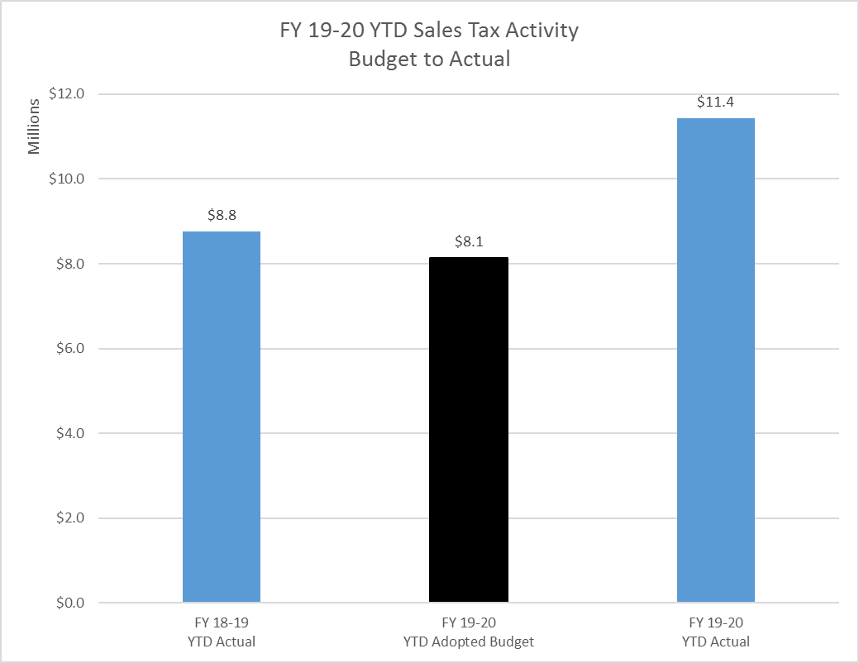
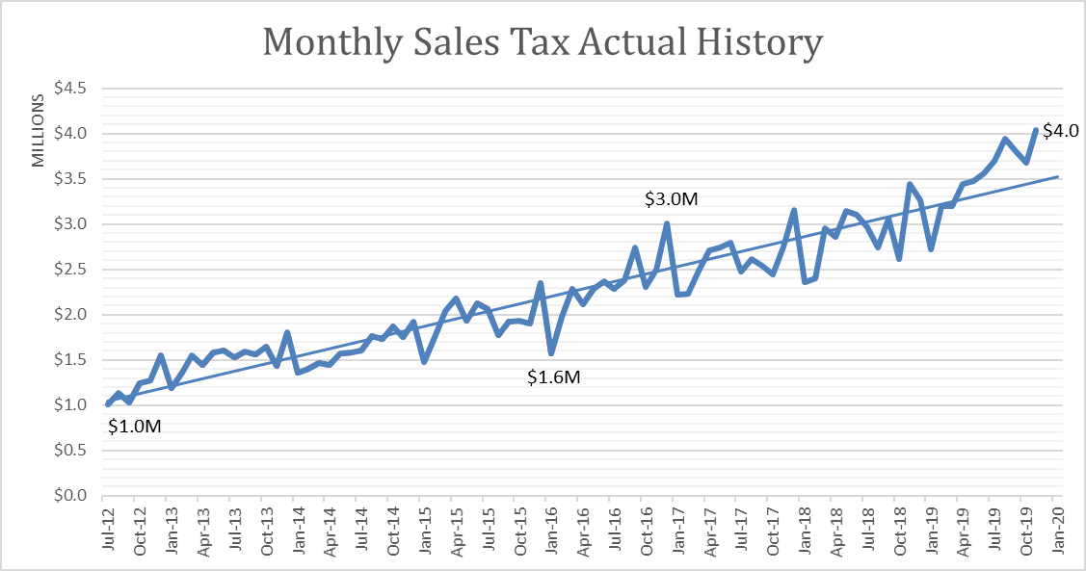
Monthly Reporting (continued)
Sample of Sales Tax Appendix Charts
Total Sales Tax
Construction Only
Sales Tax Base (Excludes Construction)

Slide 17
Annual Processes
Annual Budget Projections
  Year-over-year trends for current establishments
  Estimates for newly permitted commercial establishments
  Potential economic development updates – closings, market concerns impacting larger establishments
    As of October 2019, the top 10 payers in the retail trade sales tax category accounted for 54% of total retail sales tax collections
    Review RL Brown housing data to identify trends or market concerns
  Review Joint Legislative Budget Committee forecasts
  Revenue adjustments are made in January each year

Slide 18
Annual Processes (continued)
Contracted Sales Tax Auditing
  Conduct sales tax audits and follow-ups on trends or irregularities in sales tax collection data
  Collections from tax audits cover the cost of audits by about 4x
  In FY18-19, sales tax audit collections represented 1% of total sales tax collections
  Main audit focus is construction speculative builders
 | Fiscal Years 16-18 | Fiscal Year 18-19 | Fiscal Year 19-20 (YTD) | Total
Completed Audits | 23 | 21 | 4 | 48
Total Assessments | $370K | $300K | $150K | $820K

Slide 19
Accuracy
The Town is improving its accuracy
Most of variance between budget and actual is from construction sales tax
Sales Tax Revenues – Budget to Actual
Fiscal Year | Adopted Budget (millions) | Revised Budget (millions) | Actuals (millions) | Difference (vs. Revised) (millions) | Difference (vs. Revised) (%)
2019 | $29.0 | $32.3 | $38.2 | $5.9 | 18%
2019 (net of construction sales tax) | $20.6 | 22.0 | 22.1 | 0.1 | <1%
2018 | 29.4 | 30.2 | 32.8 | 2.6 | 9%
2017 | 25.2 | 27.9 | 30.4 | 2.5 | 9%
2016 | 20.8 | 23.6 | 24.6 | 1.0 | 4%
2015 | 18.9 | 18.9 | 22.2 | 3.3 | 17%
2014 | 13.2 | 13.2 | 18.6 | 5.4 | 41%

Slide 20
Challenges
Significant growth
  Construction activity
  Annexations
Finalize Recessionary Study
Numbers are Growing – Data Management Time Consuming
DOR
  Data Quality
  Improve DOR Data Preparation Process/Timeliness
Develop a better understanding of Online Impact and Trends
Develop internal process to validate payment of sales taxes relating to Town’s construction contracts/projects
Develop a process to track sales tax revenues relating to Town’s utility services

Slide 21
Contact Information
Scott McCarty, Finance Director
  scott.mccarty@queencreek.org
  480-358-3170
Kristen Stone, Revenue Analyst
  kristen.stone@queencreek.org
  480-358-3177

Slide 22
Phoenix

Slide 23
City of Phoenix
Introductions
Sales Tax in Phoenix
Sales Tax as a Percentage of Total Revenue
Importance of Sales Tax Forecasting
Variables for Sales Tax Forecasting
Forecasting Methods
Accuracy & Challenges
Contact Information

Slide 24
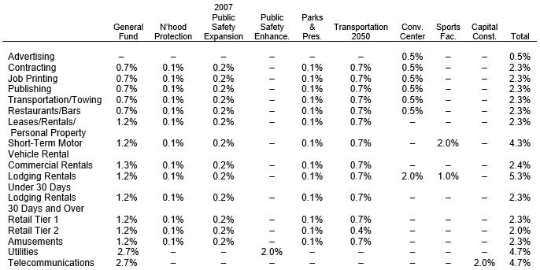
Sales Tax in Phoenix
Local Sales Tax
Stated-Shared Sales Tax: distribute based on jurisdictions’ population share

Slide 25
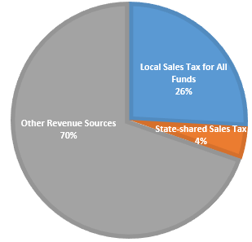
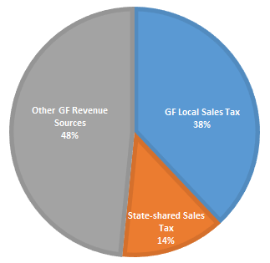
Sales Tax as a Percentage of Total Revenue
All Funds
General Fund Only

Slide 26
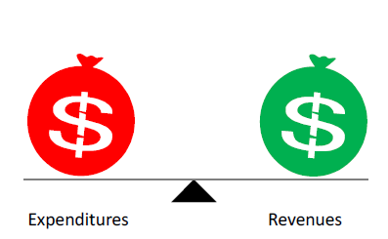

Importance of Sales Tax Forecasting

Slide 27
Variables for Sales Tax Forecasting
Sales Tax
Tax Base
Tax Rates
Demographic indicators
Economic indicators
Tax Policies
Tax Policies

Slide 28

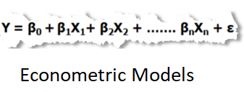
Forecasting Methods

Slide 29
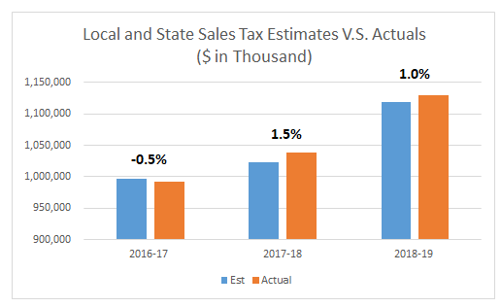
Forecasting Accuracy and Challenges
Accuracy
Challenges
Data Quality/Limited Access to Tax Data

Slide 30

Contact Information
Jeff Barton, Budget and Research Director
Email: Jeff.Barton@phoenix.gov
Tel: (602)262-4800
Dan Wang, Fiscal Manager
Email: Danielle.Wang@phoenix.gov
Tel: (602)534-1787

Slide 31
Glendale

Slide 32
City Sales Tax
Sales Tax Rate (2.9%)
  7/10 of one (1) cent increase in June 2012 with a 5-year sunset provision
    Does not apply to single transaction over $5,000
  Sunset provision removed in June 2014
    Sales tax reviewed annually through the budget process
  General Fund (1.9%)
  General government operations
    Public Safety
    Parks and recreation
  Contractual obligations
  Municipal Property Corporation and Excise Tax debt service
Notes:
Amy
Percentages of Revenue by Fund
Actual Percentages for State Shared Revenue Increases and City Sales Tax

Slide 33
City Sales Tax
  Transportation (0.5%)
  Voter approved in November 2001
  Create and implement a transportation plan
  Provide regional transit connection
  Improve traffic flow
  Reduce air pollution
Public Safety (0.5%)
  Police (2/3) and fire (1/3) services
  Voter approved original tax rate of 0.1% in March 1994
  Voter approved increasing tax rate to 0.5% in November 2007
    0.4% increase excludes food for home consumption
Notes:
Amy
Percentages of Revenue by Fund
Actual Percentages for State Shared Revenue Increases and City Sales Tax

Slide 34
General Fund Revenue
Notes:
Vicki

Slide 35
FY19-20 Debt Service
Notes:
Police Services 96,096,734
Fire Services 48,105,904
Non-Departmental 11,841,250
PFR&SE 14,149,400
Field Operations 9,706,831
Community Services 7,243,059
Development Services 6,759,146
Budget and Finance 5,231,609
City Court 5,185,785
City Attorney 3,791,124
Public Affairs 2,507,099
Engineering 2,128,325
HR & Risk Mgt 2,202,620
Mayor & Council 1,686,022
Transportation 1,142,459
Economic Development 1,350,719
City Manager 1,673,591
City Clerk 769,898
City Auditor 410,043
Total $221,981,618

Slide 36
Forecast Methodology
Conservative city sales tax growth
  Averages 2.4% over five-year forecast
  Slightly higher growth in FY20 and FY21
Moderate State-Shared Revenue increases
  Consistent with State JLBC Forecast
  Assumes continued stable statewide economy
  Accurate in expenditure forecast
Notes:
Amy
Percentages of Revenue by Fund
Actual Percentages for State Shared Revenue Increases and City Sales Tax

Slide 37
General Fund Operating Budget
Notes:
Vicki

Slide 38
General Fund
Notes:
Amy
Percentages of Revenue by Fund
Actual Percentages for State Shared Revenue Increases and City Sales Tax

Slide 39
Transportation
Notes:
Amy
Percentages of Revenue by Fund
Actual Percentages for State Shared Revenue Increases and City Sales Tax

Slide 40
Public Safety - Police
Notes:
Amy
Percentages of Revenue by Fund
Actual Percentages for State Shared Revenue Increases and City Sales Tax

Slide 41
Public Safety - Fire
Notes:
Amy
Percentages of Revenue by Fund
Actual Percentages for State Shared Revenue Increases and City Sales Tax

Slide 42
Questions?
    Lisette Camacho
    City of Glendale
    Budget and Finance Director
    lcamacho1@glendaleaz.com
    623.930.2492
Notes:
Amy
Percentages of Revenue by Fund
Actual Percentages for State Shared Revenue Increases and City Sales Tax

Slide 43
QUESTIONS??

