Slide 1

Arizona Revenues – Old and Potentially New Ones?
Kirsten Lennon, Financial Services Director, City of Cottonwood
Pat Walker, Pat Walker Consulting LLC
January 9, 2020

Slide 2
Presentation Objectives
Introduction/Overview
Arizona Revenues
Local
State Shared
Property Taxes
Potential New Revenue Sources?
Questions/Discussions

Slide 3
Revenues

Slide 4
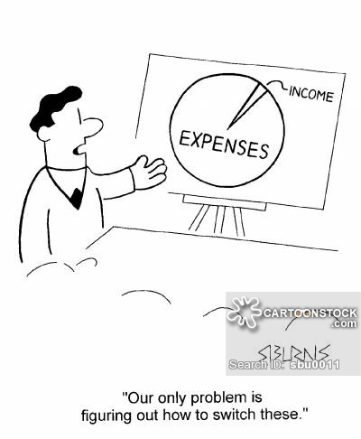

Slide 5
Summary of General Fund Revenues

Slide 6
Local Revenue Sources
Overall, any new or increase to a tax or fee must be published under ARS§9-499.19 which includes a Property Tax RATE increase.
This does not include water & sewer fees or impact fees which are under ARS§9-511.01 and ARS§9-463.05.
Also court fees set by state law or fees set by Federal such as public housing

Slide 7

Local Revenues
Local revenues
Sales tax
Franchise taxes
Licenses, permits & fees
Fines
Property taxes

Slide 8
Local Sales Taxes (TPT)
Can be Used for Any Municipal Purpose
Major Revenue Categories:
Retail
Construction
Utilities
Rental
Hotel/Motel
Restaurant/Bar
Use Tax
Approval by Council depending on language if Charter City
Notes:
FY13 Budget 525,000 FY13 Est 645,830 23.0% FY 14 615,907 17.3% Increase over prior year budget, decrease from FY13 actuals due to one time payment. Sales tax dollars and coming in less than budgeted. We are projecting the Town to realize 535,680 for FY14 and anticipate a 2% increase from this collection amount. It is still 11.3% below what we budgeted last year…..don’t know where and reason we suggested for someone to look at sales tax collection activity in the Town.

Slide 9
Local Sales Taxes (TPT)
Cities/Towns can set rates for each classification but there are restrictions as follows:
Mining tax rate must stay at .01%
Residential rental rate can only be increased by vote of the people
The Hotel/Motel tax and bed tax (if each are charged at 3% for a total of 6%) can be raised at the same level the other categories of tax are raised and not have to be dedicated to tourism.

Slide 10
Local Sales Taxes (TPT)
Use Tax
Some Cities/Towns do not have that classification in their code, but should
The internet sales have caused situations where no local tax is paid on tangible personal property and used within city/town boundaries
Retail sales may decline and this is a way to “level the playing field” with local businesses.

Slide 11
Business License
License can only be issued for one-year period
Not be less than $10 but not more than $5,000 (unless charter city)
Used to regulate businesses
Not a large portion of overall revenue
Restrictions on what businesses will be required to have a business license tax

Slide 12


Franchise Taxes
Can be used for any municipal purpose
Permission for utilities to use City/Town’s right away for underground lines
Must be approved by vote of the people
Usually based on % of gross sales
Cannot exceed 25 years

Slide 13
Charges for Services/User Fees
Pool Fees
Recreation Fees
Airport Fees
Building Permit Fees
Water, Sewer, Solid Waste Fees
Development Impact Fees

Slide 14
Charges for Services/User Fees
Water and Sewer Fees
60 Day Notice of Intent, Public Hearing on website
30 day before public hearing, publish report
20 day before public hearing, publish notice of intent in newspaper
30 day after adoption become effective

Slide 15
Charges for Services/User Fees
Development Impact Fees
Direct benefit to new development
Pays for proportionate share of “necessary” capital items
Guidance under ARS9§463.05
Many pubic hearing and notice requirements

Slide 16

Fines & Forfeitures
Police Fines
Magistrate fines
Library fees/fines
Notes:
FY 13 Budget $20,000 FYEST 13 10,423 91.9% FY14 10,527 -47.4% Primarily police/magistrate fines

Slide 17
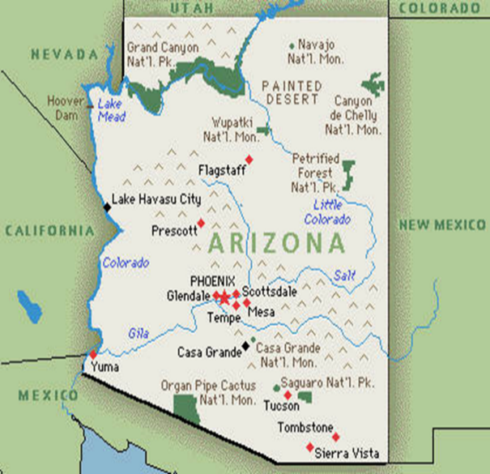
State Shared Revenues
State Sales tax
Income tax
Auto Lieu
Highway User Revenue

Slide 18
State Shared Sales Tax
Can be used on any municipal public purpose
State Tax Rate is 5.6% (.6% not shared)
Based on relation of Town’s population to other incorporated cities and towns in State based on annual population (new statute)
Notes:
.6 is used for education

Slide 19
State Income Tax
Can be used for any municipal purpose
Cities and Towns share 15% of total collections
Collections from 2 years prior
Based on relation of Town’s population to other incorporated cities and towns in State based on annual population

Slide 20
Highway User Revenues
Referred to as “gas tax”
Cities and Towns receive 27.5% of collections
One half of distribution based on relation of Town’s population to other incorporated cities and towns in State based on decennial census
One half based on “county of origin” of gasoline sales and population described above
Can only be used on street and highway purposes
Notes:
public right-of-way.74 This would include specific activities such as the paving of streets, construction of sidewalks, curbs, gutters, street lighting, and placement of traffic signs.

Slide 21
Highway User Revenues
Street and Highway purposes in the public right of way include:
Right of Way acquisition
Paving of Streets
Construction of sidewalks, curbs, gutters, street lighting and placement of traffic signals
Maintenance and repair of streets
Construction and reconstruction of streets
Bridges
Notes:
public right-of-way.74 This would include specific activities such as the paving of streets, construction of sidewalks, curbs, gutters, street lighting, and placement of traffic signs.

Slide 22
Vehicle License Tax
20% of revenues for licensing are distributed to cities and towns
Distribution is based on population in relation to total incorporated population of the county
Funds can be used for any municipal public purpose

Slide 23
Internal Service Funds
Fleet Management
Risk Management
Information Technology/GIS
Human Resources

Slide 24
Interfund Transfers
HURF Fund
Utility Fund
Sanitation Fund
Ambulance Fund
Notes:
Indirect cost allocation

Slide 25
Property Taxes- Municipal
Primary tax rate can be used for any municipal purpose
Secondary rate can only be used for payment of debt service (principal and interest) on bonds approved by voters

Slide 26
Property Taxes
Primary tax levy is limited to an increase of two percent more than the previous year's maximum allowable primary levy plus an increased dollar amount due to a net gain in property not taxed the previous year.
No statutory limit on secondary tax rate.
New primary property tax levy must be approved by voters, 3rd Tuesday in May
Notes:
If you keep the rate the same, the Town will only generate $119,615 in revenues. If you keep the levy the same, $128,428 the rate will be $2.1163 but will not require “truth in taxation” notification. Anything above that will require truth in taxation, but will generate more revenue to the general fund. For example, if you levy the following amounts, the tax rate for each goes up as presented:
$135,000 = $2.2771 tax rate
$140,000 = $2.3615 tax rate
$145,000 = $2.4458 tax rate
$150,000 = $2.5302 tax rate
$155,000 = $2.6145 tax rate
$160,000 = $2.6988 tax rate

Slide 27
Truth in Taxation
Levy versus rate!
Bottom line, if current AV goes up, truth in taxation may be required
Citizen perspective: If you had a house that was valued at $100K last year and it is valued at $110K this year and the rate stays the same, your levy is going up!

Slide 28
Truth in Taxation
Notice published twice a week.
1st publication at least 14 days but not more than 20 days before public hearing
2nd publication at least 7 days but not more than 10 days before public hearing
Hearing must be held at least 14 days before the adoption of the levy

Slide 29
Truth in Taxation
Hearings for Truth in Taxation, levy and final budget can be combined
Truth in Taxation hearing MUST be held before the adoption of final budget
Publication cannot be published in classified or legal sections
Notice must be ¼ of page in size and surrounded by a border of 1/8 inch

Slide 30
Truth in Taxation
Headline must read “Truth in Taxation Hearing-Notification of Tax Increase” at 18 point type
If you have truth in taxation, you MUST adopt tentative budget BEFORE statutory deadline of July 15
AGAIN, if rate remains the same, but AV increases above new construction, you must do truth in taxation notice procedures

Slide 31
Fund Balances
“Net” funds at end of fiscal year
Example: Town started out with $2 million FY19, added revenues, subtracted out expenditures to come up with “fund balance” which could be a positive or a deficit.

Slide 32

Fund Balances
One checking account all funds go into INCLUDING RESTRICTED FUNDS
Cash goes up and down but at the end of the year, as long as revenues meet budget collections and exp. don’t exceed budget, the Town still has their fund balance amount they started out with at the beginning of the fiscal year.

Slide 33
Special Revenue Funds

Slide 34
Special Revenue Funds
Revenues collected for specific purpose and are restricted in their use
Highway User Revenue Fund (HURF), County Excise Tax Fund, Grants

Slide 35


Enterprise Funds

Slide 36
Enterprise Funds
Like a business, needs to be “self supporting”
Revenues cover cost of providing service
User based versus tax based revenues
Enterprise Funds:
Utilities (Water & Sewer)
Ambulance
Sanitation

Slide 37
Enterprise Revenue Forecasting
Financial plan, versus rate study, versus cost of service studies
How much you need, how you are going to collect it and from whom you are going to collect it from
New housing/businesses
Type of business or manufacturing?
Weather

Slide 38
Fiduciary/Trust Fund

Slide 39
Fire Pension Fund
Restricted and must be used for purpose stated in formation of fund – Volunteer Pension Fund

Slide 40
Other Finance Sources
Bonds
General Obligation Bonds
Revenue Bonds
Excise Tax Bonds
Highway User Revenue Bonds
Special Improvement District Bonds
Municipal Property Corporation Bonds
Water Infrastructure Financing Authority (WIFA)

Slide 41

“Outside the Box” Revenues

Slide 42
New Fees
Charges to Water and Wastewater utilities to fund public safety needs
Property Taxes if utility paid as private
Franchise Fees if utility paid as private
Return on Investment for Risk if utility was private
Environmental Fee
Definition is to “help pay the costs of environmental programs for the Town and for additional safety items, such as storm water management, wash drainage and maintenance, on-call storm damage cleanup and a household hazardous waste collection day for residents.”

Slide 43
New Fees
Environmental Fee (Cont’d)
Charged at $3 per parcel
July 2019 Legislative Council ruled that is a property tax and not a fee and therefore could not be charged
August 2019 Attorney General opinion was requested but no opinion yet
Debate continues on when a new fee is set is it a tax or a fee?

Slide 44
ARS§9-499.17. Prohibition on municipal taxes and fees
Except for a municipality that, before December 31, 2013, has adopted an ordinance requiring property owners to obtain fire prevention and control services and except as provided in this title and titles 35 and 42, a municipality may not levy or assess a municipality-wide tax or fee against property owners based on the size or value of the owner's real property or improvements to real property for any public service provided by the municipality.

Slide 45
Other Alternative Revenue Sources?
Discussion on fee vs tax
Discussion on PSPRS liability financing
Other ideas?

Slide 46

Discussion/Questions?

