Slide 1
Overview of Election Process: Elections 101
July 25, 2018
Presented by Scottsdale City Clerk Carolyn Jagger, MMC

Slide 2
Topics covered include:
Election Tips
Types of Elections
Candidate and Committee Packets
Receipt of Candidate Petitions and Related Documents
Election Calendar
Election Canvass
Calculating Petition Signature Requirements
Resources

Slide 3
Election Tips:
Your Attorney is Your Best Friend
Don’t Shop For Advice
Deadlines – What do they really mean?
Bond Elections have Different Deadlines and Requirements – consult with a Bond Attorney (your new BFF), while keeping your attorney in the loop
Receipt and document
Don’t rely on what you did last time – double check the League Manual and State Statutes and touch base with your attorney every time you have an election

Slide 4
Things to Consider
Type of Election
Some elections may only be held at certain times of the year (based on statutes, city code, or charter)
Once you know the election type and when it is to be held
Determine if it is to be conducted at a polling place or by mail
Meet with County (other items may be on the ballot)
Prepare Calendar
Work Closely with your Attorney

Slide 5
Types of Elections
Candidates – Primary/General
Initiative/Referendum
Recall
Bond (General Obligation, Revenue, Street and Highway Improvement)
Sales Tax
Charter
Franchise
Direct Election of Mayor
Town to City
Spending Limit
Capital Projects Accumulation Fund
Primary Property Tax Levy Established

Slide 6
Preparing Candidate and Committee Packets
Clerk must have ready for distribution:
Nomination paper/affidavit of qualification/campaign finance laws statement
Nomination petitions
Financial disclosure forms
Campaign Finance Report form with filing dates
Statement of Organization for Political Committee
Recommended deadline for having packets ready is 90 – 120 days before the filing deadline. Depending upon your municipality’s circumstances, you my need to have prepared candidate packets available earlier.

Slide 7
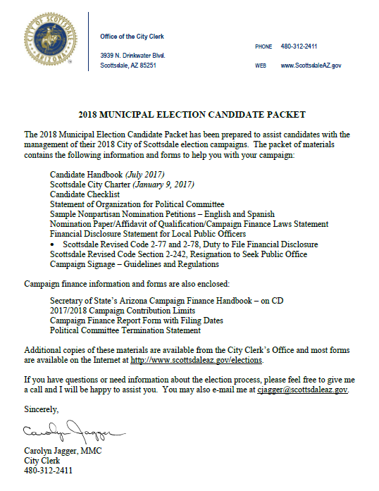
Candidate Packet

Slide 8
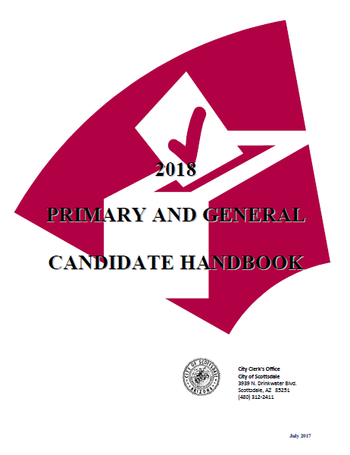
Candidate Handbook

Slide 9
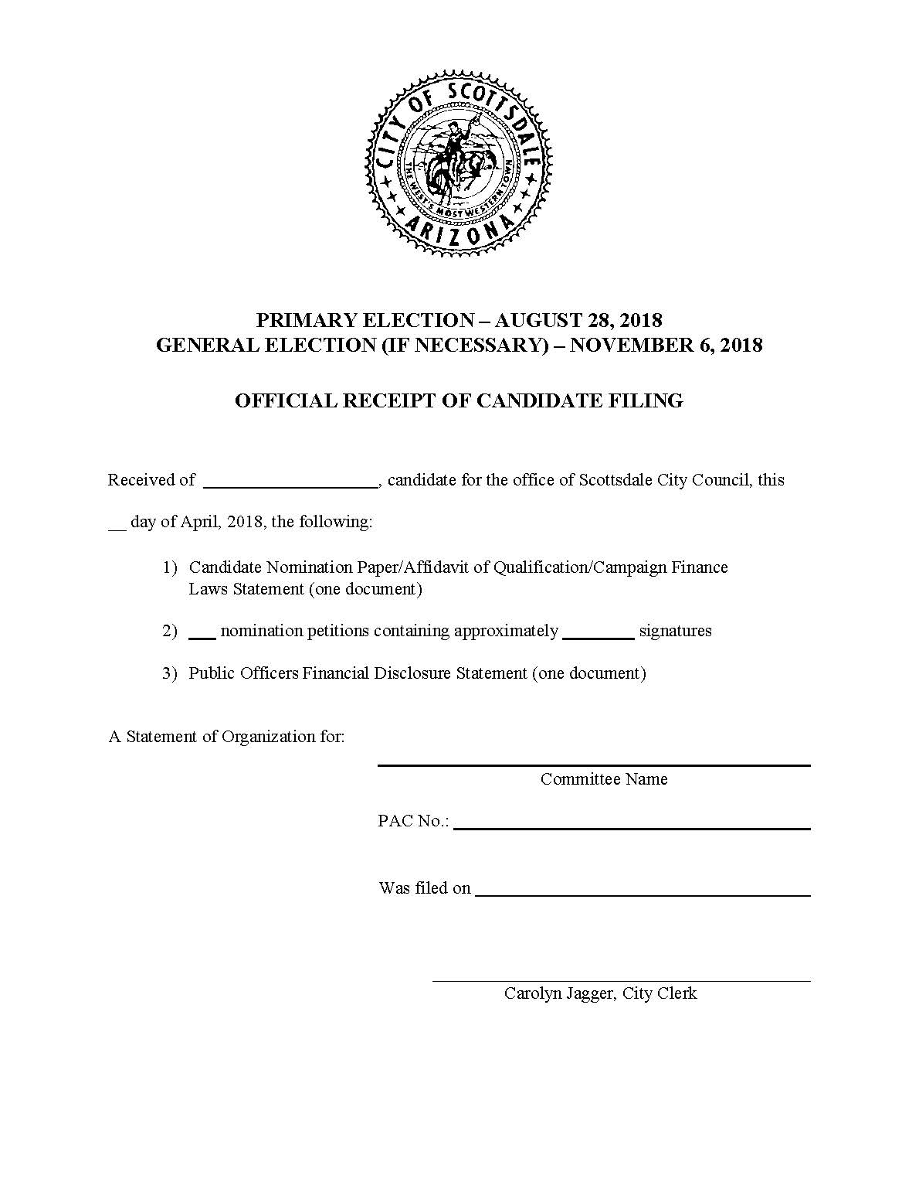
Filing Receipt – Candidate Petitions

Slide 10
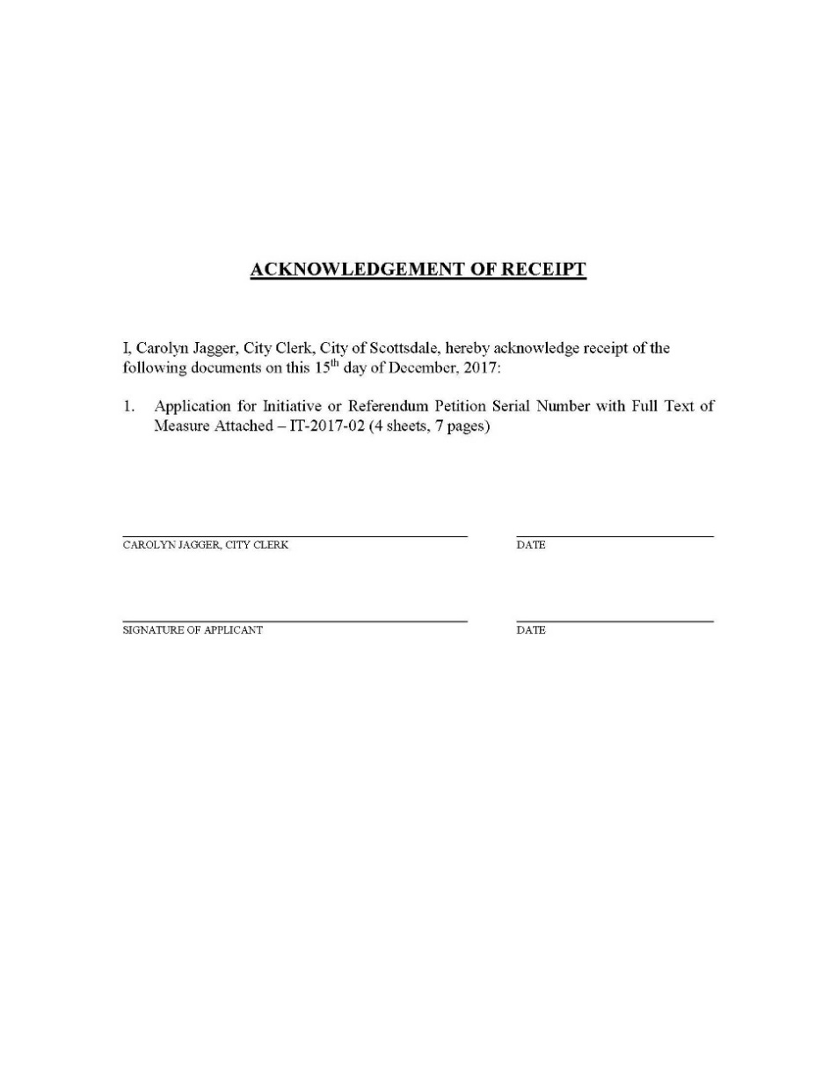
Application Receipt – Initiative

Slide 11
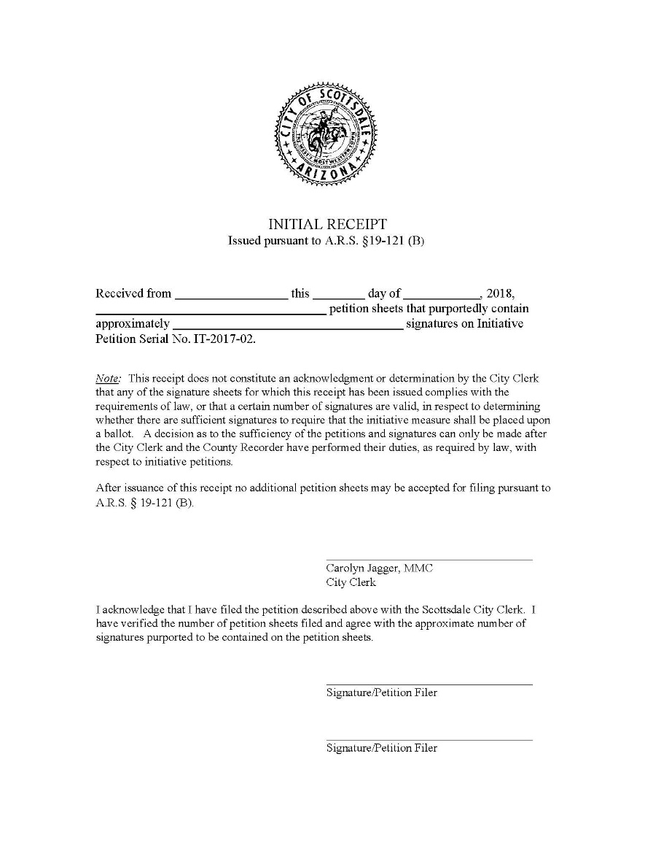
Initial Temporary Receipt – Initiative

Slide 12
Election Calendar (Fall 2018 - Candidate):
January 15, 2018:
4th Qtr/Annual 2017 campaign finance reports due (Jan or Oct – Dec 31, 2017)
March 30, 2018:
Contract with county for election services (suggested 150 days before Primary)
April 16, 2018:
1st Qtr 2018 campaign finance reports due (Jan 1 – Mar 31, 2018)

Slide 13
Election Calendar (continued):
April 30, 2018:
First day to accept candidate filings Petitions
Supplemental filings?
Nomination Paper
Financial Disclosure Statement
May 18, 2018:
Publish Call of Election (Optional - suggested 100 days prior to primary election)
05/11/18 and 05/18/18 for weekly paper
05/14/18 – 05/18/18 for daily paper

Slide 14
Election Calendar (continued):
May 30, 2018:
Candidate Filing Deadline
Petitions
Nomination Paper
Financial Disclosure Statement
Permanent early voter list notice (ARS 16-544)
June 29, 2018:
Last day to contract with county for election services to obtain County registration list
Prepare ballot proofs (suggested)

Slide 15
Election Calendar (continued):
July 13, 2018:
Mail proof of Primary sample ballot to candidates (suggest sending via email and requiring confirming response)
July 16, 2018:
2nd Qtr 2018 campaign finance report due (Apr 1 – June 30, 2018)
July 19, 2018:
Nomination papers due from write-in candidates
Written notification to county of write-in candidate name(s)
Send ballot corrections to printer (40 days prior - suggested)

Slide 16
Election Calendar (continued):
July 27, 2018:
Post notice sample ballots available - 30 days prior to election
Begin Chain of Custody Report (ARS 16-621)
July 30, 2018:
County voter registration closes (Primary)
August 1, 2018:
Begin distribution of early ballots

Slide 17
Election Calendar (continued):
August 17, 2018:
Publish city or town financial statement
Appoint and send letters to election boards.
Last day for voters to apply for early mail ballot.
August 20, 2018:
Pre-primary election campaign finance report due (July 1 – Aug 11, 2018)
August 24, 2018:
Last day for on-site early voting
August 28, 2018 - Primary Election Day

Slide 18
Election Calendar (continued):
Eye of the storm – primary is over, now what???
Take a deep breath
Calculate who was elected at primary - separate calculation for mayor if directly elected
Existing ordinances
Charter cities
Districts
Written notification to county providing the names of the candidates who are advancing to General/Runoff Election

Slide 19
Election Calendar (continued):
7 candidates are running for 3 council seats and their vote totals are as follows:
John Smith 100
Mary Johnson 90
Jane Doe 70
Fred Jackson 65
Jerry Springer 55
Sally Hancock 50
Terry Mansfield 10
Qualified write-in 5
Total Legal Votes Cast 445
To determine a majority to be elected at the primary, divide 445 by the number of seats to be filled (3). The resulting number (148.3) is divided by two (74.15) and rounded up to the next whole number (75). As a result, John Smith and Mary Johnson would be declared elected, and Jane Doe and Fred Jackson would move to the General Election ballot to determine the winner by a majority vote. If more candidates than there are offices to be filled received 75 votes or more, the top three vote getters would be declared the winners. If none of the candidates receive a majority of votes cast, the top two vote getters equal to the number of vacant seats advance to the General Election (Smith, Johnson, Doe, Jackson, Springer, and Hancock – Mansfield would be out).

Slide 20
Election Calendar (continued):
September 17, 2018:
Council meets to Canvass Primary Election
Resolution in English and Spanish
The number of ballots cast in each city or town precinct
The titles of the offices voted for and the name of each person voted for to fill the offices
Numbers and brief title of each proposed charter amendment and each initiated or referred measure
Summary of the number of votes cast in each precinct for each candidate or measure
Precinct group detail of the number of rejected ballots
Issue Certificates of Nomination and/or Election
Optional: Record with County and Publish in Newspaper

Slide 21
Election Calendar (continued):
September 21, 2018:
Mail proof of sample ballot to candidates (suggest sending via email and requiring confirming response)
September 27, 2018:
Nomination papers from write-in candidates due
October 5, 2018:
Post notice sample ballots available 30 days prior to election
October 9, 2018:
County voter registration closes (General)
October 10, 2018:
Begin distribution of early ballots

Slide 22
Election Calendar (continued):
October 15, 2018:
3rd Qtr campaign finance report due
(Aug 12 – Sept 30, 2018)
October 26, 2018:
Appoint and send letters to election boards
Last day for voters to apply for early mail ballot
October 29, 2018:
Pre-general campaign finance reports due (Oct 1 – Oct 20, 2018)

Slide 23
Election Calendar (continued):
November 6, 2018 - General Election Day
November 26, 2018:
Last day for Council to canvass General Election (may be different if held in conjunction with a bond election)
What if the results are not ready???
Issue Certificates of Election
January 15, 2019:
4th Qtr 2018 campaign finance reports due (Oct 21 – Dec 31, 2018)

Slide 24
After the Election
Transition new Councilmembers
Provide Copy of Open Meeting Law
Oath of Office
Calculate the signature requirements in advance of next election cycle for:
Candidate Elections
Initiative, Referendum, and Recall Elections
Prepare Initiative, Referendum, and Recall Packets
Take a break – you deserve it!

Slide 25
Calculating Nomination Petition signature requirement
For Cities With Directly Elected Mayor
For Mayor and Council elected at large
At least 5% and not more than 10% of the total votes cast in the City for MAYOR in the last preceding election
For Council district elections
At least 5% and not more than 10% of the total votes cast in the District for MAYOR in the last preceding election
Add the votes cast for the candidates for the office of mayor including qualified write-ins at the last election and calculate percentage.
If mayor was not elected at last preceding election, use last calculation – don’t forget to consult with your attorney.

Slide 26
Calculating Nomination Petition signature requirement (Continued)
For Cities Without a Directly Elected Mayor
At least 5% and not more than 10% of vote cast in the City for the COUNCILMEMBER receiving the highest vote at the last preceding election.
For Towns
At least 5% and not more than 10% of vote cast in the Town for the COUNCILMEMBER receiving the highest vote at the last preceding election.

Slide 27
Calculation of signatures for initiative, referendum and recall petitions
Initiatives and Referendums
Total number of VALID BALLOTS CAST at the last city or town election where a mayor or at large councilmember was elected:
For initiatives, 15%; for referendum, 10%
State law allows local ordinance to use something other than valid ballots as the basis for the calculation (initiatives only).

Slide 28
Calculation of signatures for initiative, referendum and recall petitions (Cont’d)
Recall Petitions*
For Mayor or District Councilmember
Add actual votes cast for all candidates including qualified write-ins for the office at the last general election and multiply by 25%.
For at large Councilmember
Add actual votes cast for all council candidates including qualified write-ins at the last general election. Divide by the number of offices filled at that election and multiply the result by 25%.
* Recall petitions may not be circulated against an officer until the officer has served six months of his or her first term, AZ Constitution, Article VIII, Pt 1, Sec.5.

Slide 29
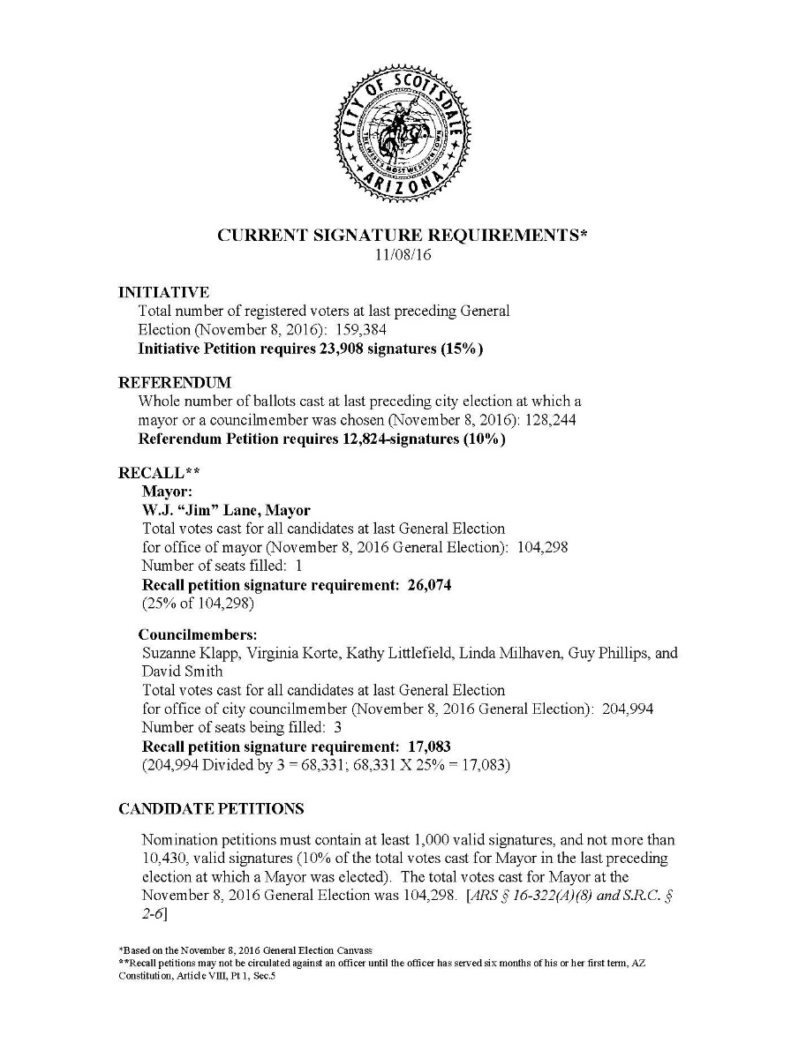
Signature Calculation

Slide 30
Resources
Your Attorney
League of Arizona Cities and Towns
City Code and/or City Charter
League of Arizona Cities and Towns Elections Manual
Calendar – Based on Type of Election
Constitution of the State of Arizona
State Law
A.R.S. Title 16 – Elections and Electors
A.R.S. Title 19 – Initiative, Referendum and Recall
https://www.azleg.gov/arstitle
Secretary of State’s – Campaign Finance Handbook
Secretary of State’s Initiative and Referendum Handbook
Secretary of State’s Elections Procedures Manual
Secretary of State’s Financial Disclosure Guide

