Slide 1


Slide 2
2018 Legislation & Case Law Update
AMCA Summer 2018 Conference
Wednesday, July 25, 2018
Christina Estes-Werther
General Counsel
League of Arizona Cities and Towns

Slide 3
HB 2078 (Laws 2018, Ch. 77) political subdivisions; candidate committee (finchem)
BACKGROUND
In 2016, campaign finance laws were repealed and replaced;
Threshold Exemption Statement REPEALED; and
Threshold amount required to register as a committee increased from $500 to $1,000 (with biennial increases of $100)
PROVISIONS (A.R.S. §§ 16-905, 16-928, 16-931)
This measure restores the $500 committee threshold amount ONLY for city and town candidates.
The $500 threshold is EXEMPT from the biennial increase.
The measure removes the payment of a fee by local jurisdictions that choose to opt-in to the Secretary’s campaign finance system.
BILL STATUS OVERVIEW
Third Read: House 2/15/18 (59-0-1-0); Senate 3/21/18 (29-0-1)
Signed by Governor Ducey 3/27/18

Slide 4
HB 2078 (Laws 2018, Ch. 77) political subdivisions; candidate committee (finchem)
ANSWERS TO FREQUENTLY ASKED QUESTIONS
Beginning August 3, 2018, your candidate committees must register, within ten days, as a committee if they receive contributions or make expenditures, in any combination, of at least $500 in connection with that candidacy.
This legislation does NOT reinstate the Threshold Exemption Statement.
Candidates who receive/spend at least $500 will register as a committee and begin reporting.
Candidates who receive/spend less than $500 will NOT register – there is no threshold statement to submit.
There will NOT be a new Statement of Organization form – the existing form is sufficient (it does not reference the threshold amounts and can be used for various jurisdictions).

Slide 5
HB 2078 (Laws 2018, Ch. 77) political subdivisions; candidate committee (finchem)
ANSWERS TO FREQUENTLY ASKED QUESTIONS
A candidate who receives/spends less than $500 can register, but is not required to register as a committee. Once a candidate registers, the candidate must file campaign finance reports.
A candidate who has currently reached the $500 threshold is NOT required to register until the effective date (August 3, 2018). The candidate has ten days from the effective date to register.
This legislation affects CANDIDATE COMMITTEES, NOT PACs. The PAC threshold remains $1,100 and is subject to the biennial increase (it will increase to $1,200 on January 1, 2019).

Slide 6
HB 2078 (Laws 2018, Ch. 77) political subdivisions; candidate committee (finchem)
HYPOTHETICALS
It’s August 5, 2018, and a mayoral candidate has received $300 and spends $201. Does she have to register as a committee?
If yes, when does she have to make her first report?
A town council candidate has raised $100 and spent $200. Does he need to file a Threshold Exemption Statement?
Does he have to register as a candidate committee?
A PAC receives $400 and spends $200. Is registration required?

Slide 7
HB 2078 (Laws 2018, Ch. 77) political subdivisions; candidate committee (finchem)
 | CITY/TOWN | STATE
THRESHOLD EXEMPTION STATEMENT | NONE - REPEALED | NONE - REPEALED
CANDIDATE COMMITTEE REGISTRATION REQUIRED | AT $500 | AT $1,100 (2017-2018 election cycle)
POLITICAL ACTION COMMITTEE REGISTRATION REQUIRED | AT $1,100 (2017-2018 election cycle) | AT $1,100 (2017-2018 election cycle)

Slide 8
HB 2153 (Laws 2018, Ch. 134) campaign finance; nonprofits; disclosure (leach)
BACKGROUND
An “entity” means a corporation, limited liability company, labor organization, partnership, trust, association, organization, joint venture, cooperative, unincorporated organization or association or other organized group that consists of more than one individual. A.R.S. § 16-901(22).
Political Action Committee Requirements - A.R.S. § 16-905(B)
An entity has to register as a PAC if the entity is organized for the primary purpose of influencing the result of an election; and
The entity knowingly receives contributions or makes expenditures, in any combination, of at least $1,100 in connection with any election during a calendar year.

Slide 9
HB 2153 (Laws 2018, Ch. 134) campaign finance; nonprofits; disclosure (leach)
PROVISIONS (A.R.S. §§ 16-901, 16-905)
An entity’s registration or standing with the Arizona Corporation Commission is no longer a factor when considering whether the entity has to register as a PAC.
The city or town clerk or attorney now has three factors (instead of five factors) to consider when making a rebuttable presumption that an entity is organized for the primary purpose of influencing the result of an election if the entity meets ANY of the following:
Claims exempt status but fails to file a form 1023 or 1024 (this does not apply to a religious organization);
Made a contribution or expenditure and at that time had its tax exempt status revoked by the IRS; or
Made a contribution or expenditure and at that time failed to file a form 990 with the IRS.

Slide 10
HB 2153 (Laws 2018, Ch. 134) campaign finance; nonprofits; disclosure (leach)
PROVISIONS (A.R.S. §§ 16-901, 16-905)
Prohibits a clerk, attorney or other municipal officer from requiring an entity that claims tax exempt status under IRC 501(a) and that remains in good standing with the IRS to do any of the following:
Register or file as a PAC;
Report or otherwise disclose personally identifying information relating to an individuals who have made contributions to that entity;
Disclose its Schedule B, Form 990; and
Submit to an audit or subpoena or produce evidence regarding a potential campaign finance violation.

Slide 11
HB 2153 (Laws 2018, Ch. 134) campaign finance; nonprofits; disclosure (leach)
PROVISIONS (A.R.S. §§ 16-901, 16-905)
This restriction does NOT apply if the entity meets the PAC registration requirements or if the clerk/attorney makes a rebuttable presumption that an entity is organized for the primary purpose of influencing the result of an election if the entity meets the criteria in A.R.S. § 16-905.
BILL STATUS OVERVIEW
3rd Read: House 2/13/18 (33-25-2-0); Senate 3/29/18 (17-13-0)
Signed by Governor Ducey 4/5/18

Slide 12
HB 2153 (Laws 2018, Ch. 134) campaign finance; nonprofits; disclosure (leach)
HYPOTHETICAL
The town clerk receives a complaint that an entity should be registered as a PAC?
Does the entity meet the PAC requirements – has the primary purpose test and threshold amount been met?
If no or uncertain, as the clerk, have you made a rebuttable presumption that the entity is organized for the primary purpose of influencing the election based on the three factors in A.R.S. §16-905?

Slide 13
HB 2153 (Laws 2018, Ch. 134) campaign finance; nonprofits; disclosure (leach)
HYPOTHETICAL
If no, this legislation prohibits a clerk, attorney or other municipal officer from requiring an entity that claims tax exempt status under IRC 501(a) and that remains in good standing with the IRS to:
Register or file as a PAC;
Report or otherwise disclose personally identifying information relating to an individuals who have made contributions to that entity;
Disclose its Schedule B, Form 990; OR
Submit to an audit or subpoena or produce evidence regarding a potential campaign finance violation.
If the entity doesn’t meet the requirements of a PAC or satisfy the rebuttable presumption, the entity cannot be required to provide certain information.

Slide 14
HB 2153 (Laws 2018, Ch. 134) campaign finance; nonprofits; disclosure (leach)
HYPOTHETICAL
What happens if you are a charter city and have a separate disclosure provision?
Talk to your attorney about next steps and how the legislation and your specific charter provisions interact to determine if there is a conflict.

Slide 15
HB 2173 (Laws 2018, Ch. 154) notice of participation; jurisdictional elections (coleman)
PROVISIONS (A.R.S. § 16-226)
Requires a city and town election not held concurrently with the general election to be called no later than 120 days before the date of holding the election.
Applies to special elections, recall elections, and any election not on the statewide cycle.
BILL STATUS OVERVIEW
Third Read: House 2/8/18 (58-0-1-0); Senate 4/4/18 (30-0)
Signed by Governor Ducey 4/10/18

Slide 16
HB 2173 (Laws 2018, Ch. 154) notice of participation; jurisdictional elections (coleman)
ANSWERS TO FREQUENTLY ASKED QUESTIONS
This legislation does NOT require publication of:
A Call of Election (see A.R.S. § 16-227); or
A Notice of Election (see A.R.S. § 16-228).
The purpose of the bill is for your city or town to notify the county at least 120 days before the election date if the county administers the election. Past this date, the county may refuse to administer the election (it becomes increasingly difficult to meet election deadlines with less than 120 days notice).
If a Call of Election or Notice of Election are not required, how is a call of election made under the new law?
No guidance in statute; discuss with attorney about the use of a resolution or a statement by the council to satisfy this requirement.

Slide 17
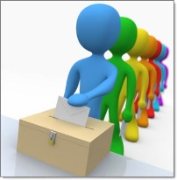
HB 2604 (Laws 2018, Ch. 247) consolidated elections; voter turnout (mesnard)
PROVISIONS (A.R.S. §§ 16-204.01, 16-204.02, 16-205, 16-542, 16-646)
Beginning in 2018, if a city or town holds its elections on a nonstatewide election date and its regular candidate election (not a special election or recall election) results in a significant decrease in voter turnout, the city or town must hold its future elections on the statewide election dates (Fall even-numbered years), beginning three years after the election with the significant decrease.
The county recorder or election officer shall calculate the voter turnout and announce the results and any implementation date for consolidation at a public meeting within 90 days after the issuance of the county canvass.
After the implementation date of the consolidation, the county may not call, authorize the call for or administer an election for that city or town that is not on the statewide election dates.

Slide 18
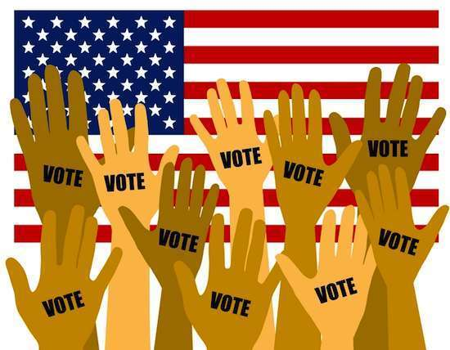
HB 2604 (Laws 2018, Ch. 247) consolidated elections; voter turnout (mesnard)
PROVISIONS (A.R.S. §§ 16-204.01, 16-204.02, 16-205, 16-542, 16-646)
The canvass shall show for each candidate race in each city or town, the number of ballots cast and the number of active registered voters in each political subdivision and portion of a political subdivision for which a candidate may be elected.
Provides a mechanism to accommodate alternative expenditure limitation expirations and extend term limits as a result of a city or town that is required to move to statewide election dates.
Reiterates that voters with no party preference must designate a ballot for the election, including a nonpartisan ballot if requested.
BILL STATUS OVERVIEW
Final Read: House 4/12/18 (31-23-6); Senate 4/12/18 (16-12-2-0)
Signed by Governor Ducey 4/17/18

Slide 19

HB 2604 (Laws 2018, Ch. 247) consolidated elections; voter turnout (mesnard)
How is voter turnout calculated?
The county recorder/elections must calculate:
The number of ballots cast for a candidate in an office that received the highest number of votes divided by the total number of active registered voters in that city or town.
The number of ballots cast for the city or town in which the office of governor appeared on the ballot divided by the number of active registered voters in that city or town.
If the city or town voter turnout for the candidate race is 25% less than the voter turnout in the city or town in which the governor’s race was on the ballot, the county must find a significant decrease in voter turnout and the city or town must move their election date within 3 years to the statewide election dates.

Slide 20
HB 2604 (Laws 2018, Ch. 247) consolidated elections; voter turnout (mesnard)
Here, the city/town turnout for the highest candidate was 30% and the city/town turnout in the Gov race was 50%; taking 25% of the voter turnout of the 50% results in 37.5%. The city/town turnout of 30% is at least 25% lower than the Gov race and requires moving the election to the statewide election dates.
FORMULA | EXAMPLE | % | CALCULATION
Ballots Cast for City/Town Candidate with Highest # Votes Total Number of Active Registered Voters in City/Town | 1,200 ballots cast 4,000 active registered voters | 30
Ballots Cast for Governor in City/Town Total Number of Active Registered Voters in City/Town | 2,000 ballots cast for Gov in city/town 4,000 active registered voters in city/town | 50 | 25% of 50% = 12.5%; 50% - 12.5% = 37.5%

Slide 21
HB 2604 (Laws 2018, Ch. 247) consolidated elections; voter turnout (mesnard)
Here, the city/town turnout for the highest candidate was 45% and the city/town turnout in the Gov race was 50%; taking 25% of the voter turnout of the 50% results in 37.5%. The city/town turnout of 45% is NOT at least 25% lower than the Gov race and the city/town is NOT required to move to the statewide election dates.
FORMULA | EXAMPLE | % | CALCULATION
Ballots Cast for City/Town Candidate with Highest # Votes Total Number of Active Registered Voters in City/Town | 1,800 ballots cast 4,000 active registered voters | 45
Ballots Cast for Governor in City/Town Total Number of Active Registered Voters in City/Town | 2,000 ballots cast for Gov in city/town 4,000 active registered voters in city/town | 50 | 25% of 50% = 12.5%; 50% - 12.5% = 37.5%

Slide 22
HB 2604 (Laws 2018, Ch. 247) consolidated elections; voter turnout (mesnard)
QUESTIONS
What cities/towns does this affect?
Only those cities that are not holding elections on the statewide election dates (Fall even-numbered years). This does not affect general law cities and towns that are already on the consolidate statewide election cycle.
Is this calculation required for every election?
No, only candidate elections – it exempts special elections or recall elections.
What is the city/town’s role in the calculations?
Nothing, the county is responsible for the calculations (although it’s good to double-check their work since this may require your city/town to move election dates).
Are the counties comparing the primary election results or the general election results?
Both; the counties will calculate at the primary and the general for every election to determine the voter turnout.

Slide 23
HB 2604 (Laws 2018, Ch. 247) consolidated elections; voter turnout (mesnard)
QUESTIONS
What happens if a city is required to move to statewide election dates?
The city has three years to prepare to move its election dates;
Term limits may be extended;
Alternative expenditure limits scheduled to expire the year when the city is required to comply with the election consolidation are given an extension until the next eligible regular election date (no penalties imposed).

Slide 24
SB1249 (Laws 2018, Ch. 56) campaign finance violations; appeals (Burges)
PROVISIONS (A.R.S. § 16-938)
Allows an alleged campaign finance violator to appeal the city or town attorney’s penalty directly to the superior court instead of through state agency appeals process.
Requires a copy of the appeal to be provided to the city attorney.
At the appeal hearing:
Requires the superior court to conduct a trial de novo (a new trial without considering the enforcement officer’s previous finding); and
The city or town attorney has the burden of proving any alleged violation by a preponderance of the evidence (sufficient to incline a fair and impartial mind to one side of the issue rather than the other).
Effective January 1, 2019.
BILL STATUS OVERVIEW
3rd Read: Senate 2/21/18 (30-0); House 3/20/18 (57-0-3-0)
Signed by Governor Ducey 3/23/18

Slide 25
SB1437 (Laws 2018, Ch. 261) elections; equipment; amendments (Burges)
PROVISIONS (NEARLY 50 STATUTES AFFECTED)
System Requirements
Generally, the legislation removes and repeals outdated and antiquated language from the election statutes (lever voting equipment, ballot cards, tally boards, etc.);
Updates ballot instructions to voters;
Defines “e-pollbook” as an electronic system in which a voter is checked in, and through which a voter’s signature is recorded to indicate that the voter has voted; and
Outlines how an electronic voting system must accommodate the ballot layout;

Slide 26
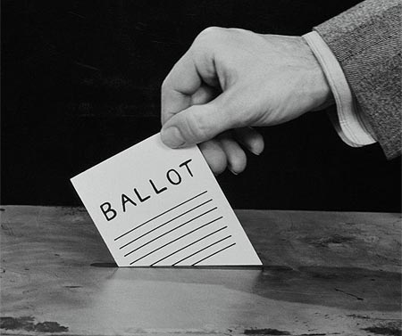
SB1437 (Laws 2018, Ch. 261) elections; equipment; amendments (Burges)
PROVISIONS (NEARLY 50 STATUTES AFFECTED)
Polling Place Updates
Removes the election marshal’s authority to act with the powers of a constable;
Removes the requirement that a person at the end of the line when polls close must vote in the presence of the election board or officials;
Removes the 5-minute limit for a voter in the voting booth; and
Allows the voter to reenter the voting area as an official observer or to assist another voter.
BILL STATUS OVERVIEW
Third Read: Senate 2/15/18 (29-0-1); House 4/4/18 (60-0)
Signed by Governor Ducey 4/25/18

Slide 27

StateWIDE REFERENDUM EFFORTS
These measures have submitted applications; deadline to submit signatures is July 5, 2018.
Stop Political Dirty Money: Seeks to refer a measure that requires all persons (including individuals, corporations, and other legal persons) who spend more than $10,000 in a political election cycle to disclose the identity of donors contributing more than $2,500.
Clean Energy for a Healthy Arizona: Seeks to refer a measure that requires Arizona electric utilities to incrementally increase the share of power generated by renewable sources to 50% by 2030.

Slide 28
StateWIDE REFERENDUM EFFORTS
These measures have submitted applications; deadline to submit signatures is July 5, 2018.
Invest in Education Act: Seeks to refer a measure that increases state income taxes on high-income earners. The tax increase is exempt from the state shared revenue formula and directly funds education; therefore, cities and towns will not receive any additional funds from the proposed increase.
On the ballot:
Save Our Schools Arizona: Seeks to refer Laws 2017, Ch. 139 (S.B. 1431), which expands the Empowerment Scholarship Accounts (ESAs) program (aka school vouchers).

Slide 29


CASE LAW UPDATE
Perea v. Reagan (Save Our Schools Arizona)
On August 8, 2017, SOS Arizona submitted referendum petitions
On August 11, 2017, petitioners challenged the registration and circulation of certain circulators of the SOS referendum petition; the court dismissed the case finding that the petitioners did not have standing;
On appeal, the Arizona Supreme Court upheld the dismissal.
During this timeframe, the petitions were verified by the State.
Petition will be on the ballot this Fall.

Slide 30

CASE LAW UPDATE
Legacy Foundation Action Fund v. Citizens Clean Elections Comm’n
In 2014 the Legacy Foundation Action Fund (LFAF) ran an television advertisement criticizing the work of the U.S. Conference of Mayors and its president, Mesa, Ariz. Mayor Scott Smith, who was also a candidate for governor.
A complaint was filed by Smith’s campaign that LFAF had failed to register and disclose the ad as an independent expenditure. The Secretary of State’s Office did not find reasonable cause; however, the Citizens Clean Elections Commission (CCEC) found reasonable cause to believe that LFAF’s ads, which ran from late March to early April, were express advocacy, not issue advocacy, and voted to impose a $96,000 fine against the Legacy Foundation Action Fund for failure to disclose.

Slide 31
CASE LAW UPDATE
Legacy Foundation Action Fund v. Citizens Clean Elections Comm’n
On April 14, 2015, Appellant the Legacy Foundation Action Fund (LFAF) filed a Notice of Appeal and Complaint for Judicial Review of Administrative Decision in superior court.
On May 4, 2015, CCEC filed a Motion To Dismiss contending LFAF had filed after the 14 day deadline and the court agreed and dismissed the case.
June 2015, the Secretary’s Office motioned to intervene.
LFAF appealed; the Court of Appeals affirmed the lower court’s decision.
LFAF filed for review with the Arizona Supreme Court.
On January 25, 2018, the Arizona Supreme Court affirmed the lower court’s decision that Legacy Foundation, as a party subject to the Clean Elections Act, must abide by the 14-day deadline to appeal and rejected Legacy Foundation’s argument that they were subject to the longer court rule timeframe.

Slide 32

CASE LAW UPDATE
Horne v. Polk
The Secretary of State made a reasonable cause determination that Attorney General Horne and his campaign had violated campaign finance laws. Due to the conflict of referring the matter to the Attorney General’s Office, the solicitor general referred the investigation to Yavapai County Attorney Sheila Polk. Polk investigated, found violations and ultimately attempted to prosecute based her findings that the AG had violated the law.
Horne appealed those findings, but the superior court and court of appeals affirmed.
On May 25, 2017, the Arizona Supreme Court found due process concerns because the same office combined prosecutorial and adjudicative functions and there was not a neutral adjudicator. The Court vacated the court decisions and remanded for further proceedings.

Slide 33

CASE LAW UPDATE
Arizona Advocacy Network v. State or Arizona (CV 2017-096705)
On Nov. 15, 2017, the plaintiffs filed a challenge against SB1516 provisions are in conflict with the Clean Elections Act. Specifically, provisions that restrict enforcement of independent expenditure reporting to the Secretary of State, the requirements of committee registration, and the redefinition of “contributions” and “expenditures.”
Case pending.

Slide 34

CASE LAW UPDATE
Madonna, et al. v. State of Arizona
HB 2244 passed requiring strict compliance for STATEWIDE initiative measures.
Plaintiffs (including Sandy Bahr and Animal Defense League of Arizona) filed a complaint seeking the Court to order that HB2244 (strict compliance standard for statewide initiatives) violates Article III of the Arizona Constitution by superseding the prior decisions of the judiciary that initiatives are subject to a substantial compliance standard; and enjoin the State from implementing or enforcing HB2244.
On August 8, 2017, the court found that the matter was not ripe for judicial review and none of the plaintiffs had a pending measure that was affected.

Slide 35
CASE LAW UPDATE
Madonna, et al. v. State of Arizona
On May 8, 2018, the Arizona Court of Appeals affirmed the superior court’s decision holding that the petitioners had not yet engaged in the initiative petition process so there is no particularized injury. Further, the petitioners have not taken any concrete, affirmative steps such as filing an application or obtaining a serial number to begin circulating petitions for a 2018 ballot measure. The Court held that no justiciable issue or controversy exists.

Slide 36
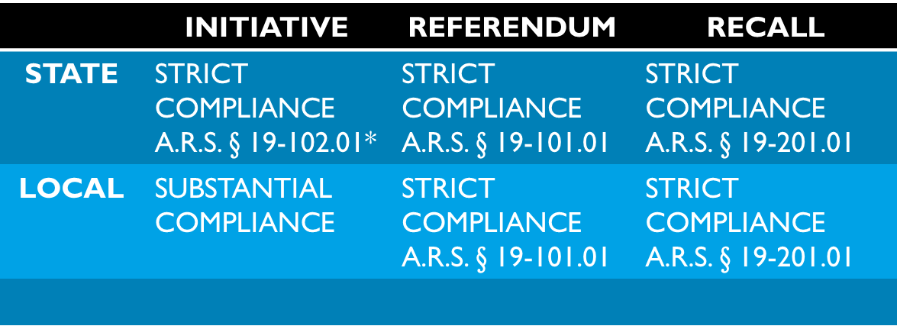
CASE LAW UPDATE
Compliance Standards – State v. Local

Slide 37
CASE LAW UPDATE
CANDIDATE CHALLENGES RE RESIDENCY
Elias v. Kirkpatrick: Plaintiff alleges Ann Kirkpatrick does not have residency in CD 2 (residency not required for Congressional seats) and therefore the information she provided on her nomination form was false; the Court found Kirkpatrick has an intent to remain in Tucson and remains on the ballot.
Backus v. Shooter: Plaintiff brought challenge alleging Don Shooter’s residency; the court ruled that Shooter can remain on the ballot because despite his wife living in Phoenix, his primary residence remains listed as Yuma. Appeal filed.

Slide 38
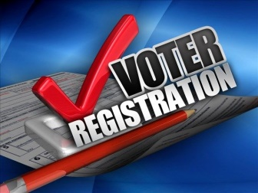
CASE LAW UPDATE
LULAC v. Reagan, Fontes (U.S. District Court)
On November 7, 2017, LULAC-Arizona and Arizona Students Association filed an action against the Secretary and Recorder Fontes alleging that Arizona’s dual voter registration policies violate the First and Fourteenth Amendments to the United States Constitution. Specifically, the lawsuit alleged that Arizona treats voter registration applicants differently depending on whether they use Arizona’s state registration form (the “State Form”) or the national registration form (the “Federal Form”).

Slide 39

CASE LAW UPDATE
LULAC v. Reagan, Fontes (U.S. District Court)
On June 4, 2018, the parties entered into a consent decree that stipulates:
the Secretary shall revise the Procedures Manual to incorporate the terms of this Consent Decree (“Procedures Manual Revisions”);
check all State Form applications submitted without documentary proof of citizenship against the MVD database Proxy Table, via the automated processes in the Database, to determine whether the MVD has citizenship on file for the applicants’;
The counties have the option of following this procedure for voter registration forms submitted after January 1, 2017;
Voters who move between counties in Arizona will not have to show proof of citizenship if the voter’s information has already been provided and is in the system.

Slide 40


CASE LAW UPDATE
Lair v. Motl (9th Circuit)
Montana enacted contribution limits to candidates for state office. Political parties and campaign donors brought an action challenging the constitutionality of the state’s contribution limits.
The District Court found that these limits violated First Amendment speech protections because they were unduly restrictive.
On October 23, 2017, the 9th Circuit reversed and held that the limits are justified by and adequately tailored to the state’s interest in combating quid pro quo corruption or its appearance.

Slide 41

CASE LAW UPDATE
Minnesota Voters Alliance v. Mansky (U.S. Supreme Court)
The State prohibits individuals from wearing political apparel at or around polling places on election days. A man wearing a t-shirt with a Tea Party logo and a button that advocated for a photo ID requirement was told that he was in violation of the law.
The plaintiffs claimed that statute violated his First Amendment rights and was selectively enforced, in violation of the Equal Protection Clause.
The Court held that Minnesota’s ban on political apparel at polling places violates the First Amendment’s free speech clause. The law was vague because it provides little guidance about what kind of apparel may or may not be worn to the polls, and the state has not provided any “objective, workable standards.”

Slide 42
CASE LAW UPDATE
Husted v. Randolph (U.S. Supreme Court)
Plaintiff brought a challenge alleging Ohio was violating the National Voter Registration Act (NVRA) by purging voters from its voter registration database based on a voter’s inactivity.
Ohio uses the failure to vote for two years as a rough way of identifying voters who may have moved, and it then sends a preaddressed, postage prepaid card to these individuals asking them to verify that they still reside at the same address. Voters who do not return this card and fail to vote in any election for four more years are presumed to have moved and are removed from the rolls.
On June 11, 2018, the Court upheld Ohio’s process and found it does not violate NVRA.

Slide 43
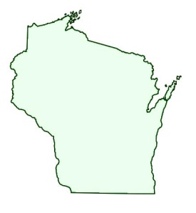
CASE LAW UPDATE
Gill v. Whitford (U.S. Supreme Court)
Plaintiffs (12 Democratic voters) challenged the Wisconsin legislative redistricting plan alleging that the plan unfairly favored Republican voters and candidates by packing Democratic voters in certain districts to diminish their votes.
On June 18, 2018, the Court unanimously held that the plaintiffs had failed to demonstrate standing because they had not shown any specific, individual injury to their right to vote. The case is remanded back to the lower court.

Slide 44
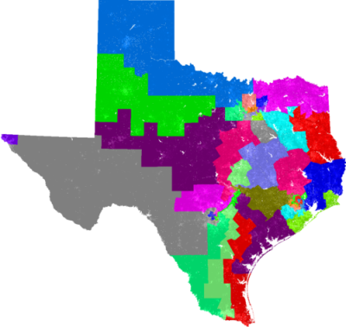
CASE LAW UPDATE
Abbot v. Perez (U.S. Supreme Court)
In 2011, Texas adopted new congressional and legislative districting plans attempting to balance the U.S. Constitution’s requirements that forbids racial gerrymandering with the requirements of the Voting Rights Act, which cannot provide less opportunity for racial minorities to elect representatives of their choice. The plans were immediately challenged and the Texas court redrew the maps in 2013.
The case was litigated for years and in 2017, the Texas court found defects in several of the districts in the 2011 plan and invalidated multiple districts holding there was discriminatory intent when the plan was created. Additionally, several districts were invalidated under the VRA because they deprived Latinos of the equal opportunity to elect candidates of their choice.
The U.S. Supreme Court found that the burden of proof lies with the challenger, not the state; and the lower court should not have enjoined the use of the 2013 maps, which were drawn by the court so there was no lingering discriminatory intent. The Court held that the evidence by plaintiffs was “plainly insufficient” to prove that the 2013 Legislature acted in “bad faith’ when it enacted the districts.

Slide 45

State Procedures manual
The Arizona Secretary of State's Office drafted the State of Arizona Election Procedures Manual for the 2017-2018 election cycle.
The Manual was submitted to the Governor and Attorney General for approval on March 30, 2018.
Addition of new chapters:
Campaign Finance;
Holding Public Office
Qualifications to Hold City or Town Office
Running for Public Office – Federal, State and Local Elections;
https://azsos.gov/elections/arizona-election-laws-publications

Slide 46

OTHER MATERIALS
State Publications
Candidate Campaign Finance Handbook (June 2018)
Financial Disclosure Statement Guide (May 2018)
Initiative and Referendum Guide (May 2018)
Recall Handbook (2013)
League Election Manual
Current Version – November 2017
Updated version expected Fall 2018

Slide 47

Questions?

