Slide 1

Vehicle Replacement Model

Slide 2
Project Evolution
Trigger
City of Mesa’s Vehicle Replacement Model
Theory
Data Assets
Dilemmas
Framing
Alignment
Analysis
Process
Analytical Framework
Trigger
Theory
Analysis
Process
Dilemmas

Slide 3
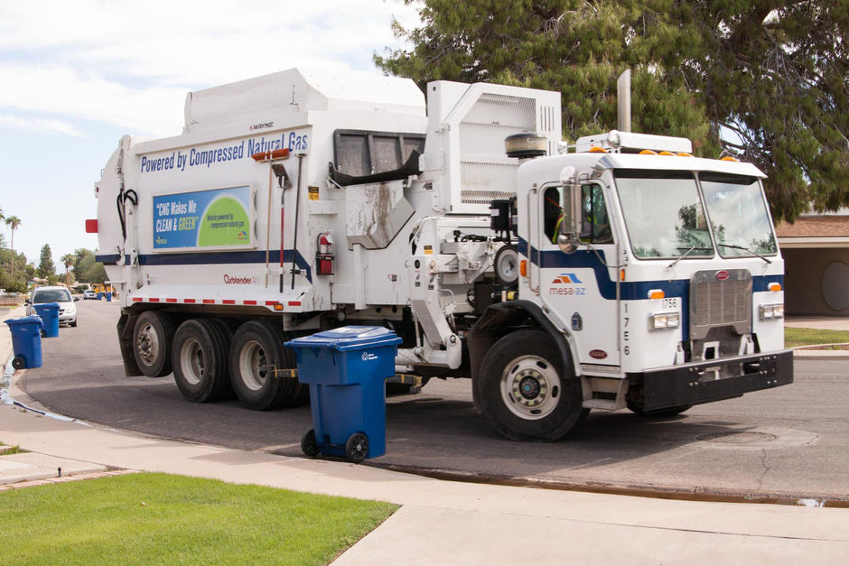
Trigger¹
December 2015:
Solid Waste Department requests help to evaluate pros and cons of moving to a 5-year replacement cycle from a 7-year replacement cycle for ASL garbage trucks.
Framing
Data Assets
Alignment
Trigger
Theory
Analysis
Process
Dilemmas

Slide 4
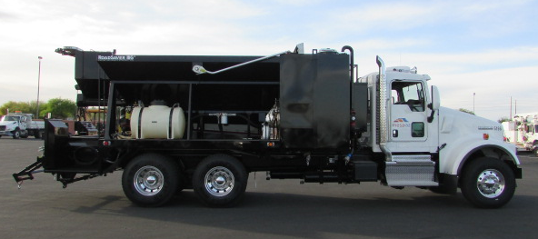
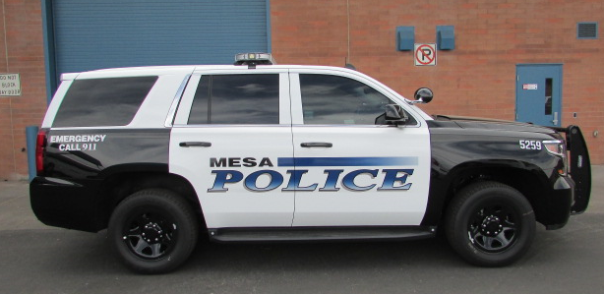
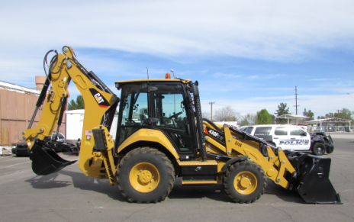
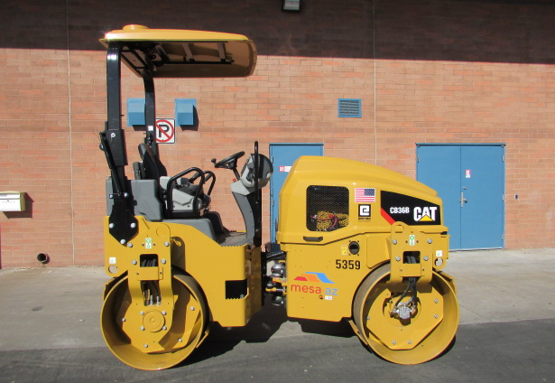
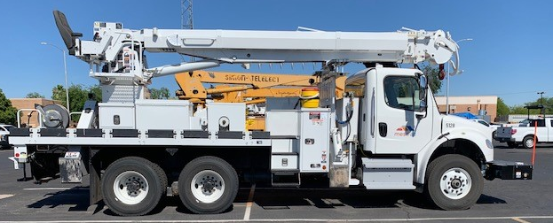
Trigger²
Mesa’s Fleet:
1,493 vehicles
$105 million book
$160 million replace
10-year cycle?
13-year cycle?
Framing
Data Assets
Alignment
Trigger
Theory
Analysis
Process
Dilemmas

Slide 5
Practice
Why do we retire a vehicle?
Factors Influencing Vehicle Replacement
Age
Mileage
Blue Book : Repair cost
Framing
Data Assets
Alignment
Trigger
Theory
Analysis
Process
Dilemmas

Slide 6
Performance Analysis Framework
Post-mortem
Describe
Causality
Predict
Prescribe
Objectives
Simulation
Optimization
Change Management
Outcomes
Inputs
Framing
Data Assets
Alignment
Trigger
Theory
Analysis
Process
Dilemmas

Slide 7
Vehicle Data at City of Mesa
For every vehicle since its introduction into the fleet:
Activity
Vehicle Costs
Miles
Downtime: Department
Work Order
Gross DT Hours
Age
Direct Shop Labor Hours
Purchase
Upfitting
Fuel
Preventative Maintenance
Repairs
(Warranty)
Modifications
Accidents
Decommission
(Sale)
Framing
Data Assets
Alignment
Trigger
Theory
Analysis
Process
Dilemmas

Slide 8
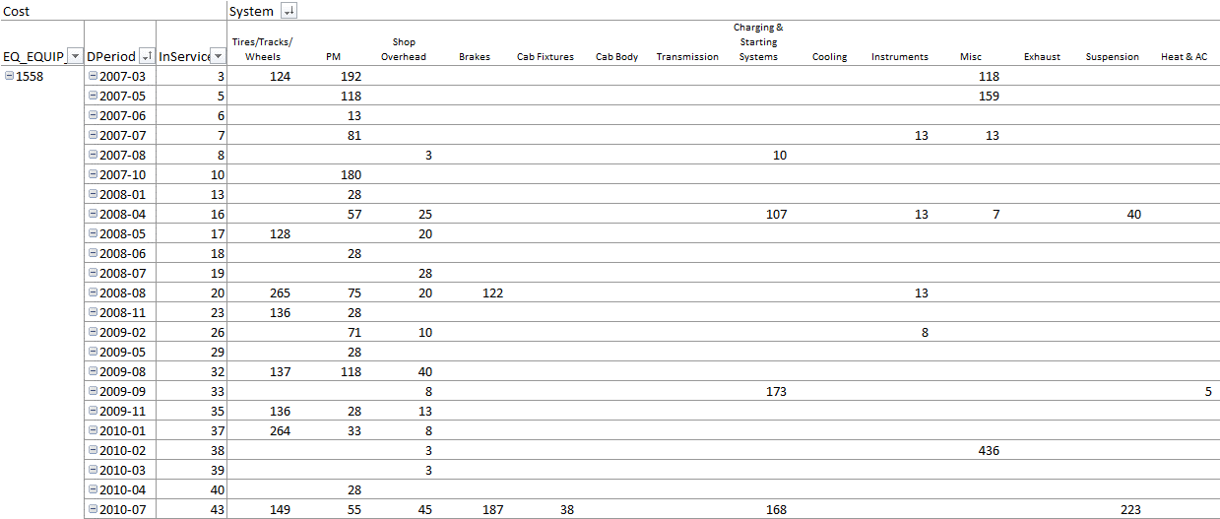
Patrol Vehicle #1558
Framing
Data Assets
Alignment
Trigger
Theory
Analysis
Process
Dilemmas

Slide 9
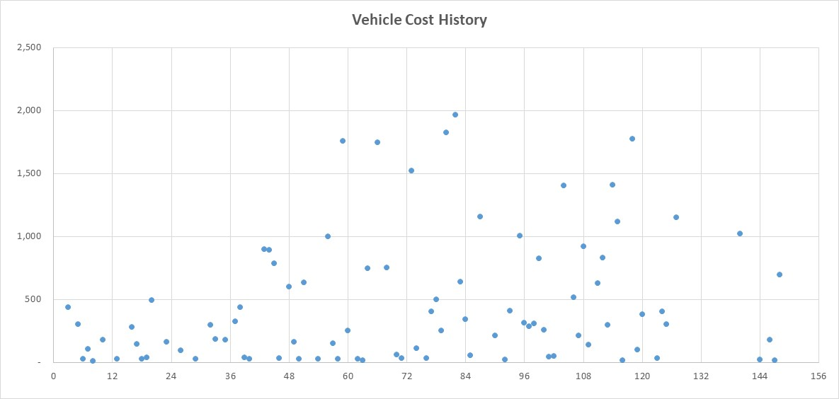
Patrol Vehicle #1558
Framing
Data Assets
Alignment
Trigger
Theory
Analysis
Process
Dilemmas

Slide 10
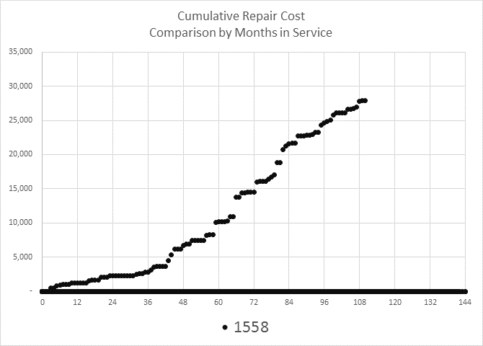
Patrol Vehicle #1558
Framing
Data Assets
Alignment
Trigger
Theory
Analysis
Process
Dilemmas

Slide 11
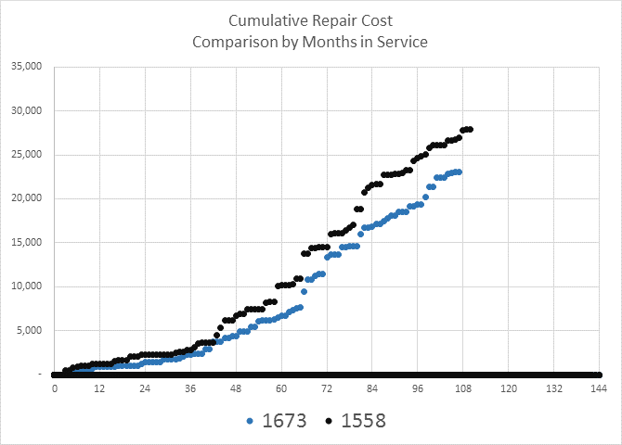
Patrol Vehicle #1558 & #1673
Framing
Data Assets
Alignment
Trigger
Theory
Analysis
Process
Dilemmas

Slide 12
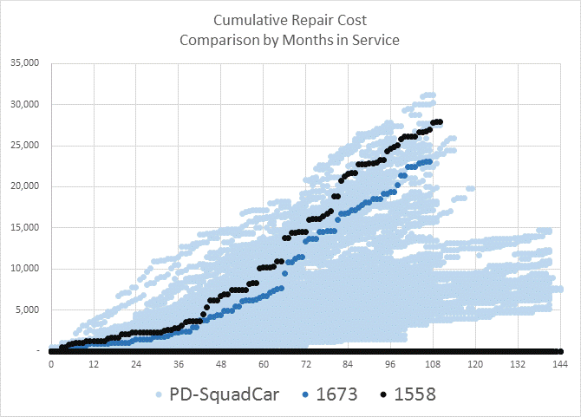
Patrol Vehicle #1558 & #1673 & All Patrol Cars
Month 96:
$24,500
Evaluate by AGE
Lemons: Too long
Cherries: Too soon
Month 82:
$19,000
Month 96:
$19,000
Framing
Data Assets
Alignment
Trigger
Theory
Analysis
Process
Dilemmas

Slide 13
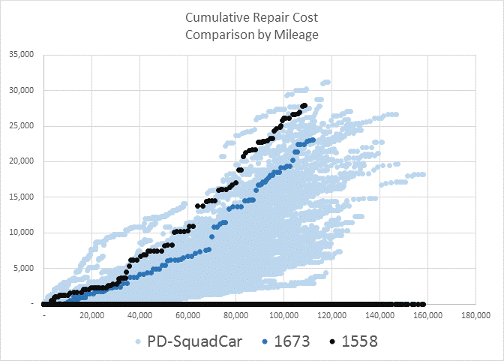
Patrol Vehicle #1558 & #1673 & All Patrol Cars
Evaluate by MILES
Framing
Data Assets
Alignment
Trigger
Theory
Analysis
Process
Dilemmas

Slide 14
Theory
Why do we retire a vehicle?
Factors Influencing Vehicle Replacement
Age
Mileage
Blue Book valuation
Conceptually easy to understand
Weak reliability
Weak validity
Ignores individual characteristics
Inter-department competition
Framing
Data Assets
Alignment
Trigger
Theory
Analysis
Process
Dilemmas

Slide 15
Theory
Why should we retire a vehicle?
Factors Influencing Vehicle Replacement
Age
Mileage
Blue Book valuation
Safety
Configuration
Availability
Operating Cost
Capital Cost
Financial capacity
Department
Fleet Services
Budget Office
Framing
Data Assets
Alignment
Trigger
Theory
Analysis
Process
Dilemmas

Slide 16
Theory
Why should we retire a vehicle?
How to make a decision based on all relevant factors…
…quickly
…transparently
…accurately
…inexpensively
…consistently?
Framing
Data Assets
Alignment
Trigger
Theory
Analysis
Process
Dilemmas

Slide 17
Analysis
Calculate the optimal retirement year of each vehicle in real-time
Inputs
Vehicle cost history
Vehicle operating pattern
Vehicle cost forecast
Estimated salvage value
Compare lifetime costs of different retirement cycles
Consider additional inputs
Safety
Configuration
Availability
Financial capacity
Alternative Vehicle Retirement Model
Framing
Data Assets
Alignment
Trigger
Theory
Analysis
Process
Dilemmas

Slide 18
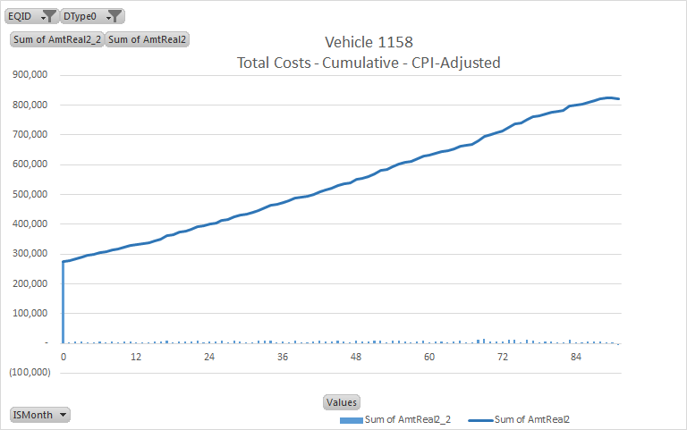
Total Costs of a Vehicle by Month in Service
Sale
Purchase
Framing
Data Assets
Alignment
Trigger
Theory
Analysis
Process
Dilemmas

Slide 19
Total Costs of a Vehicle by Month in Service
7 year
5 year
(5,000)
(25,000)
Framing
Data Assets
Alignment
Trigger
Theory
Analysis
Process
Dilemmas

Slide 20
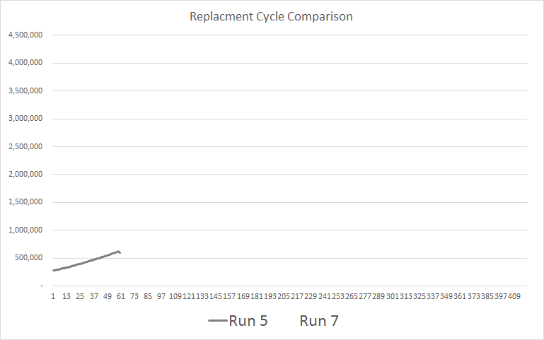
Total Costs of a Vehicle by Month in Service
5-year retirement cycle
Framing
Data Assets
Alignment
Trigger
Theory
Analysis
Process
Dilemmas

Slide 21
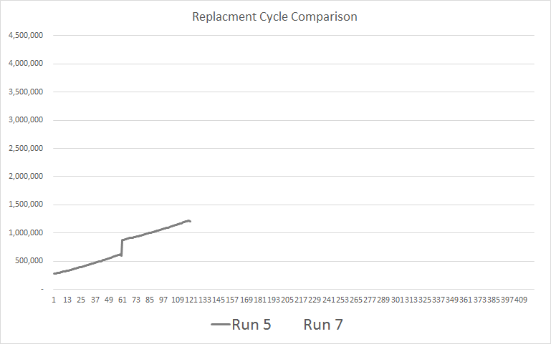
Repeat the Decision
5-year retirement cycle
Framing
Data Assets
Alignment
Trigger
Theory
Analysis
Process
Dilemmas

Slide 22
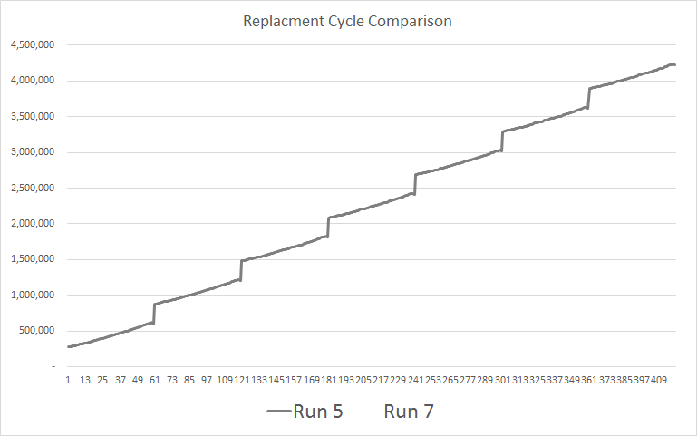
Repeat the Decision
5-year retirement cycle
Framing
Data Assets
Alignment
Trigger
Theory
Analysis
Process
Dilemmas

Slide 23
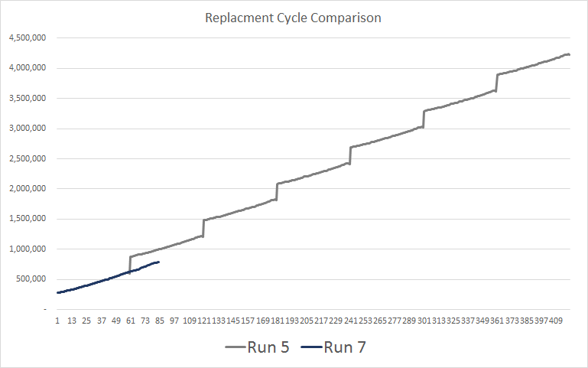
Total Costs of a Vehicle by Month in Service
5-year retirement cycle
7-year retirement cycle
Framing
Data Assets
Alignment
Trigger
Theory
Analysis
Process
Dilemmas

Slide 24
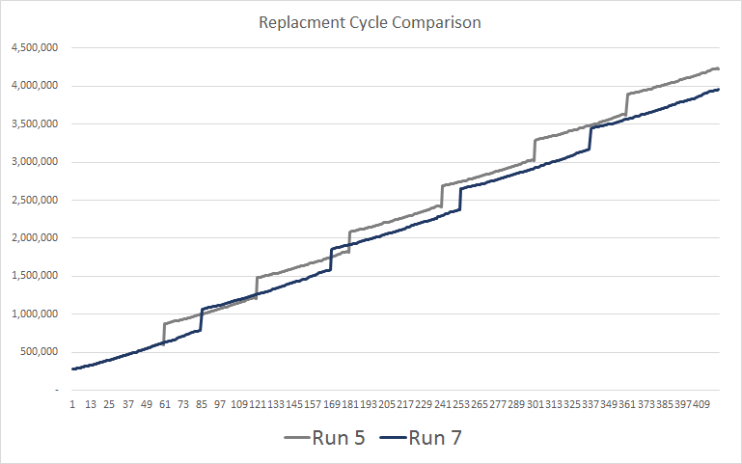
Repeat the Decision
and Compare
5-year retirement cycle
7-year retirement cycle
The 7-year replacement cycle is
6.1% less expensive
…per year
But is it the optimal year to retire the vehicle?
Framing
Data Assets
Alignment
Trigger
Theory
Analysis
Process
Dilemmas
Notes:
Not a lot of savings until you realize that is only for one vehicle at 33. That gives us a savings of $261,275 per year for keeping the vehicles for 7 years over 5. However, this model only looked at 5 vs. 7. Could it be more cost saving to keep for 8, 9, 10 years?

Slide 25
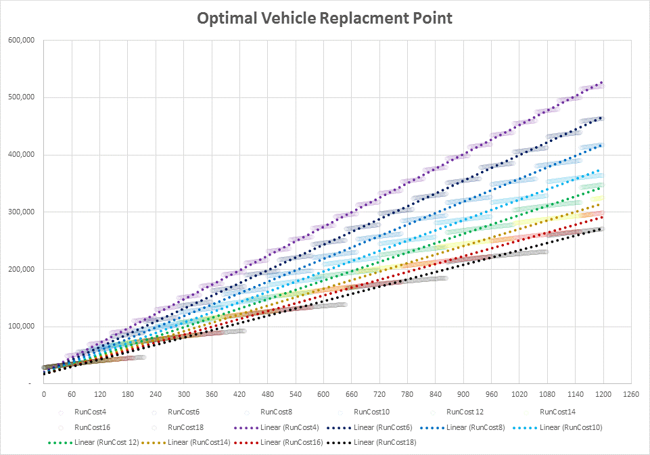
Repeat the decision for multiple cycle durations
(4-year, 5-, 6-,…, 25-year)
…over very long periods
…compare the slopes of the trajectory
5.8%
4.6%
3.5%
2.6%
1.9%
1.3%
0.0%
0.8%
0.0%
Framing
Data Assets
Alignment
Trigger
Theory
Analysis
Process
Dilemmas

Slide 26
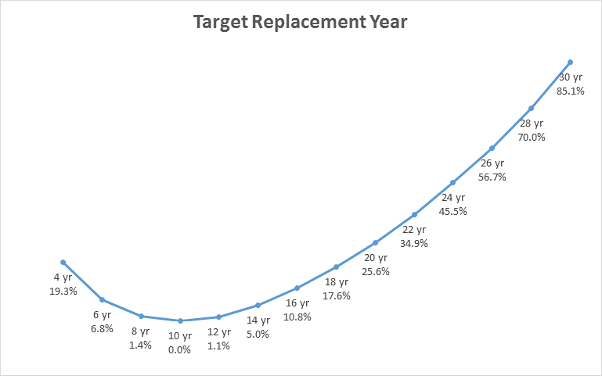
Alternative Replacement Model
Lowest cost replacement cycle
Comparing the marginal cost of maintenance to the net capital cost
Premium over lowest cost year
Framing
Data Assets
Alignment
Trigger
Theory
Analysis
Process
Dilemmas

Slide 27
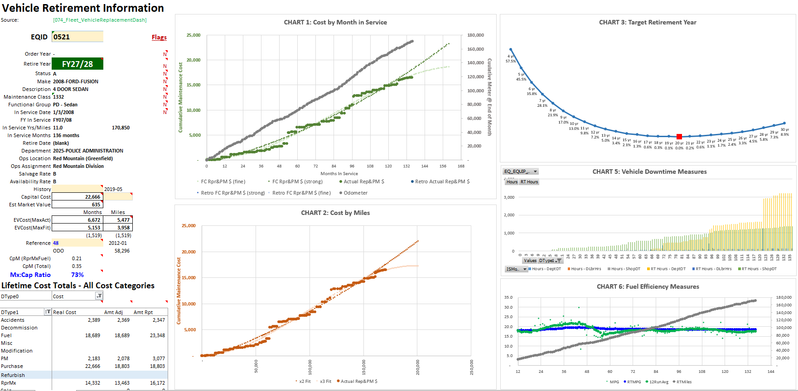
Framing
Data Assets
Alignment
Trigger
Theory
Analysis
Process
Dilemmas

Slide 28
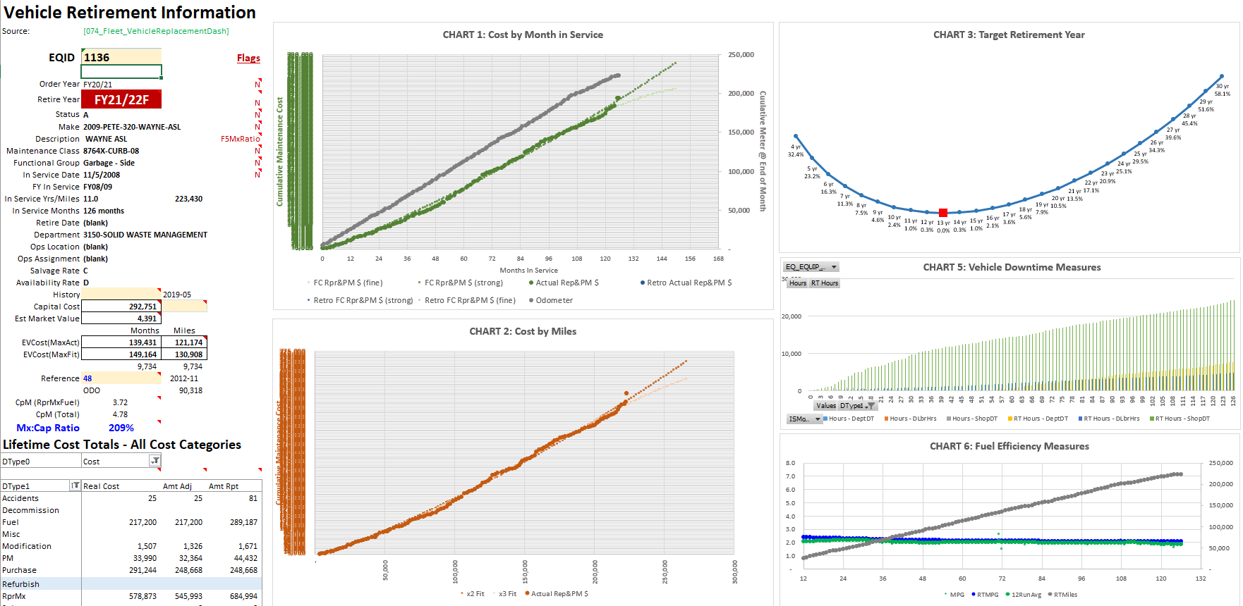
Framing
Data Assets
Alignment
Trigger
Theory
Analysis
Process
Dilemmas

Slide 29
Alternative Replacement Practices
Advantages
Disadvantages
Considers all known replacement factors for each individual vehicle
Significant change from current replacement practice
More complex
Requires advanced operator…for now
Considers operational patterns
Updates daily
Improved reliability and validity
Improved flexibility for cost assumptions
Improved “memory” for exceptions
Identifies ways to conserve money
Framing
Data Assets
Alignment
Trigger
Theory
Analysis
Process
Dilemmas

Slide 30
Process
Access to high quality long term data
Big, long-lived asset class → compelling need
Invited vs sent → improved receptivity; double-edged
Early executive support → manage information
Built the simulation in advance → end from beginning
Focus groups → describe stakeholder bias
Long implementation horizon → no “quick win” bias
Presentation innovations → extreme transparency
Incriminating artifacts → passed the logic test
Live experiment → time to reflect and learn
Framing
Data Assets
Alignment
Trigger
Theory
Analysis
Process
Dilemmas

Slide 31
Dilemmas (at Year 3 ½ )
Trade-offs
Lower capital expense → older vehicles → more mechanics
Low use & old vehicles → refurbishing risks
Playing the odds
Extend 35 but lose 2
Answer shopping
Say whatever it takes to justify a new vehicle
Emergent “appearance standard”
Controls, picking your battles, end-runs
Strong tendency to revert back to age and miles
Slippage and rounding: accelerate by a year…or three
Need 0; Want 1; Ask for 20; Get 1
Distractions, bad memory, pork-barreling
Bait & switch
Documentation
Configuration “inflation”
Framing
Data Assets
Alignment
Trigger
Theory
Analysis
Process
Dilemmas

Slide 32
Decision Quality
Strategy
Analytics
Management

Slide 34
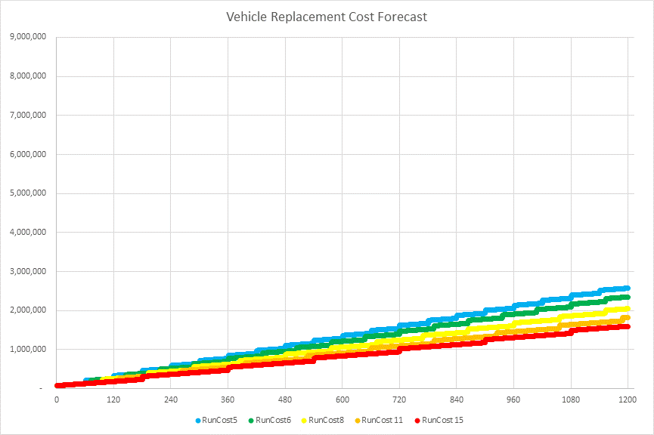
0.0%

Slide 35
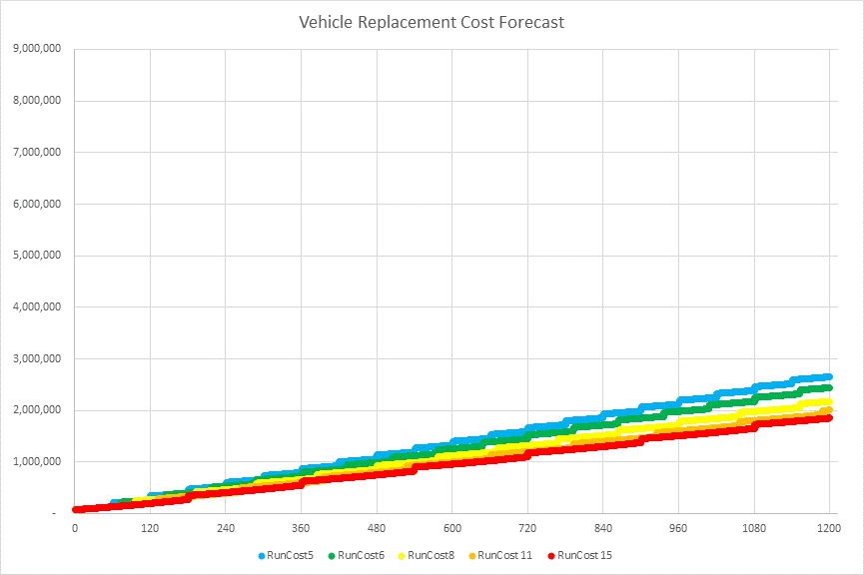
1.0%

Slide 36
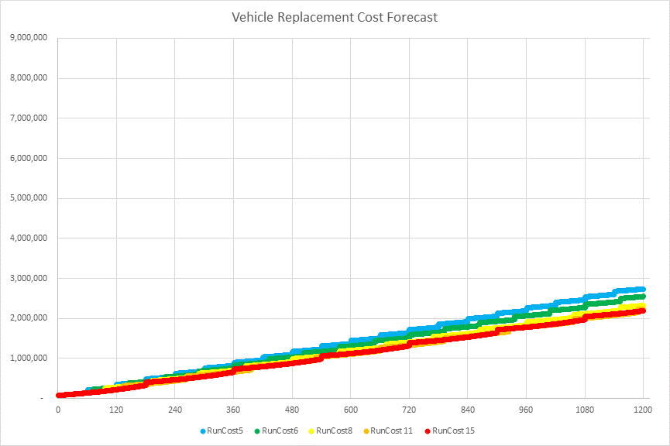
2.0%

Slide 37
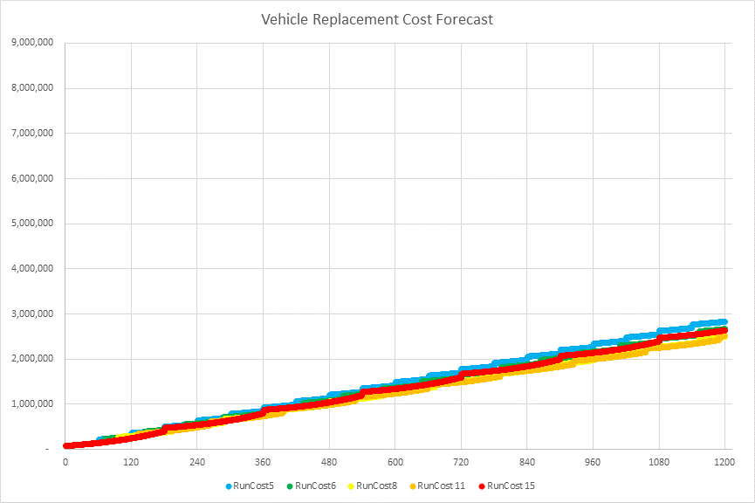
3.0%

Slide 38
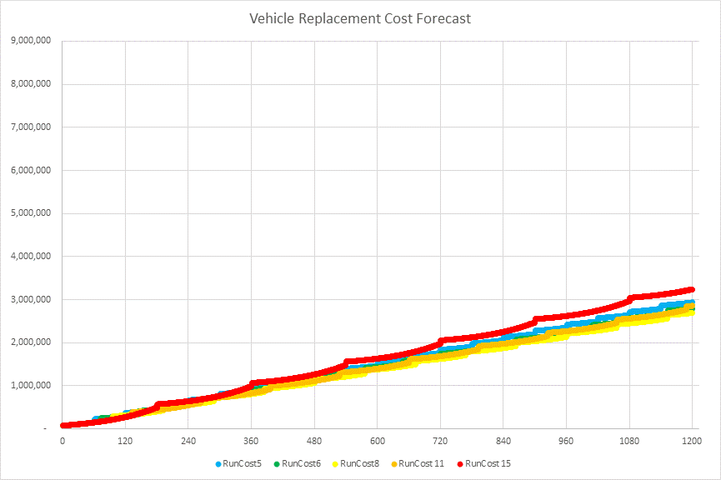
4.0%

Slide 39
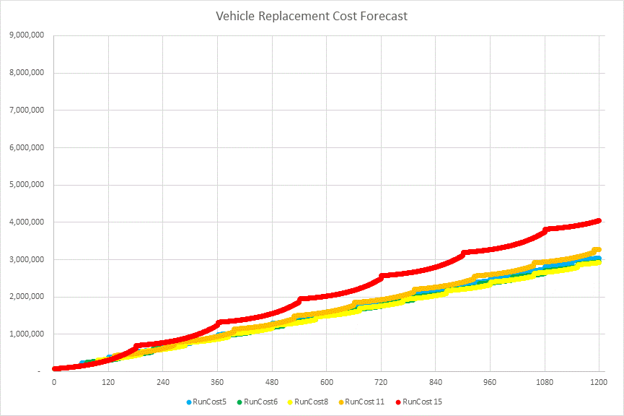
5.0%

Slide 40
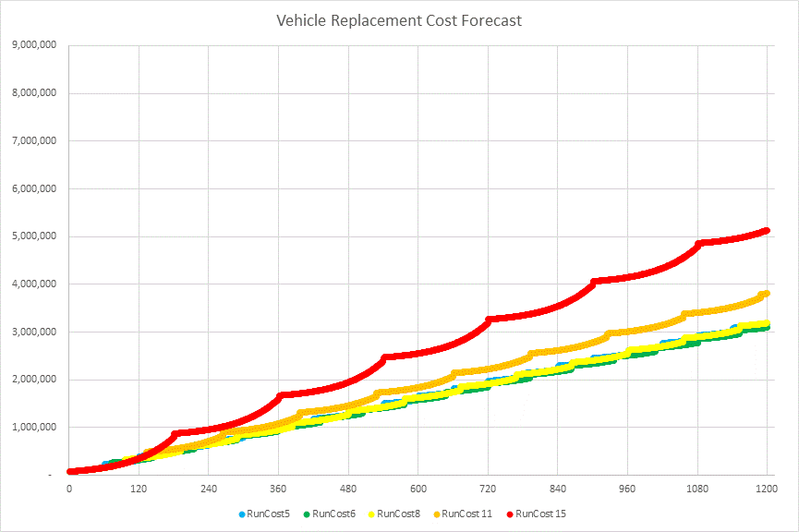
6.0%

Slide 41
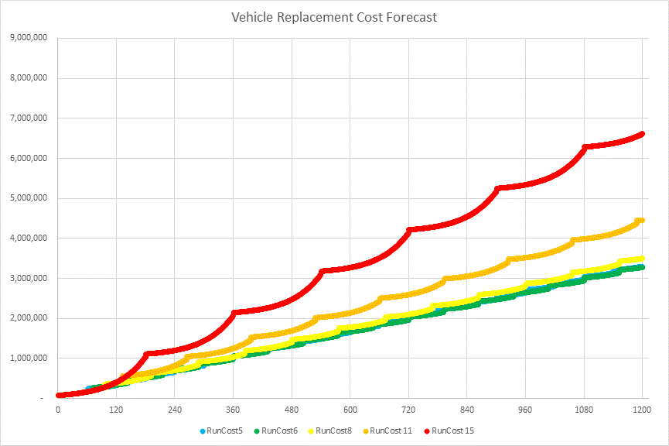
7.0%

Slide 42
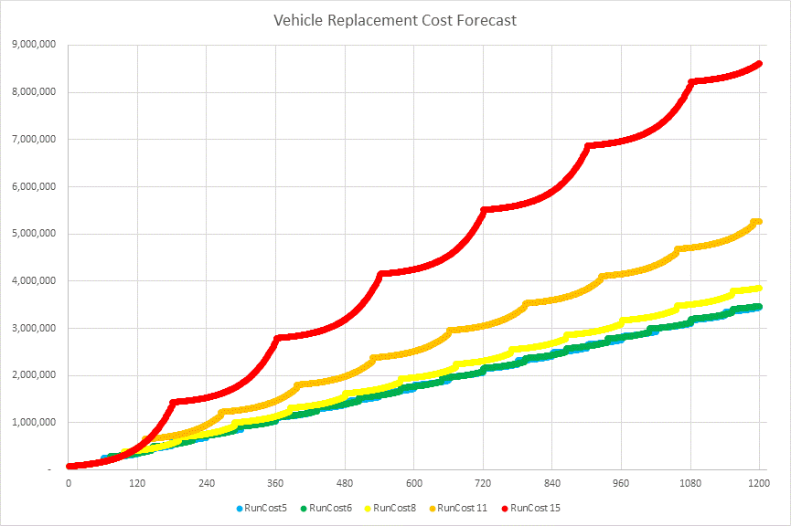
8.0%

Slide 43
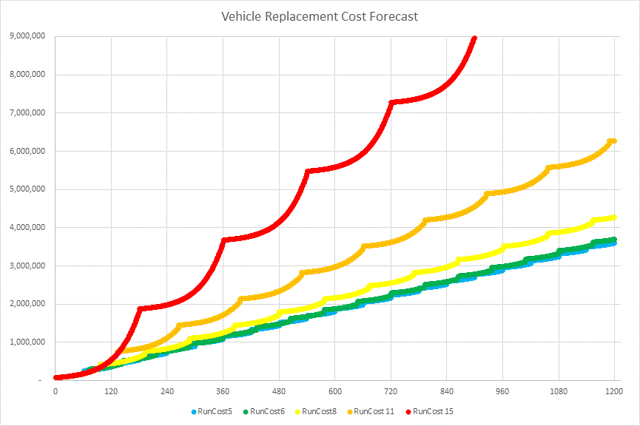
9.0%

